Slide 1



Session 11
Presentation
Planning

Slide 2
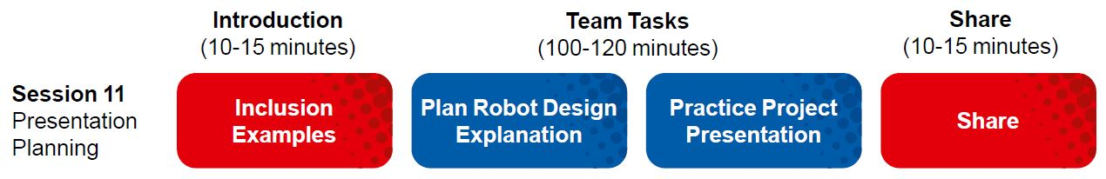
Session Overview
Outcomes
The team will finalize their Innovation Project presentation.
The team will finalize their robot for the Robot Game and create their Robot Design presentation.
Notes:
Facilitator Tips

Slide 3

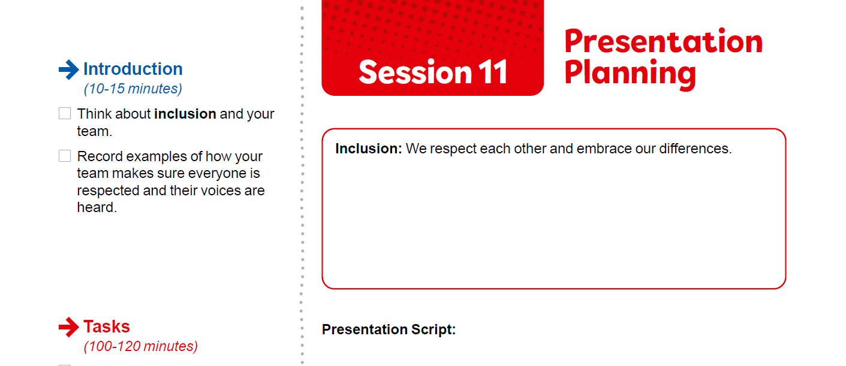
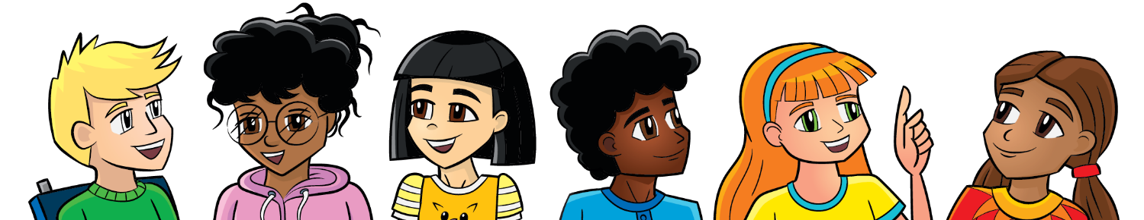
Introduction
Think about Inclusion and your team.
Record examples of how your team makes sure everyone is respected and their voices are heard.
Notes:
Facilitator Tips
Have the team review the rubrics for examples of where inclusion is evaluated.

Slide 4
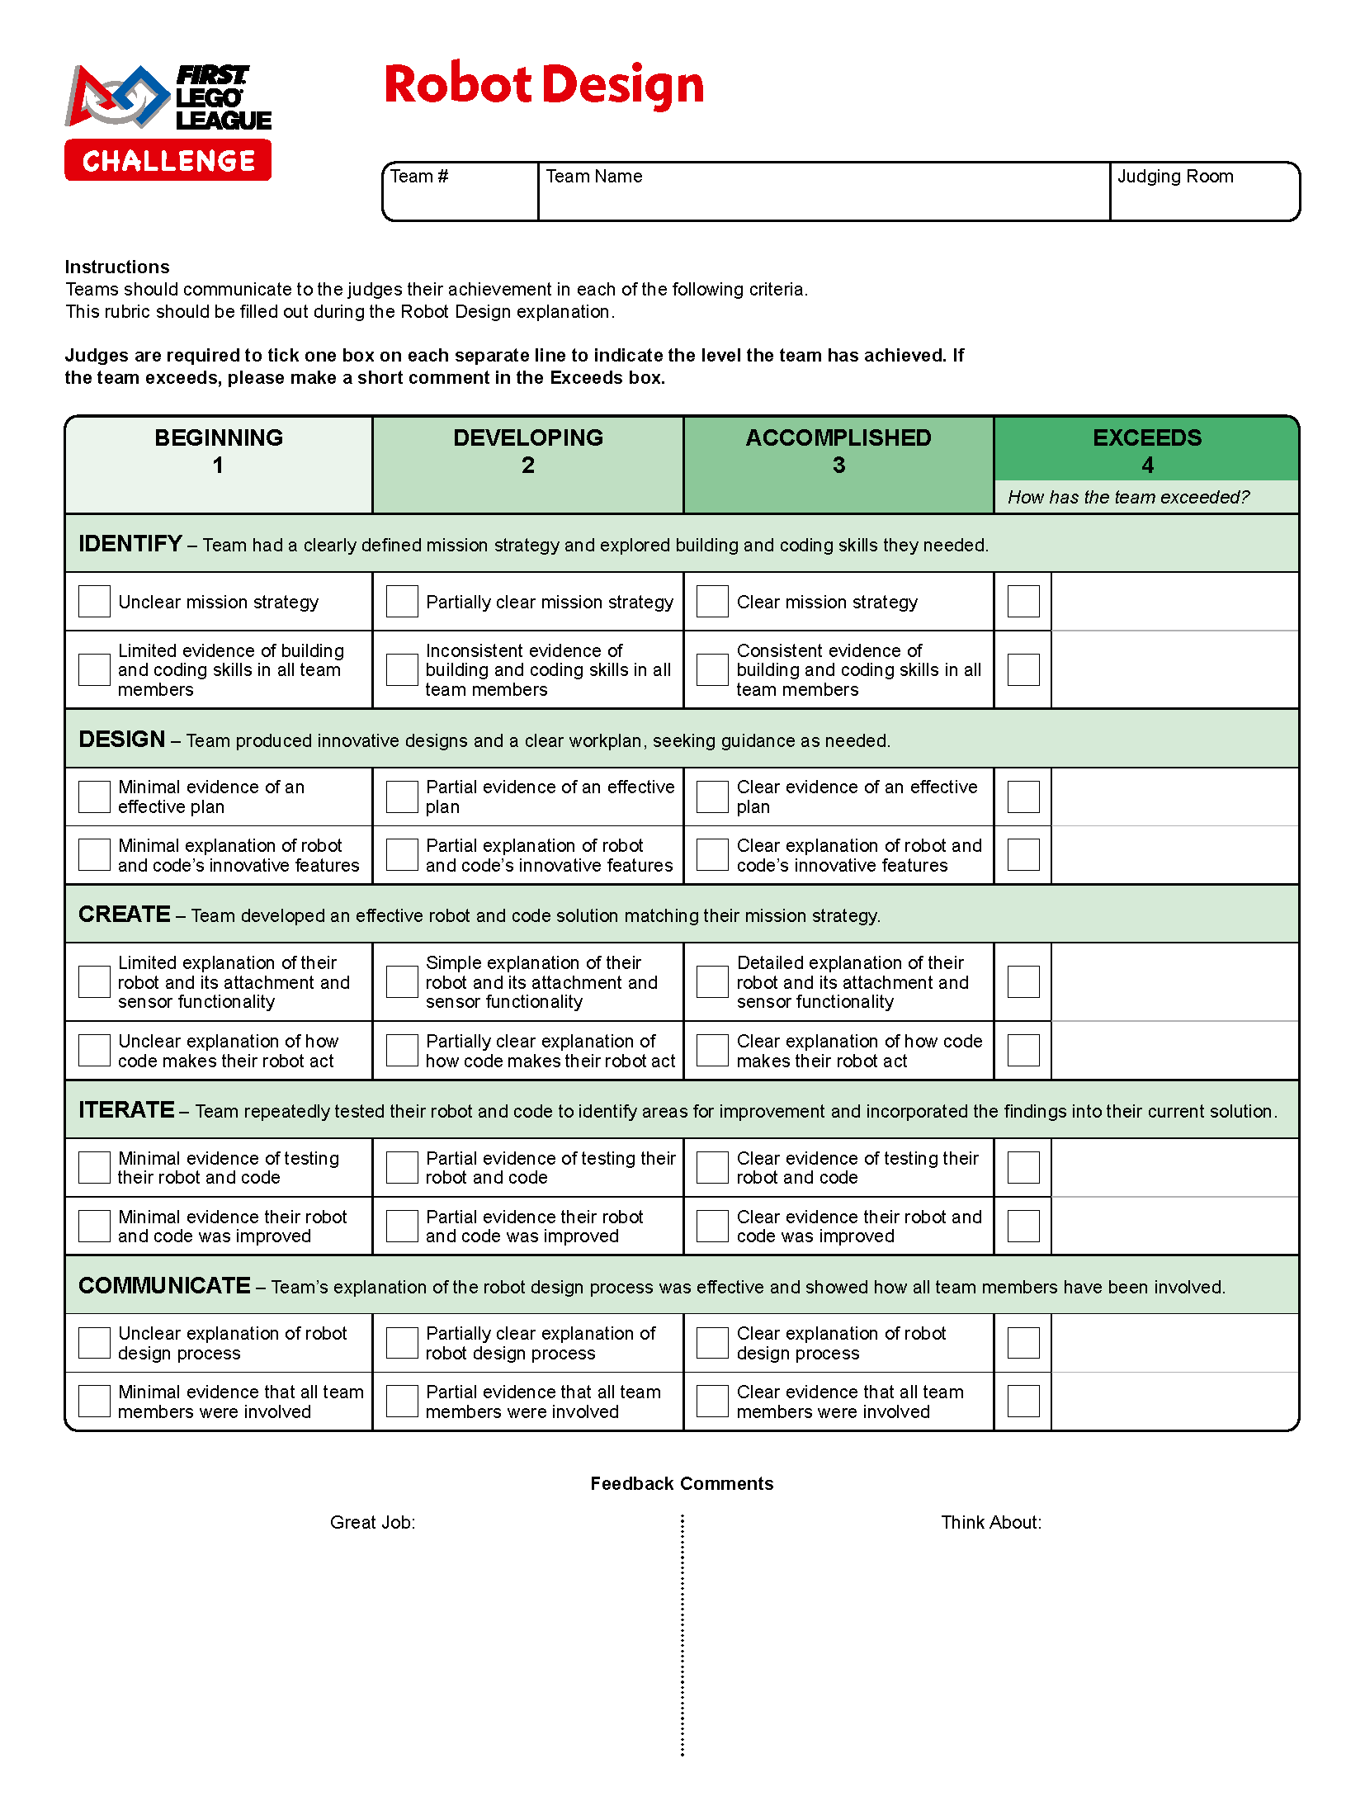

Plan & Practice
Continue working on your Innovation Project presentation.
Plan and write out your Robot Design explanation. Refer to the Robot Design rubric for what to cover.
Make sure everyone can communicate about your design process and programs.
Notes:
Facilitator Tips
Practicing how to communicate their Innovation Project solution and explain their Robot Design is important.
Every team member should be involved in the presentation at the tournament.
The rubrics used to evaluate the teams in these areas are based on the engineering design process. The team works on their project and robot and solves problems using this process. Team members need to demonstrate and explain everything they have done during the judging session.

Slide 5
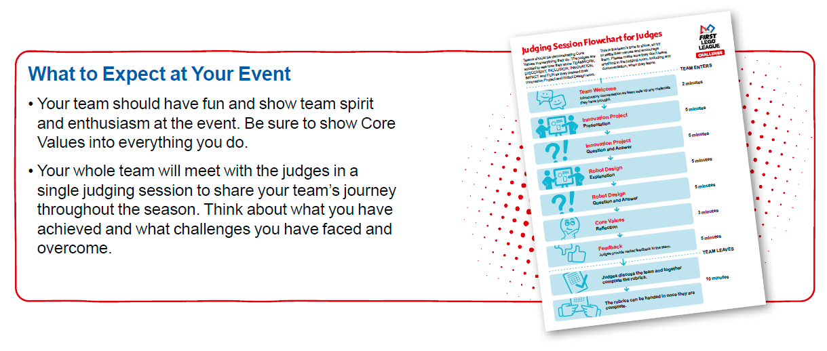
Plan & Practice
Determine what each person on the team will say.
Practice your full presentation.
Notes:
Facilitator Tips
Practicing how to communicate their Innovation Project solution and explain their Robot Design is important.
Provide the team with the Robot Design rubric. Find it here: firstlegoleague. org/season#resources.
Every team member should be involved in the presentation at the tournament.

Slide 6

Share
Get together at the mat.
Discuss the presentation and each person’s role.
Run a practice 2.5-minute match and explain what missions were done.
Discuss the reflection questions.
Decide what else needs to be done and clean up your space.
Notes:
Facilitator Tips
Provide the team with the Innovation Project Rubric.

Slide 7
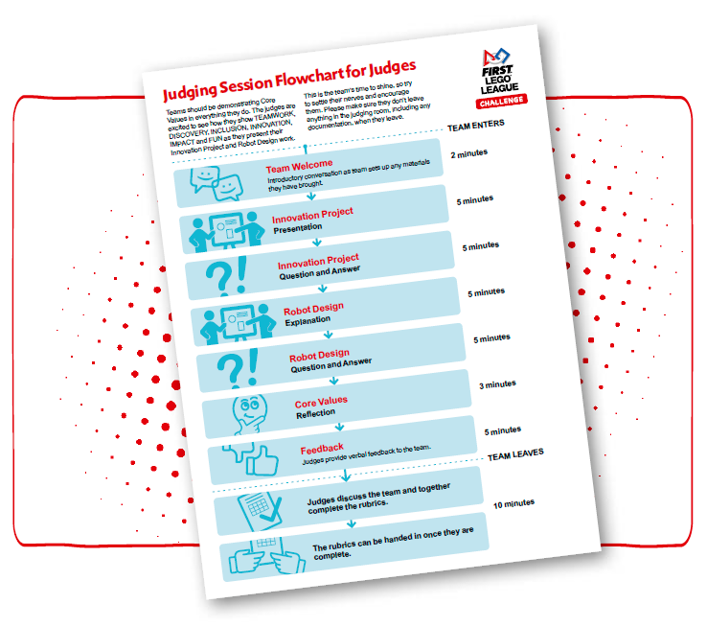
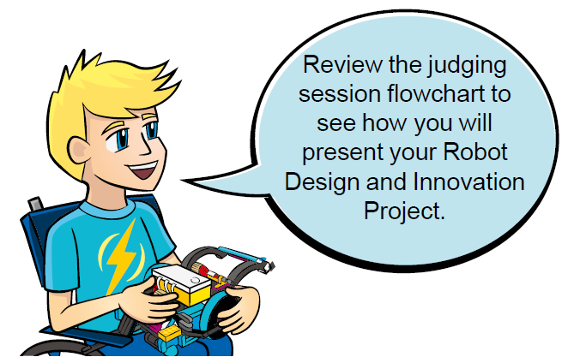
Reflection Questions
Do you have a plan for what to do if one mission does not work?
Does everyone have a speaking part in the presentation?
How has FIRST® LEGO® League impacted you?
Notes:
Facilitator Tips
Find the judging session flow chart in the FIRST LEGO League season resources (https://www.firstlegoleague.org/season#resources)

Slide 8

Multimedia Resources
You may wish to embed a relevant, age-appropriate video for your students here. See the Notes for an example.
Notes:
Choose a relevant, age-appropriate video for your students. In this session, you could show a video with some tips on giving presentations.
Here are two examples made by middle school students:
Schooled by Kids: Presentation Skills, Part 1: https://www.youtube.com/8IbheB2-ixM
Schooled by Kids: Presentation Skills, Part 2: https://www.youtube.com/PX_DAFXQxpc
Ford’s Delivery Robot Walks on Two Legs Like a Human from Tech Insider – Length 3:00 https://youtu.be/U8Iey_wfo0I

Slide 9

Clean Up

Slide 10


FIRST® and the FIRST® logo are registered trademarks of For Inspiration and Recognition of Science and Technology (FIRST). LEGO® and MINDSTORMS® are registered trademarks of the LEGO Group. FIRST® LEGO® League and SUPERPOWEREDSM are jointly held trademarks of FIRST and the LEGO Group. SPIKE™ Prime is a trademark of LEGO® Education. All other trademarks are the property of their respective owners. ©2022 FIRST and the LEGO Group. All rights reserved.

