Slide 1
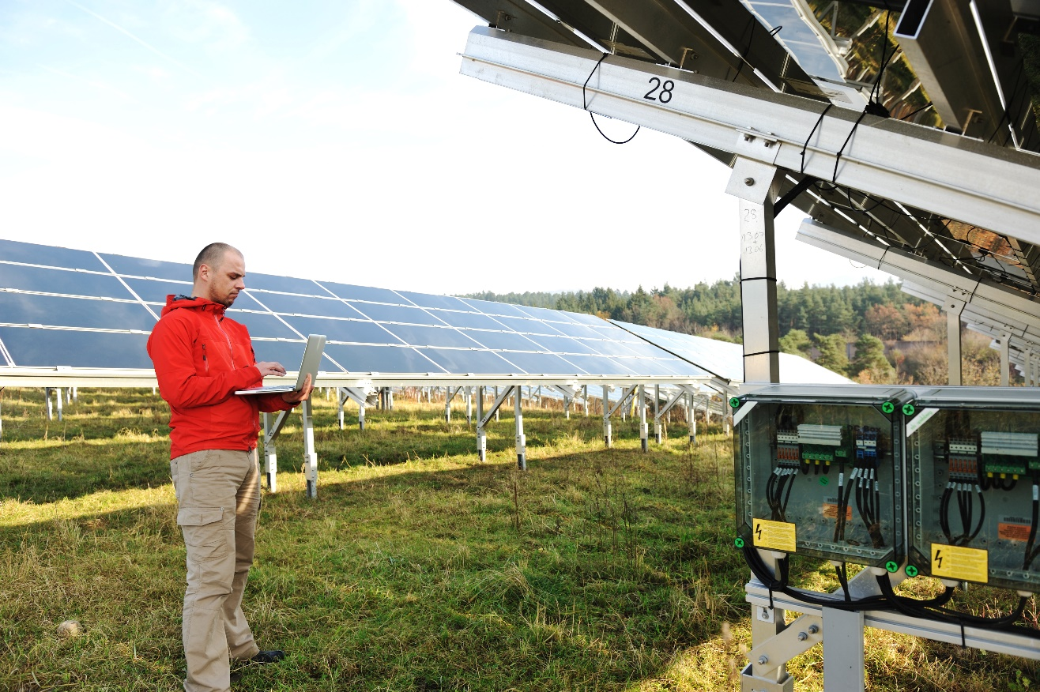


Session 12
Communicate
Solutions

Slide 2
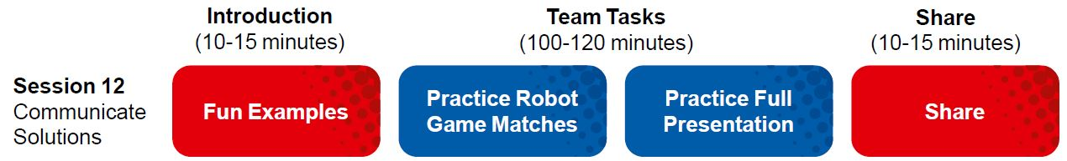
Session Overview
Outcomes
The team will practice their presentation their Innovation Project and robot solutions.
The team will run practice Robot Game matches.
Notes:
Facilitator Tips

Slide 3

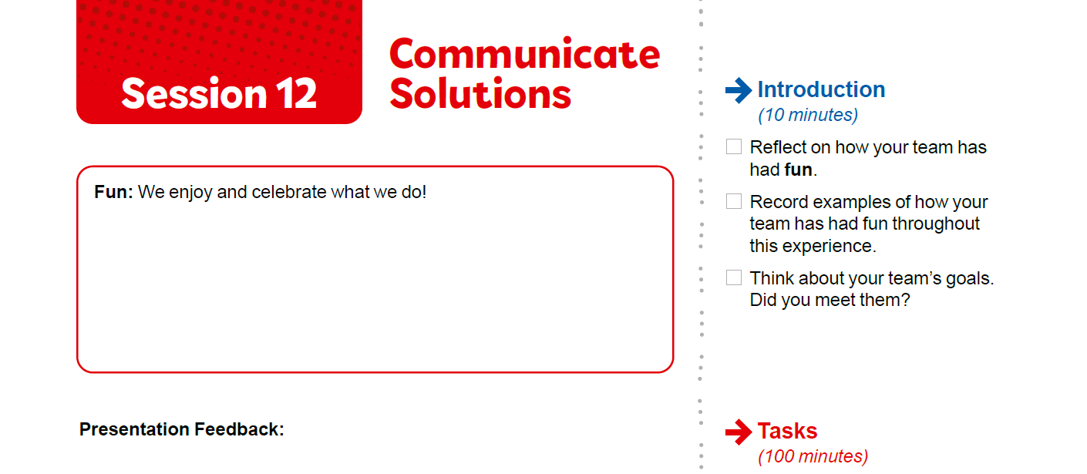

Introduction
Reflect on how your team has had Fun.
Record examples of how your team has had fun throughout this experience.
Think about your team’s goals. Did you meet them?

Slide 4
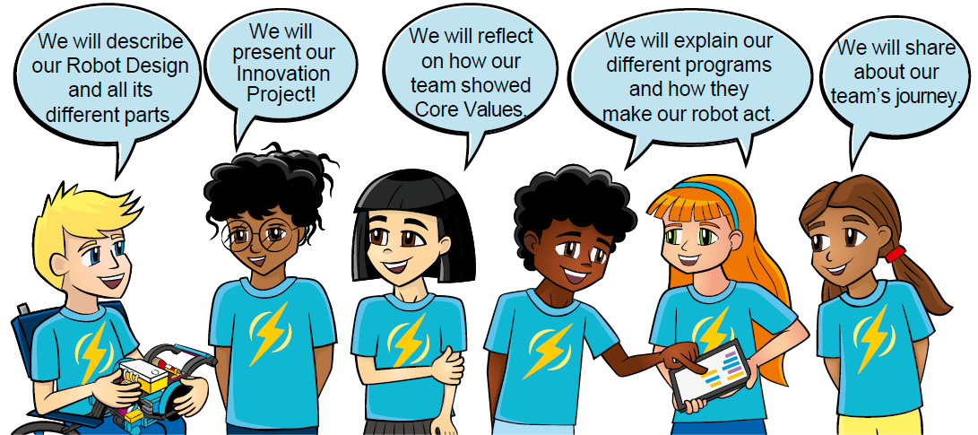
Practice
Rehearse your full presentation communicating your robot and Innovation Project solutions.
Demonstrate Core Values when you present!
Have practice 2.5-minute Robot Game matches.
Review pages 32-33. Prepare for Your Event.
Notes:
Facilitator Tips
Plan to split the time in this session equally between practicing the presentation and the Robot Game matches.
Encourage the team to practice their presentation before the event. They can practice by sharing their solution with others.
Have the team run their 2.5-minute robot matches. Make sure they practice running their programs in the right order.
The team should have a contingency plan for if things don’t go as planned during the Robot Game. They could identify other missions to run.
Facilitator Tips
Remind the team about the Core Values and how they will show them throughout the event, including at every Robot Game match.

Slide 5
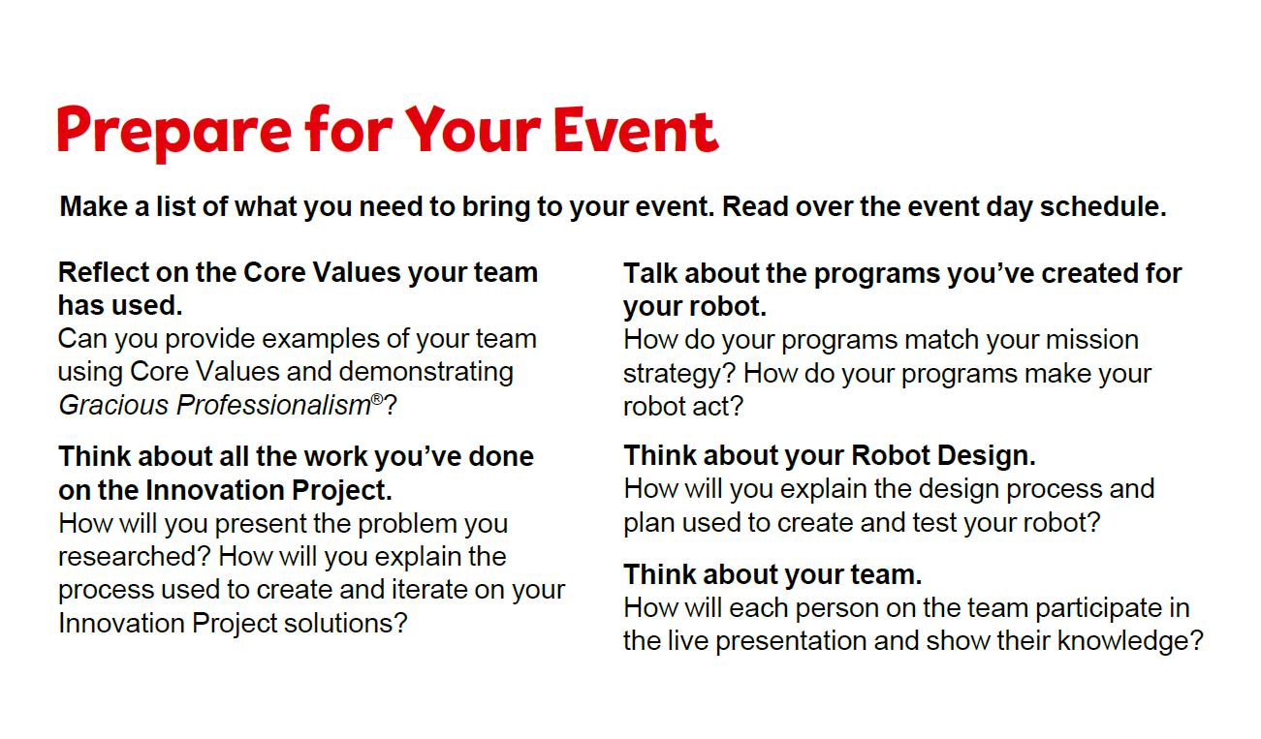
Notes:
Facilitator Tips
Plan to split the time in this session equally between practicing the presentation and the Robot Game matches.
Encourage the team to practice their presentation before the event. They can practice by sharing their solution with others.
Have the team run their 2.5-minute robot matches. Make sure they practice running their programs in the right order.
The team should have a contingency plan for if things don’t go as planned during the Robot Game. They could identify other missions to run.
Remind the team about the Core Values and how they will show them throughout the event, including at every Robot Game match.

Slide 6
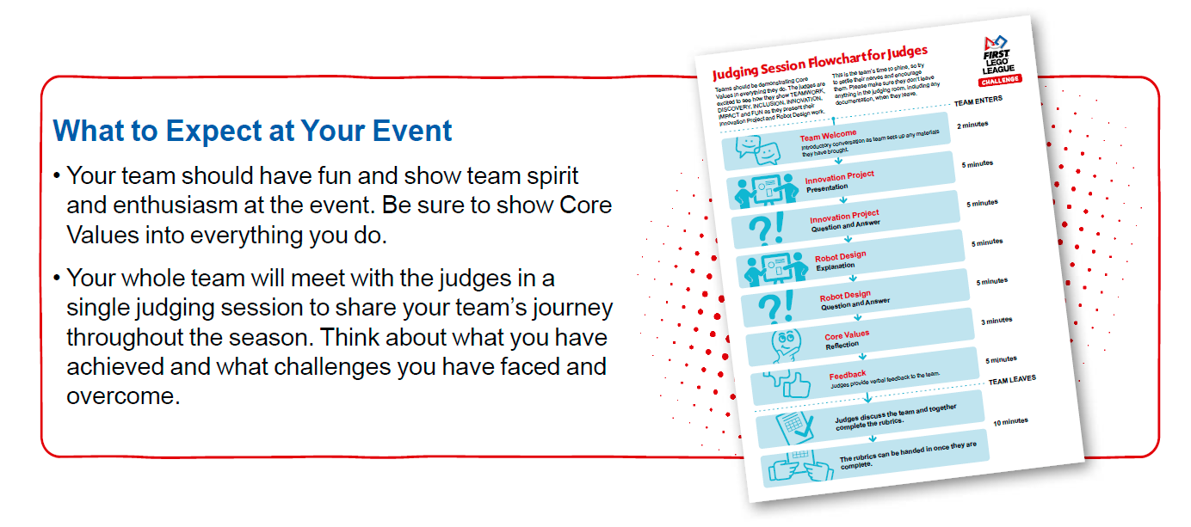
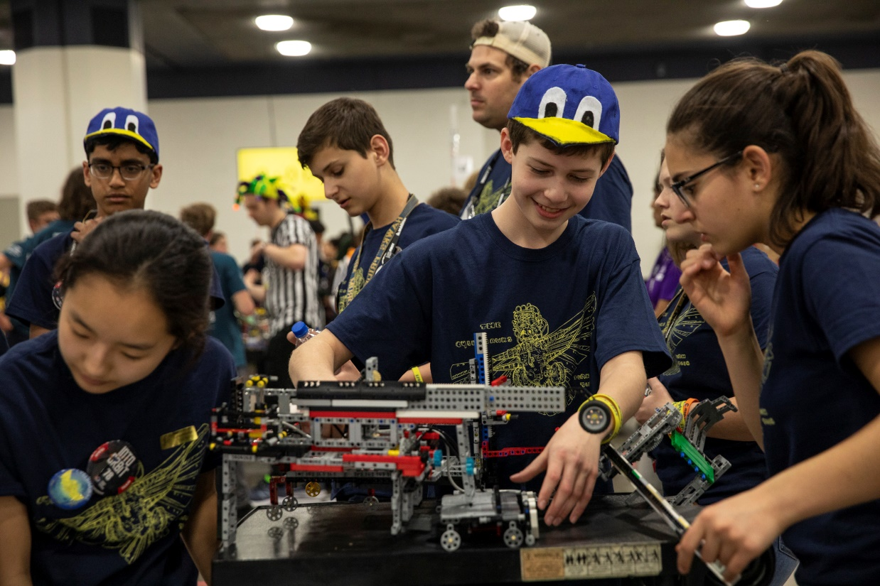
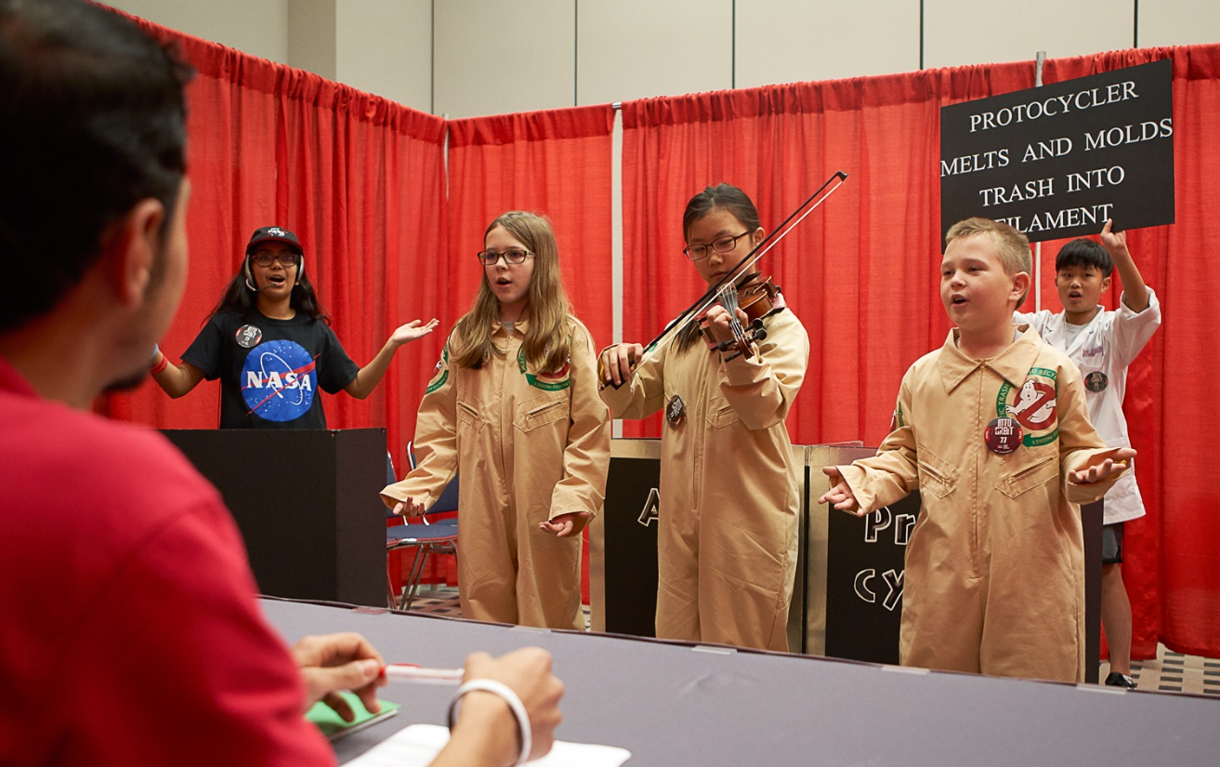
Notes:
Facilitator Tips
Plan to split the time in this session equally between practicing the presentation and the Robot Game matches.
Encourage the team to practice their presentation before the event. They can practice by sharing their solution with others.
Have the team run their 2.5-minute robot matches. Make sure they practice running their programs in the right order.
The team should have a contingency plan for if things don’t go as planned during the Robot Game. They could identify other missions to run.
Remind the team about the Core Values and how they will show them throughout the event, including at every Robot Game match.

Slide 7


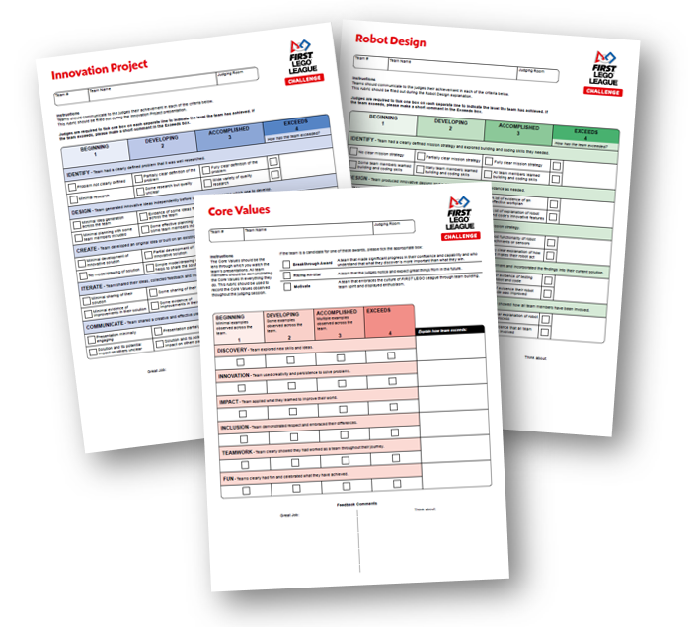
Prepare for Your Event
FIRST® LEGO® League is evaluated equally in four areas: Core Values, Innovation Project, Robot Design, and Robot Game. The judges and referees use the rubrics and Robot Game scoresheets to make this evaluation.
Make sure you are familiar with the rubrics. It is your team’s job to explain everything to the judges during the session.
Notes:
Facilitator Tips
Plan to split the time in this session equally between practicing the presentation and the Robot Game matches.
Encourage the team to practice their presentation before the event. They can practice by sharing their solution with others.
Have the team run their 2.5-minute robot matches. Make sure they practice running their programs in the right order.
The team should have a contingency plan for if things don’t go as planned during the Robot Game. They could identify other missions to run.
Remind the team about the Core Values and how they will show them throughout the event, including at every Robot Game match.

Slide 8

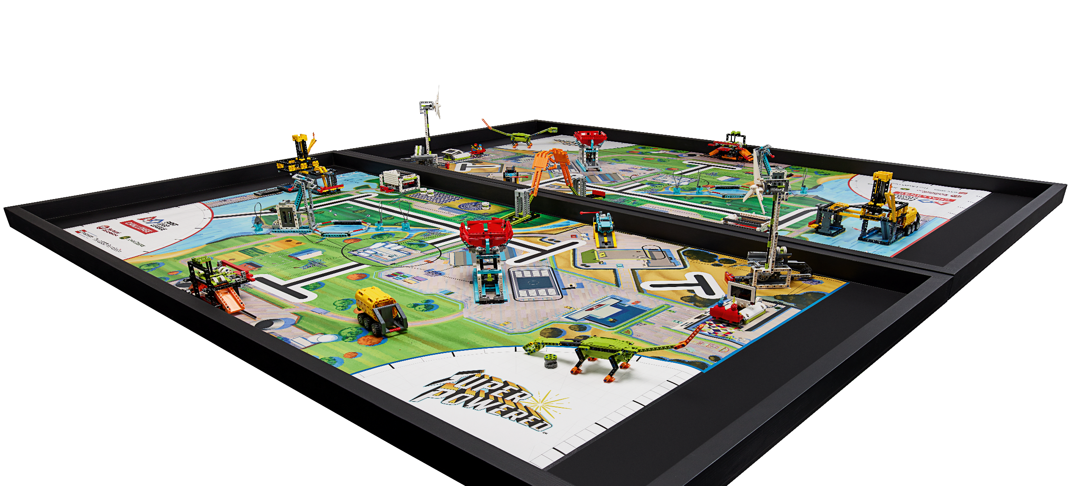
Prepare for Your Event
FIRST® LEGO® League teams express their Core Values through Gracious Professionalism®. This will be evaluated by referees for each team at every Robot Game match.
During the Robot Game, only some team members can be at the table during the 2.5-minute match. You can tag in other team members for different missions.
Notes:
Facilitator Tips
Plan to split the time in this session equally between practicing the presentation and the Robot Game matches.
Encourage the team to practice their presentation before the event. They can practice by sharing their solution with others.
Have the team run their 2.5-minute robot matches. Make sure they practice running their programs in the right order.
The team should have a contingency plan for if things don’t go as planned during the Robot Game. They could identify other missions to run.
Remind the team about the Core Values and how they will show them throughout the event, including at every Robot Game match.

Slide 9

Share
What is your plan for having any LEGO® attachments built ready for the Robot Game?
Is everyone ready to speak clearly, smile, and have fun?
What has your team accomplished?
Notes:
Facilitator Tips
Remind the team about the Core Values and how they will show them throughout the event, including at every Robot Game match.

Slide 10



Reflection Questions
What is your plan for having any LEGO® attachments built ready for the Robot Game?
Is everyone ready to speak clearly, smile, and have fun?
What has your team accomplished?

Slide 11

Multimedia Resources
You may wish to embed a relevant, age-appropriate video for your students here. See the Notes for an example.
Notes:
Choose a relevant, age-appropriate video for your students.
Here is one example:
Getting Started with FIRST LEGO League Challenge - the Tournament Experience from the IET in the UK, prepared for the 2020-2021 RePLAY Season – Length 1:55
https://youtu.be/E7XOzjeE7F8

Slide 12

Clean Up

Slide 13


FIRST® and the FIRST® logo are registered trademarks of For Inspiration and Recognition of Science and Technology (FIRST). LEGO® and MINDSTORMS® are registered trademarks of the LEGO Group. FIRST® LEGO® League and SUPERPOWEREDSM are jointly held trademarks of FIRST and the LEGO Group. SPIKE™ Prime is a trademark of LEGO® Education. All other trademarks are the property of their respective owners. ©2022 FIRST and the LEGO Group. All rights reserved.

