Slide 1
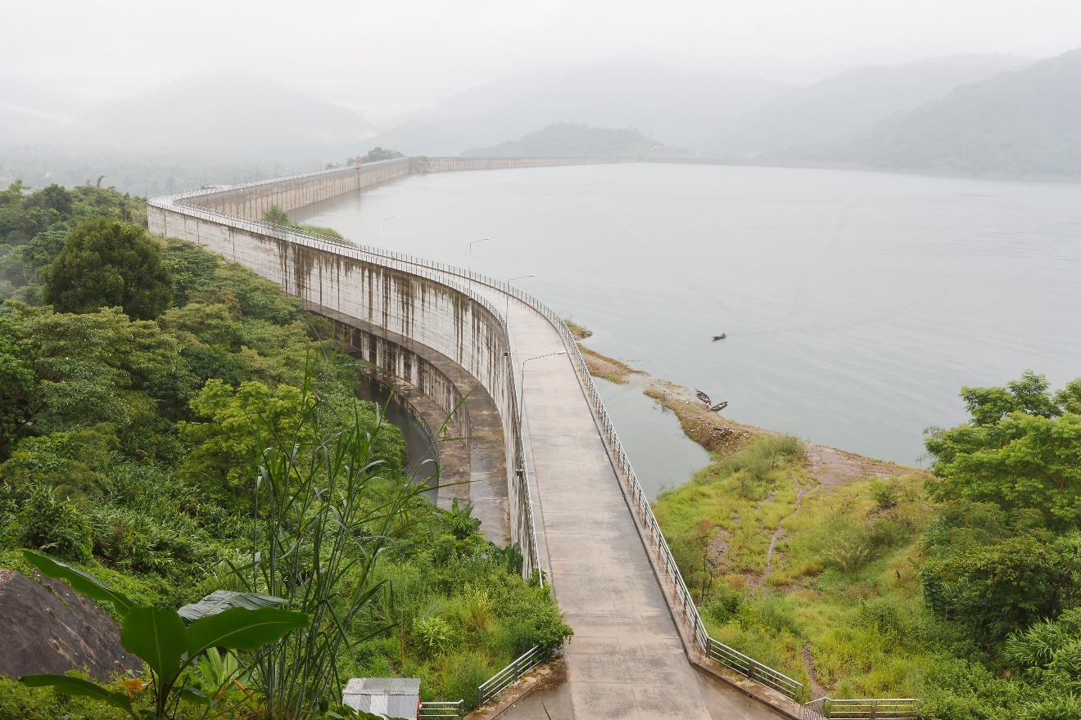


Session 2
Blue Energy
Journey

Slide 2

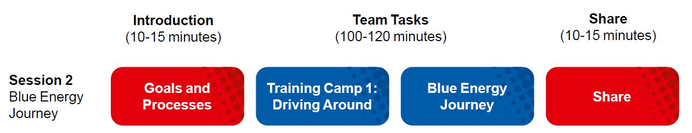
Session Overview
Outcomes
The team will build a driving base and code it to move forward, move backward, and turn.
The team will make connections from the mission models to the Blue Energy Journey Project Spark ideas.
Notes:
Facilitator Tips
Some of the team may excel at model building and can help others who get stuck. If the team talks over each other, refer them to the team roles and designate one person as the communicator.

Slide 3
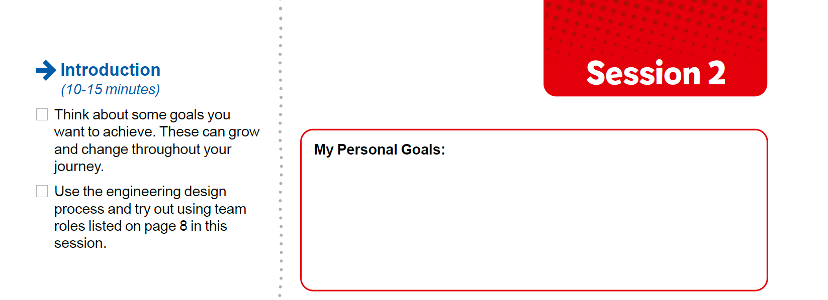
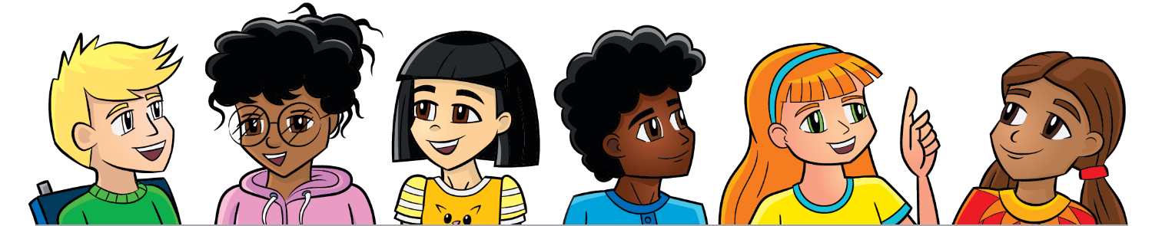
Introduction
Think about some goals you want to achieve. These can grow and change throughout your journey.
Use the engineering design process and try out using team roles listed on page 8 in this session.
Notes:
Facilitator Tip
Example prompts for goal setting are provided in the Engineering Notebook.

Slide 4
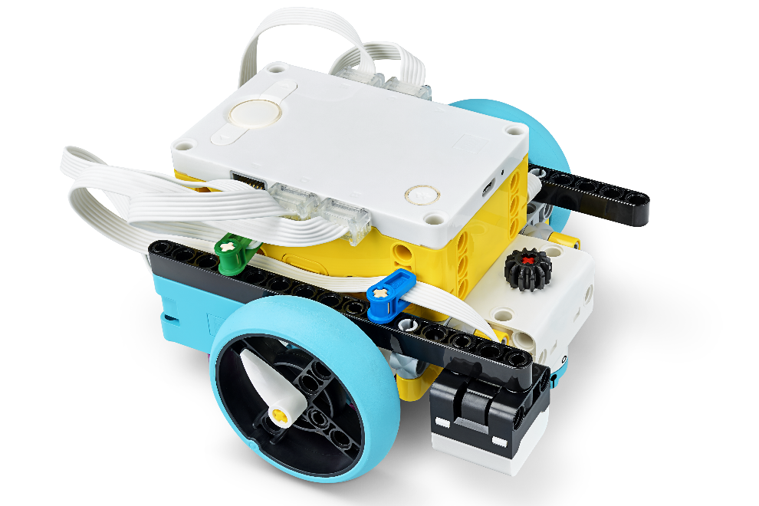
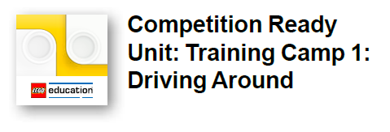
Robot Lesson 2
Open the SPIKE™ Prime app. Find your lesson.
Determine what coding and building skills you can apply in the Robot Game.
Try it out! See if you can use the skills you learned to drive your robot to one of the mission models.
Notes:
URL for SPIKE on-line: https://spike.legoeducation.com (remember to use a Chrome browser)
Training Camp 1: Driving Around – https://education.lego.com/en-us/lessons/prime-competition-ready/training-camp-1-driving-around#lesson-plan
Facilitator Tips
Remind the team to save their programs often on their device.
After a program is downloaded onto the controller, it cannot be transferred back to be opened and edited.
Have the team practice their new skills by trying to drive the robot to a model and then returning to home.
Robot Game Connection: Have the team code the robot to push an object and deliver it to a target area on the mat.

Slide 5
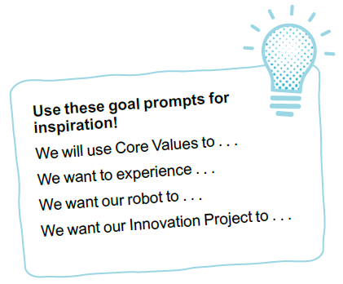
Reflection Questions
How can you aim your robot toward a model?
How did you use the engineering design process and team roles in this session?

Slide 6
Blue Energy Project Spark
Hydroelectric stations can generate electricity using moving water. Water that passes through the turbines can be pumped back up to the reservoir at the top of the dam to be used again. This is a good way to use surplus energy that consumers are not using.
Think about and research
How could surplus energy from renewable sources be used in your community?
How is energy used in industries and homes?
How is water in the oceans used to capture energy?
Could water be used to capture energy where you live?

Slide 7

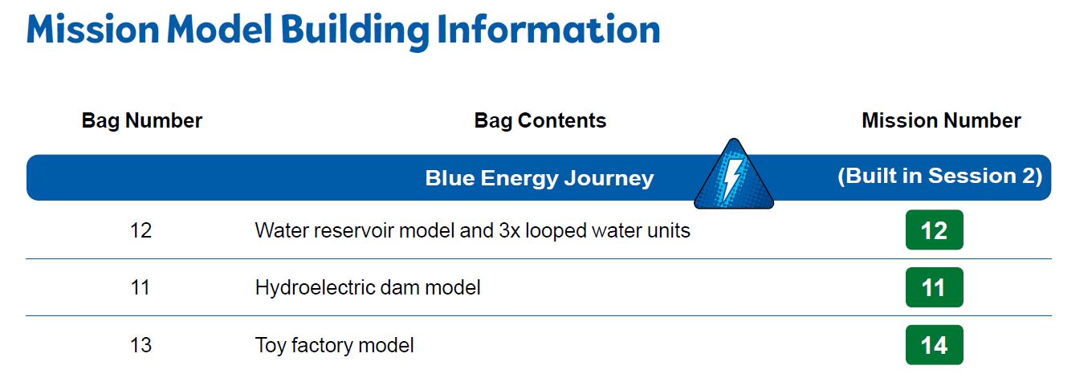
Blue Energy Project Spark
Build the blue energy journey models in Bags 11-13 using Building Instruction Books 11-13.
Notes:
Facilitator Tips
Provide the digital building instructions Books11-13 to the team. Find them at firstlegoleague.org/ season#resources.
The team will need Bags11-13 from the Challenge set. Larger pieces may be in an unnumbered LEGO® bag.

Slide 8
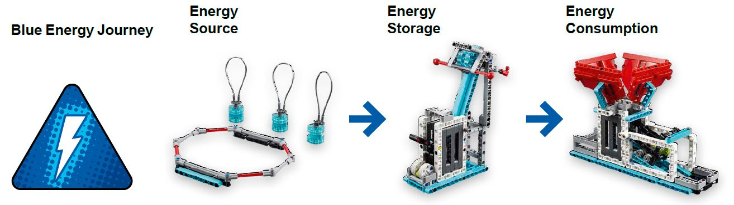
Blue Energy Project Spark
Look over the missions that correspond to the models.
Talk about how the mission models relate to the Project Spark.

Slide 9

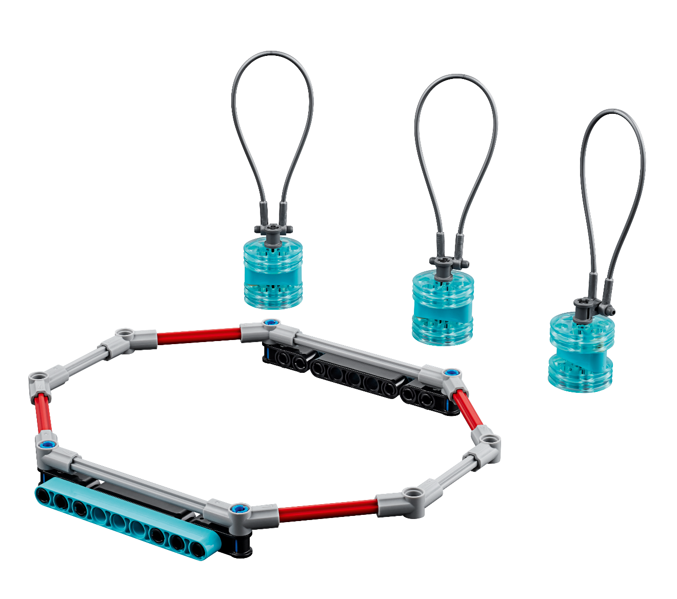
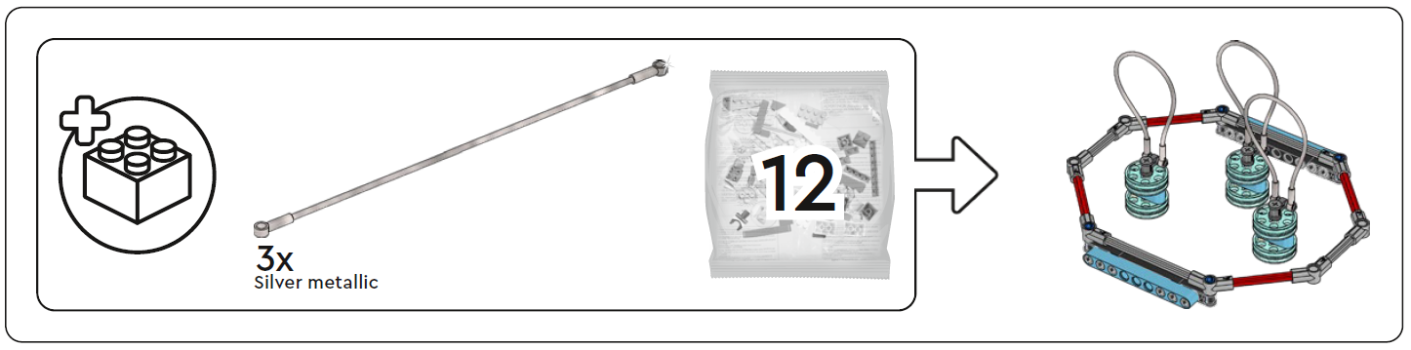
Water Reservoir and 3 looped water unit
1 bag

Slide 10
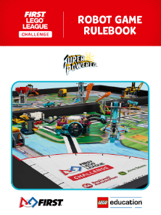
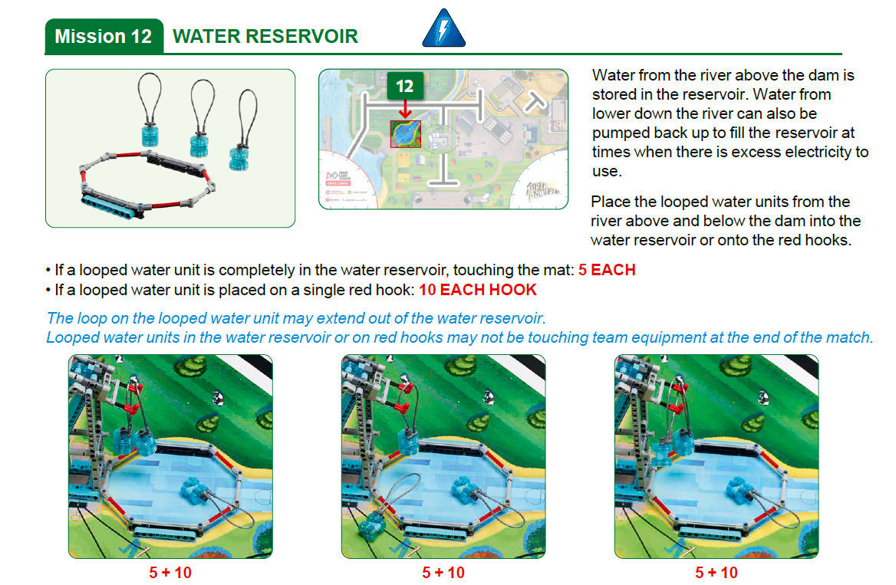
Robot
Game
Rulebook
page 13

Slide 11

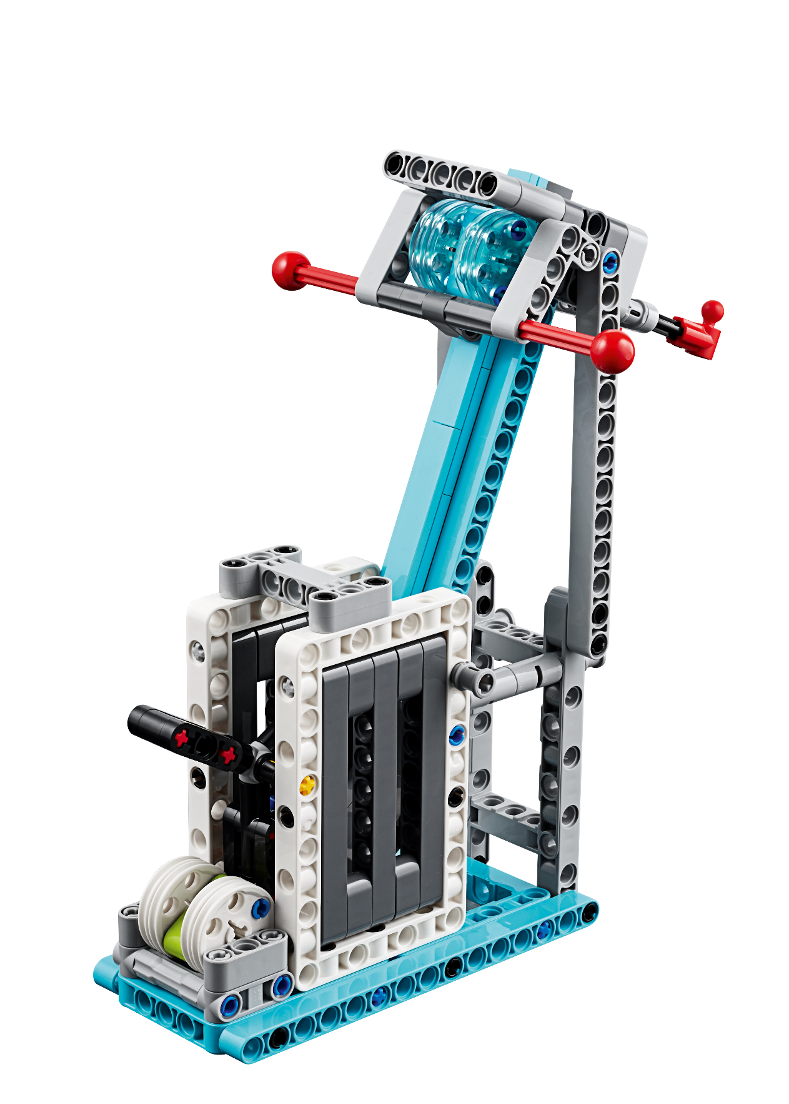
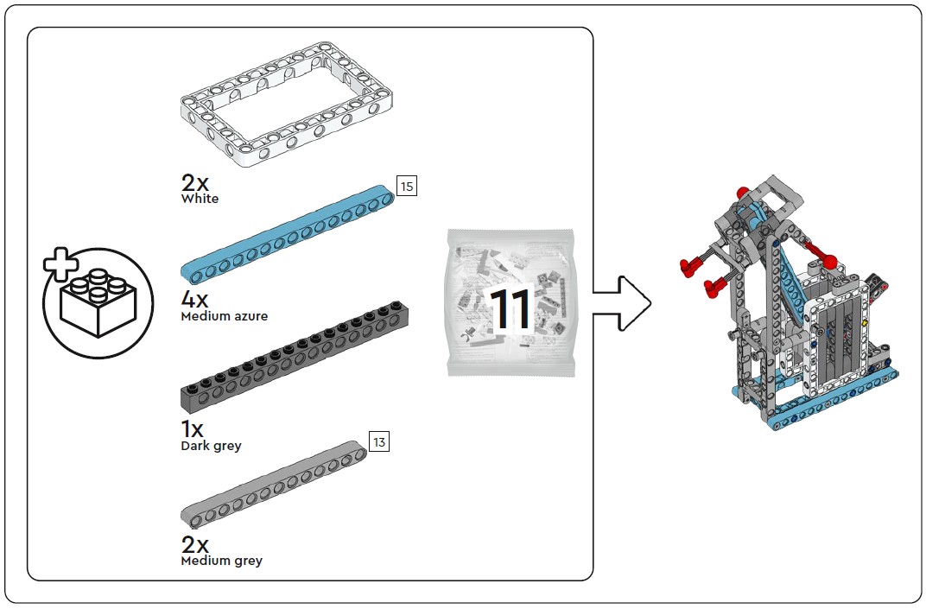
Hydroelectric Dam
2 bags

Slide 12
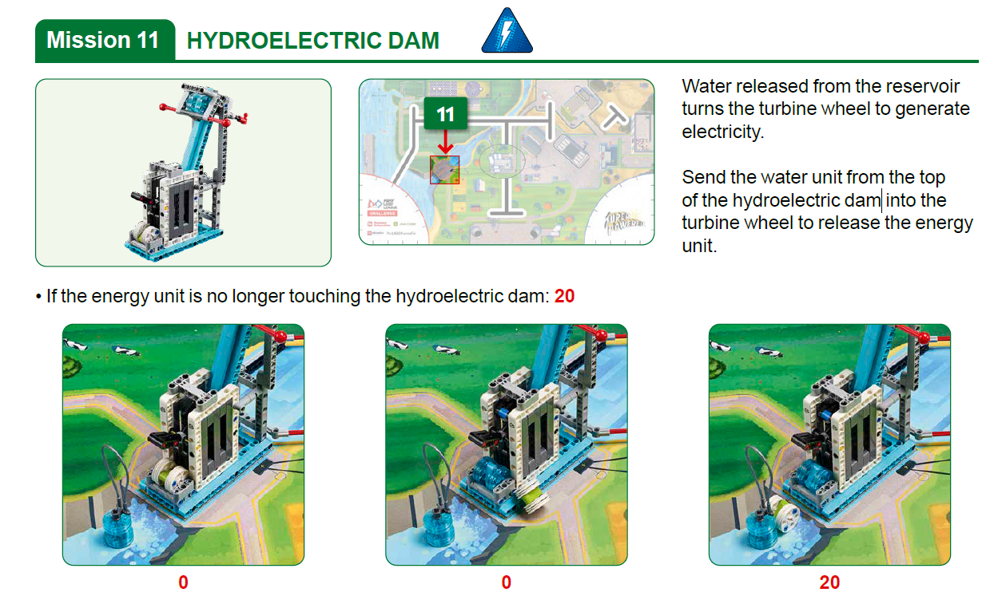
Robot
Game
Rulebook
page 13

Slide 13

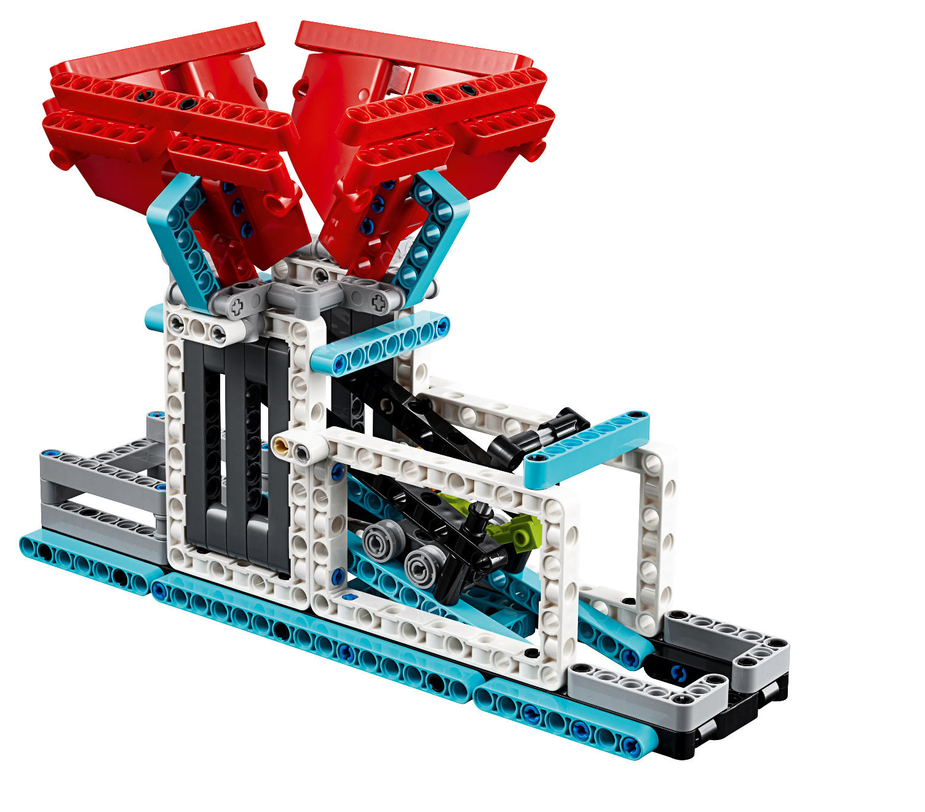
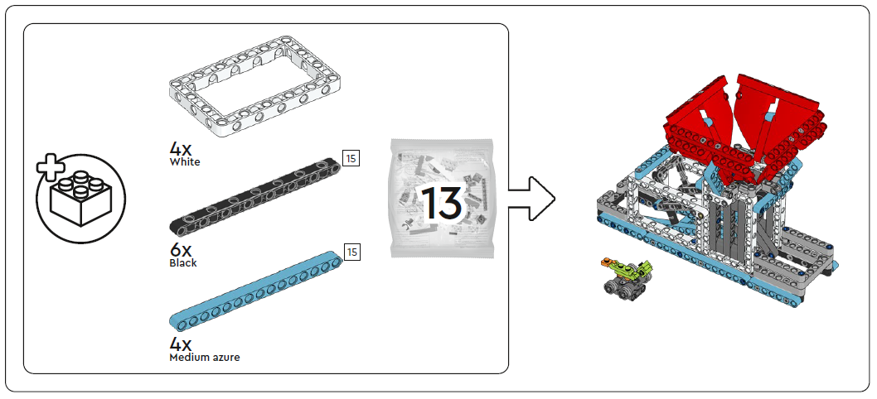
Toy Factory and Mini Dinosaur Toy
2 bags

Slide 14
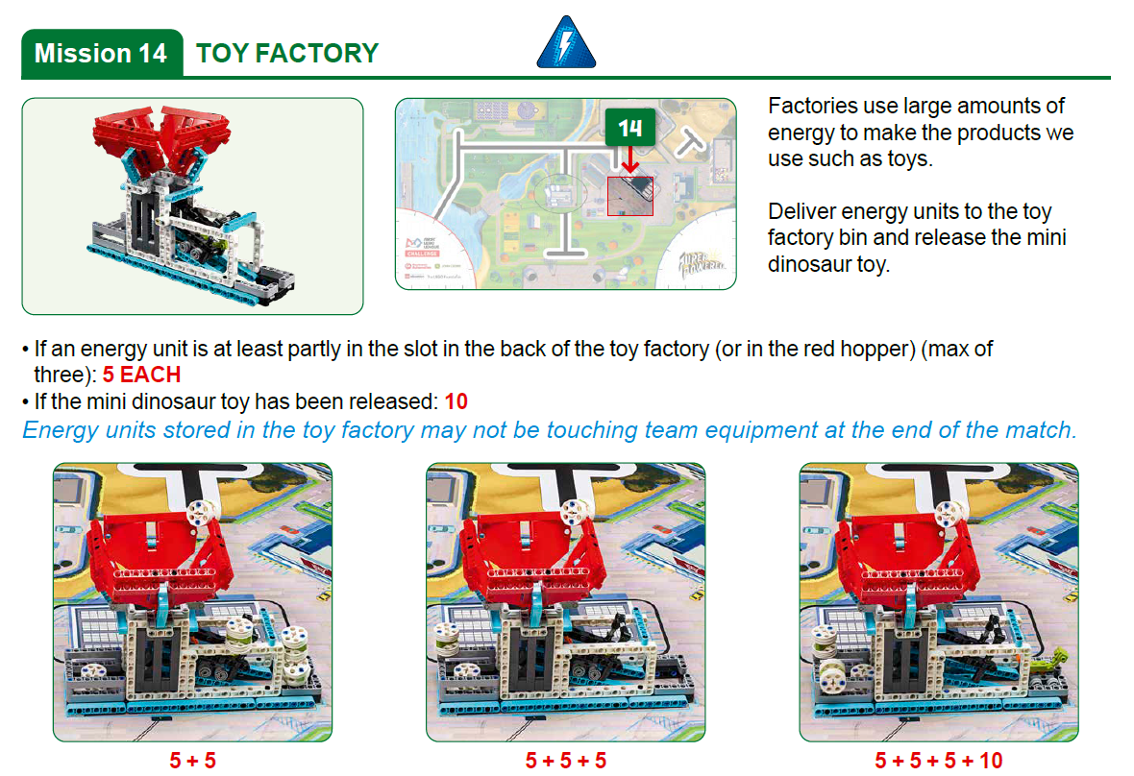
Robot
Game
Rulebook
page 14

Slide 15
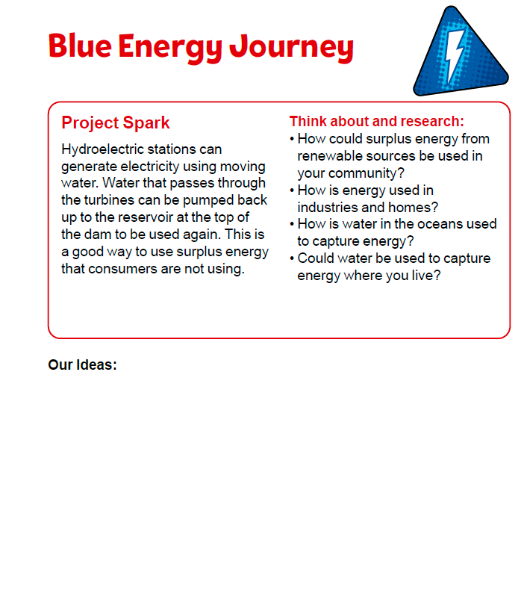
Blue Energy Project Spark
Review the blue energy journey on page 9.
Look over the missions that correspond to the models.
Talk about how the mission models relate to the Project Spark.
Capture your ideas.
Notes:
Facilitator Tips
Have the team think about equipment or technology they could invent as a solution to the Project Spark.
The team can use visual aids to help explain their Innovation Project solution, so this gives them practice at creating a detailed diagram.

Slide 16

Share
Get together at the mat.
Place each model where it belongs. Refer to the Field Setup section in the Robot Game Rulebook.
Share the robot skills you learned.
Show how the models work and explain their connections to the Project Spark.
Chat about the reflection questions.
Clean up your space.

Slide 17
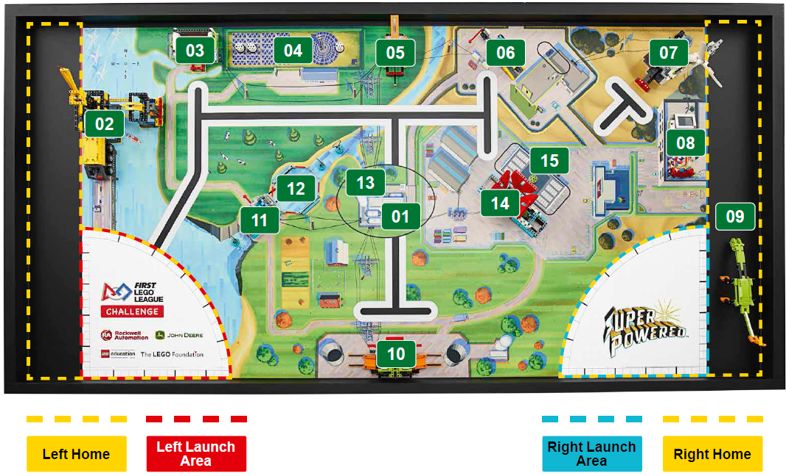
Models built this session are for the circled missions.
Notes:
Place the completed models on the mat with Dual Lock™ according to the field setup in the Robot Game Rulebook.

Slide 18

Reflection Questions
• What are the positive
and negative
consequences of
each segment of
the blue energy
journey?
• What are examples
of renewable energy
sources in your
community?
What skills do
you need to be
a hydroelectric
specialist?
Notes:
Facilitator Tips
Check out Career Connections pages in the Engineering Notebook that link to jobs listed in the sessions.

Slide 19


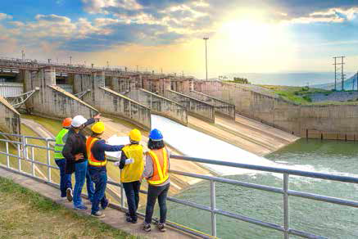
Career Connections
Hydroelectric Specialist
Role:
A hydroelectric specialist installs, maintains, and operates hydroelectric power systems and equipment.

Slide 20

Multimedia Resources
You may wish to embed a relevant, age-appropriate video for your students here. See the Notes for an example.
Notes:
Choose a relevant, age-appropriate video for your students.
Examples:
Hydropower 101 – https://www.youtube.com/watch?v=q8HmRLCgDAI – length 3:12
Learn about Hydropower | Energy 101 – https://www.youtube.com/watch?v=pTKNT7Do3xM – length 3:50

Slide 21

Clean Up

Slide 22
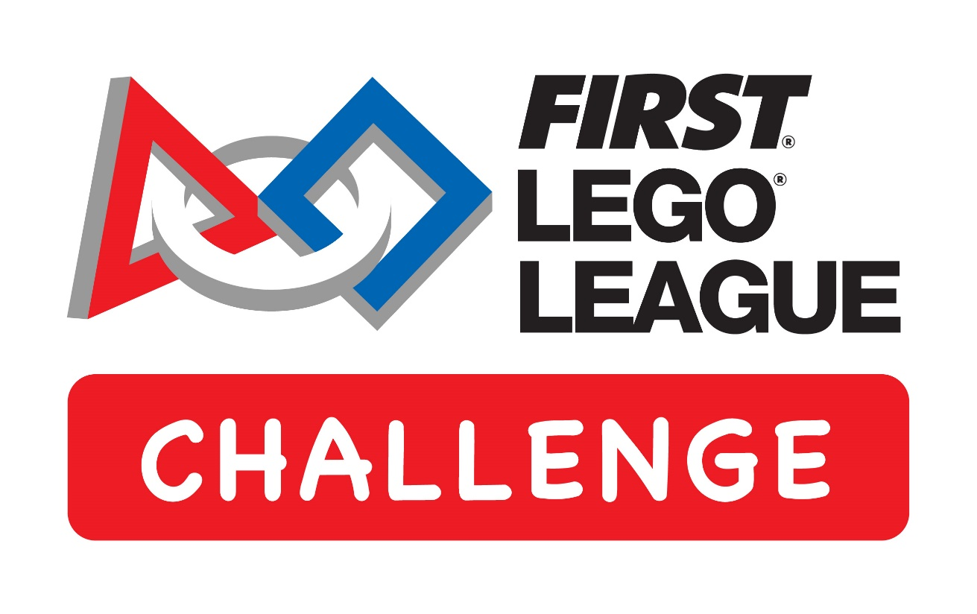

FIRST® and the FIRST® logo are registered trademarks of For Inspiration and Recognition of Science and Technology (FIRST). LEGO® and MINDSTORMS® are registered trademarks of the LEGO Group. FIRST® LEGO® League and SUPERPOWEREDSM are jointly held trademarks of FIRST and the LEGO Group. SPIKE™ Prime is a trademark of LEGO® Education. All other trademarks are the property of their respective owners. ©2022 FIRST and the LEGO Group. All rights reserved.

