Slide 1
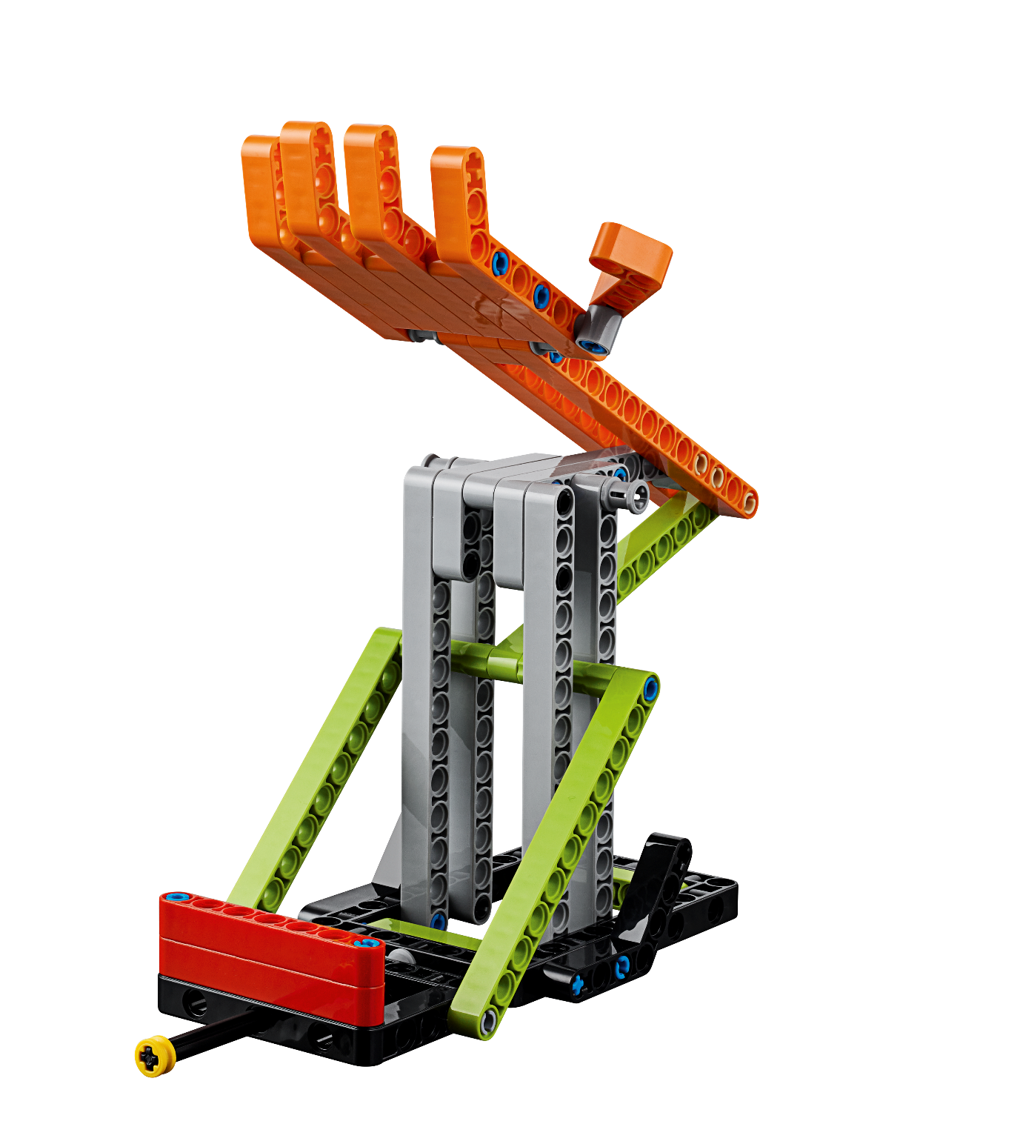


Session 5
Investigate
Ideas

Slide 2
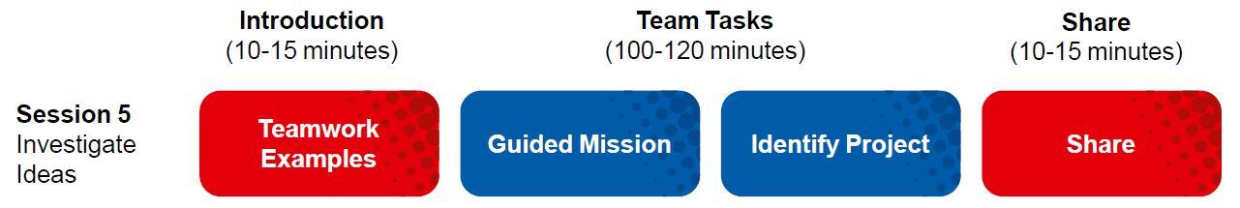
Session Overview
Outcomes
The team will apply coding principles to the guided mission.
The team will research solutions and identify their Innovation Project problem to solve.
Notes:
Facilitator Tips for Session 5-8
- Core Values: Remember the Core Values are about HOW the team behaves and works together. They should be demonstrated by all the team members all the time.
- Innovation Project: Teams will have to select a final problem and solution to focus on, so thinking about this goal during each session is helpful.
- Robot Design: At the Robot Game matches, two Robot Game tables will be set up next to each other. However, during the sessions, you will probably work with a single Robot Game table.
- Robot Game: Look for missions that:
• Use basic robot skills like push, pull, or lift. • Have models close to a launch area. • Involve navigation with line following. • Have easy access to home.
Facilitator Tips for Session 5
Team-building activities are great ways for teams to develop and use their Core Values and learn how to work together.

Slide 3

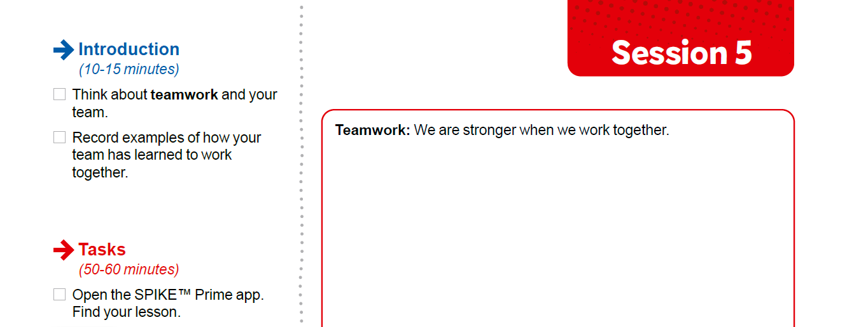

Introduction
Think about teamwork and your team.
Record examples of how your team has learned to work together.
Notes:
Facilitator Tips
The team should be able to describe what everyone’s strong points are and why they like working with them.

Slide 4


Guided Mission
Open the SPIKE™ Prime app. Find your lesson.
Read over the guided mission.
Have fun practicing this guided mission until it works perfectly!
Notes:
URL for SPIKE on-line: https://spike.legoeducation.com (remember to use a Chrome browser)
The Guided Mission – https://education.lego.com/en-us/lessons/prime-competition-ready/spike-prime-the-guided-mission#lesson-plan
Facilitator Tips
If the team is sharing one robot, they can code on individual devices then take turns running their programs onto the robot.
The provided program for the guided mission will not only solve the Smart Grid mission but will also be helpful to use on other missions.
Remind the team to test program changes in small steps instead of changing the entire program at once.
If an attachment is needed for a mission, keep it in a plastic bag labeled with the mission number.

Slide 5
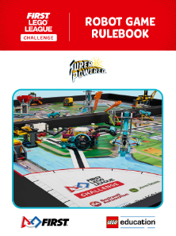
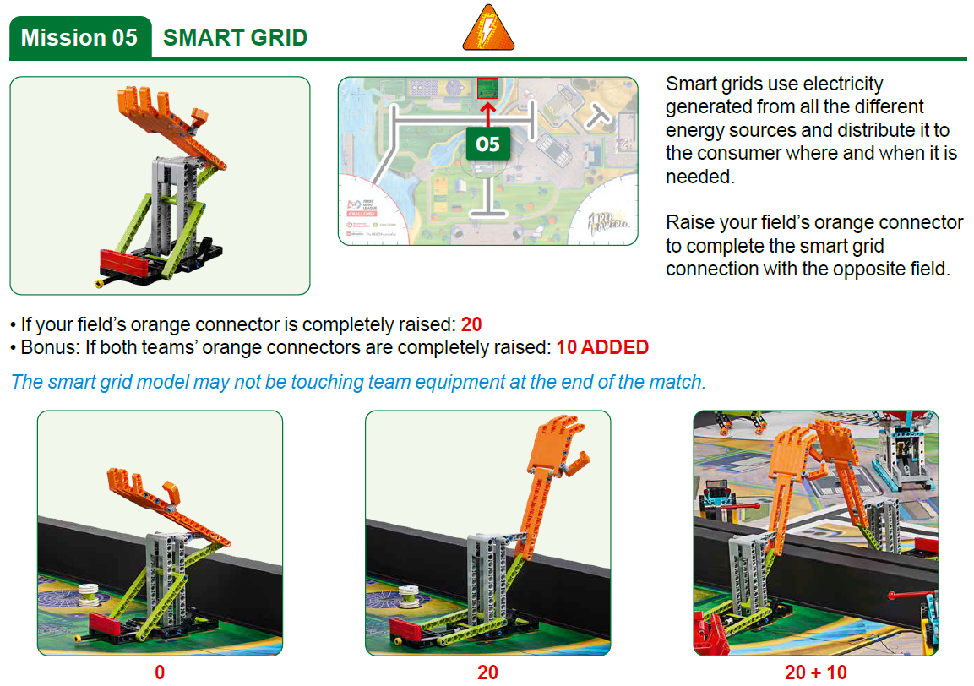
Robot
Game
Rulebook
page 10

Slide 6
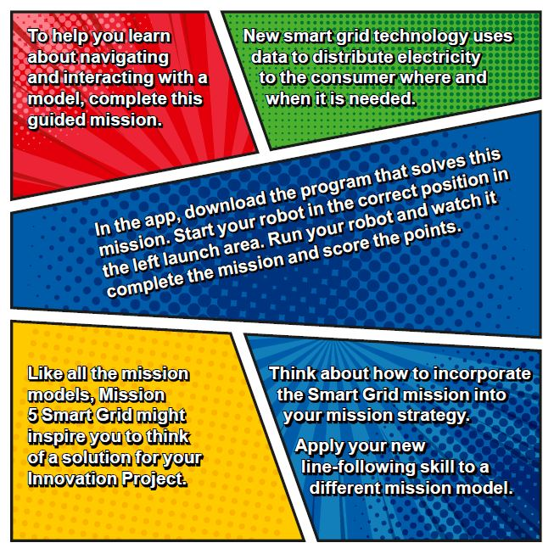
Guided Mission:
Mission 5 Smart Grid
Notes:
- To help you learn about navigating and interacting with a model, complete this guided mission.
- New smart grid technology uses data to distribute electricity to the consumer where and when it is needed.
- In the app, download the program that solves this mission. Start your robot in the correct position in the left launch area. Run your robot and watch it complete the mission and score the points.
- Like all the mission models, Mission 5 Smart Grid might inspire you to think of a solution for your Innovation Project.
- Think about how to incorporate the Smart Grid mission into your mission strategy.
- Apply your new line-following skill to a different mission model.

Slide 7

Guided Mission:
Mission 5 Smart Grid
Notes:
To help you learn about navigating and interacting with a model, complete this guided mission.

Slide 8

Guided Mission:
Mission 5 Smart Grid
Notes:
New smart grid technology uses data to distribute electricity to the consumer where and when it is needed.

Slide 9
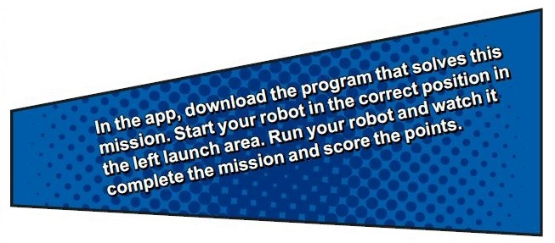
Guided Mission:
Mission 5 Smart Grid
Notes:
In the app, download the program that solves this mission. Start your robot in the correct position in the left launch area. Run your robot and watch it complete the mission and score the points.

Slide 10
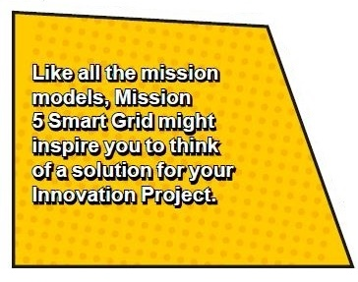
Guided Mission:
Mission 5 Smart Grid
Notes:
Like all the mission models, Mission 5 Smart Grid might inspire you to think of a solution for your Innovation Project.

Slide 11
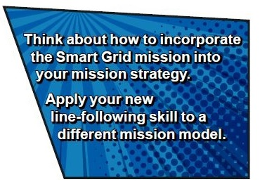
Guided Mission:
Mission 5 Smart Grid
Notes:
Think about how to incorporate the Smart Grid mission into your mission strategy.
Apply your new line-following skill to a different mission model.

Slide 12
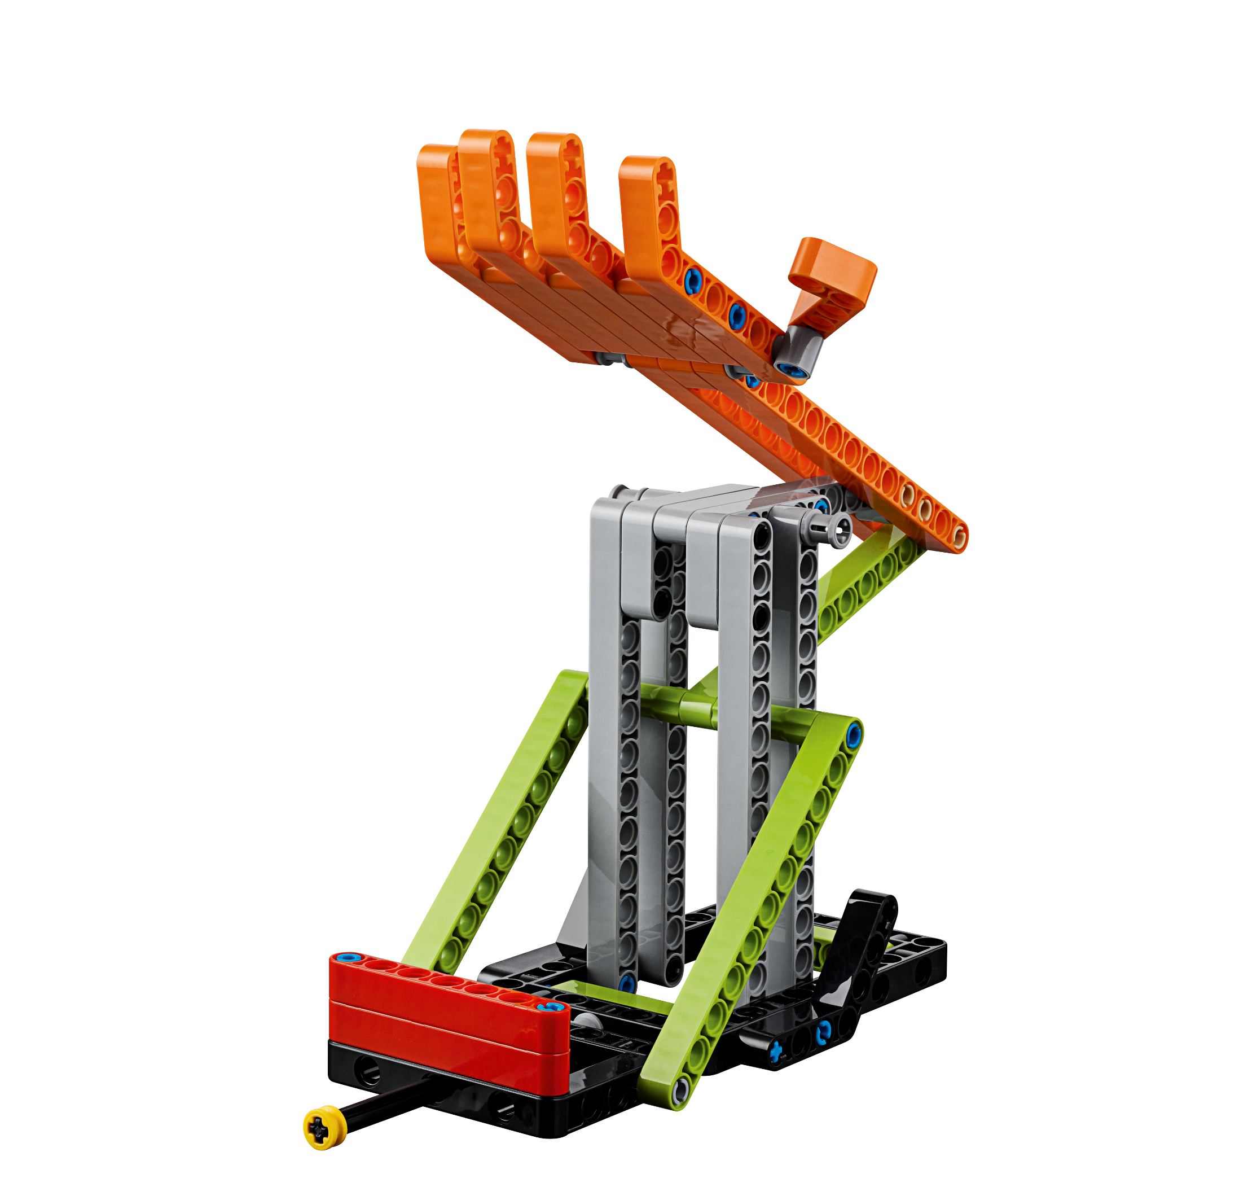
Reflection Questions
What does the guided mission show you about Coopertition®?
Can you change the program so that the mission works when you start the robot from the opposite launch area?

Slide 13
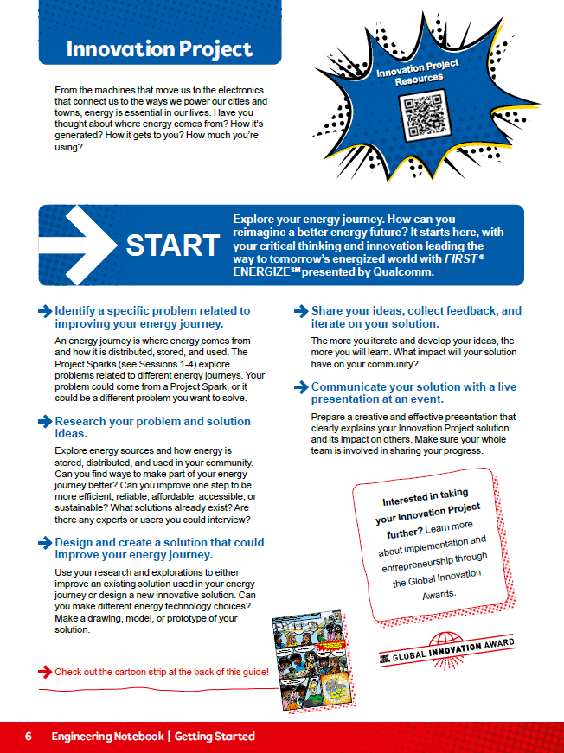
Investigations
Revisit page 6 and review the Project Sparks.
Think about the great solutions you have come up with in the previous sessions.
Notes:
Facilitator Tips
Encourage the team to record all problem ideas they have identified for the Innovation Project.

Slide 14
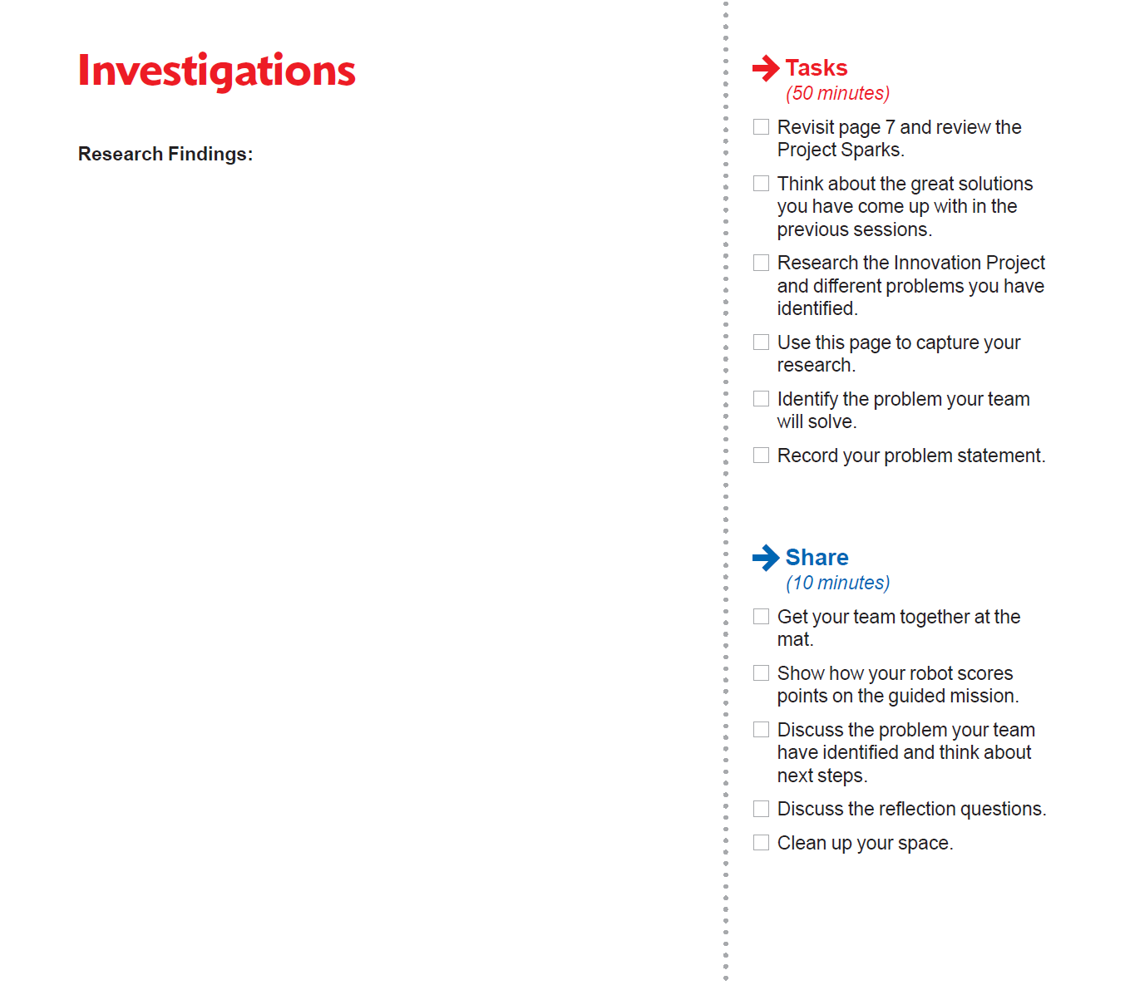
Investigations
Research the Innovation Project and different problems you have identified.
Use this page to capture your research.
Notes:
Facilitator Tips
Project resource examples include the Internet, books, magazines, personal stories, user experiences, and experts (in person or virtual).

Slide 15

Investigations
Identify the problem your team will solve and record your problem statement.
Notes:
Facilitator Tips
Each team member might not get their favorite problem chosen, but the team should choose something everyone supports.
The team can use a problem identified within one of the Project Sparks to develop their solution.
The team will write their final problem statement here. If they have multiple ideas, use a voting process to narrow it down to one.

Slide 16

Share
Get together at the mat.
Show how your robot scores points on the guided mission.
Discuss the problem your team has identified and think about next steps.
Discuss the reflection questions.
Clean up your space.

Slide 17

Reflection Questions
What energy problem did you decide to solve?
Is there an expert or end user you can talk to about the problem?

Slide 18



Career Connections
Power and Smart Grid Engineer
Warehouse Worker

Slide 19

Multimedia Resources
You may wish to embed a relevant, age-appropriate video for your students here. See the Notes for an example.
Notes:
Choose a relevant, age-appropriate video for your students.
Examples:
What Is the Smart Grid? – https://www.youtube.com/watch?v=JwRTpWZReJk – length 5:18
Smart Energy Islands - Isles of Scilly - Hitachi – https://www.youtube.com/watch?v=7VP1tDYGjvU&t=20s – length 2:38

Slide 20

Clean Up
Notes:
Allow time for cleanup and place any unfinished models and their pieces in a sealed plastic bag.

Slide 21


FIRST® and the FIRST® logo are registered trademarks of For Inspiration and Recognition of Science and Technology (FIRST). LEGO® and MINDSTORMS® are registered trademarks of the LEGO Group. FIRST® LEGO® League and SUPERPOWEREDSM are jointly held trademarks of FIRST and the LEGO Group. SPIKE™ Prime is a trademark of LEGO® Education. All other trademarks are the property of their respective owners. ©2022 FIRST and the LEGO Group. All rights reserved.

