Slide 1



Session 8
Continue
Creating

Slide 2
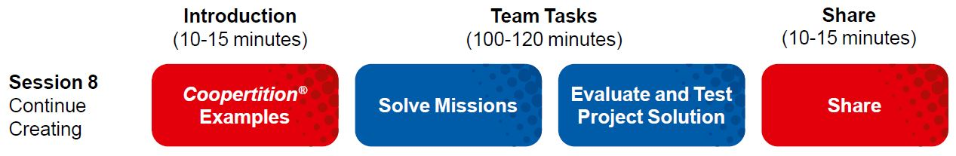
Session Overview
Outcomes
The team will evaluate and improve on their Innovation Project solution.
The team will design robot attachments and create programs to solve missions.
Notes:
Facilitator Tips
Use the Core Values where appropriate to encourage the team. To celebrate the team learning these important values, highlight examples of these principles being demonstrated by the team.

Slide 3
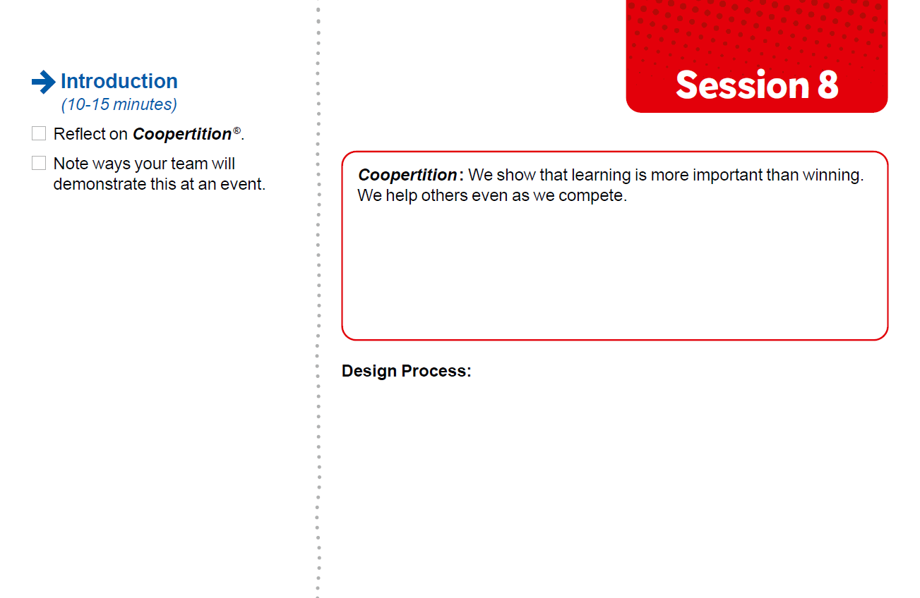

Introduction
Reflect on Coopertition®.
Note ways your team will demonstrate this at an event.
Notes:
Facilitator Tips
Have the team discuss how the guided mission is an example of Coopertition®.

Slide 4
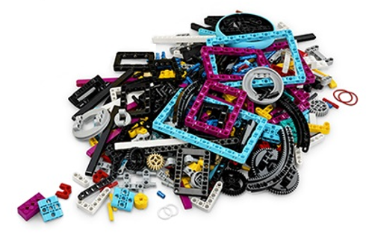
Solve Missions
Decide which mission to attempt next.
Think about your mission strategy and plan.
Build any attachments you need to complete missions.
Iterate and refine your program so your robot completes the mission reliably.
Be sure to document your design process and testing for each mission!
Notes:
Facilitator Tips
The team should think about strategy when choosing missions to solve. Multiple missions can be completed on the same run to save time.
Encourage the team to discuss how their program works. Break the program into blocks that control one movement.
Treat the Robot Game like a sport. The team needs to practice, practice, practice to perform well in the Robot Game.
Where the robot starts in a launch area strongly influences where it ends. Have the team keep good notes about where the robot is placed.

Slide 5
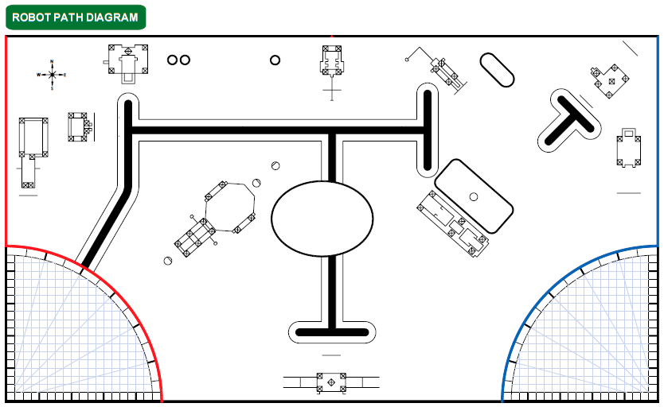
Solve Missions

Slide 6
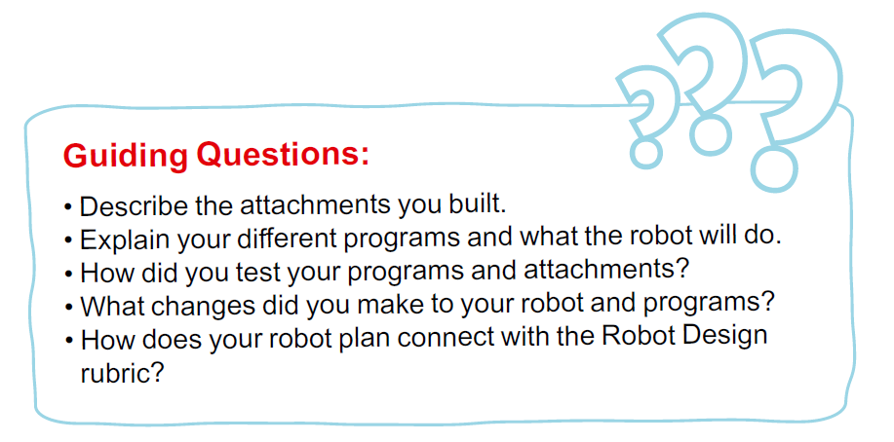
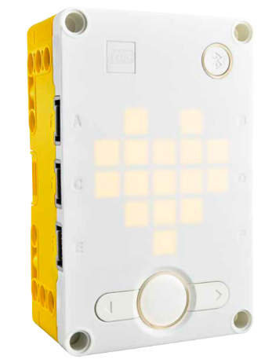
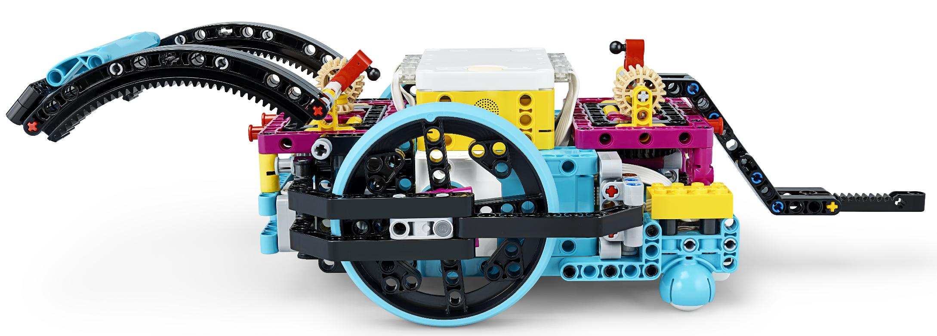

Slide 7

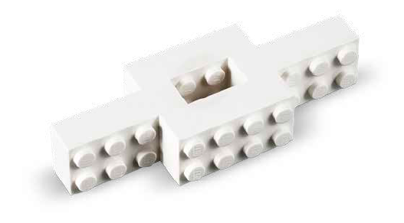
Reflection Questions
How has your team used Core Values to develop your robot solution?
In what order will you run the missions in the Robot Game?

Slide 8
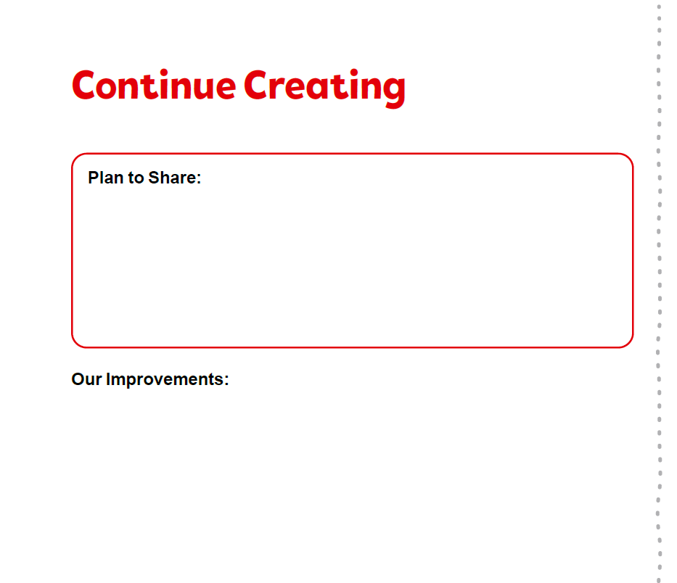
Evaluate & Test Project Solution
Make a plan to share about your solution with others!
Evaluate your present solution.
Iterate and improve to make it better based on feedback.
Determine if you can do any testing of your solution.
Notes:
Facilitator Tips
The team can create a survey to evaluate their solution or ask for feedback from someone who is an expert or user for their chosen problem.
The team should iterate and improve their Innovation Project solution following feedback from others.
Collect the remaining bricks from Bag 14 in a sealed plastic bag. The team does NOT have to use all the bricks.
Keep the brick model made by the team representing their Innovation Project solution for the Robot Game.
The team could go through multiple cycles of the engineering design process as they test and improve their Innovation Project solution.

Slide 9
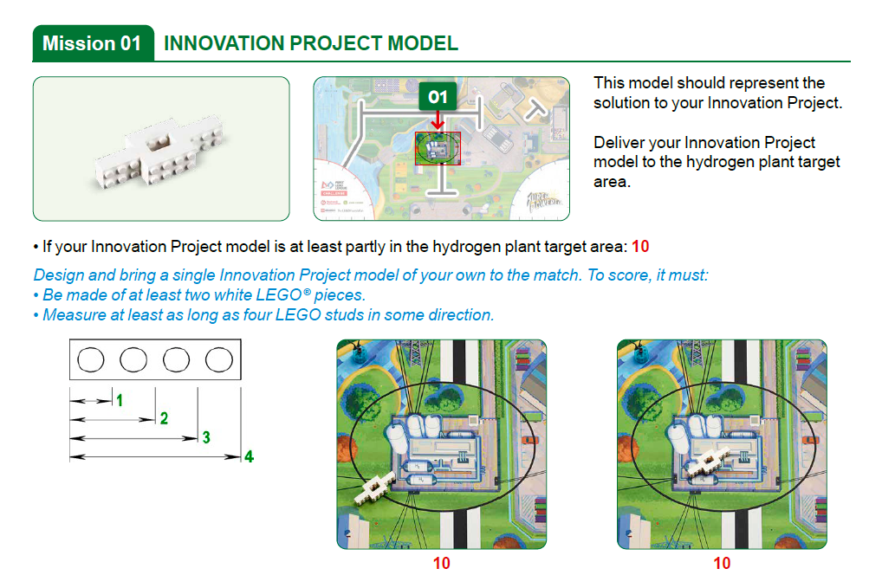
Evaluate & Test Project Solution
Use the elements from Bag 14 to build a model that represents your Innovation Project solution.
Notes:
Facilitator Tips
Keep the white brick model made by the team representing their Innovation Project solution.
Collect the remaining white bricks from Bag 14 in a sealed plastic bag. They do NOT have to use all the white bricks.

Slide 10

Share
Get together at the mat.
Show any missions you are working on or have completed.
Discuss how you will share your solution and project plan with others.
Discuss the reflection questions.
Clean up your space.

Slide 11
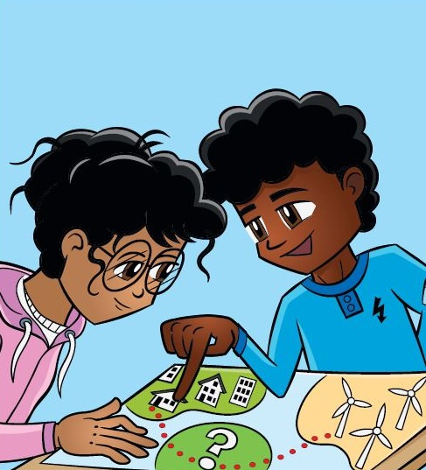

Reflection Questions
How can you realistically implement your Innovation Project solution?
Could your Innovation Project solution be manufactured? What would it cost?

Slide 12
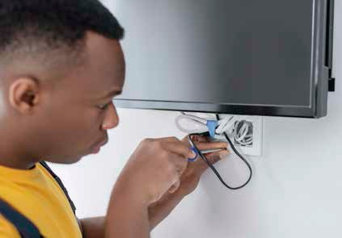
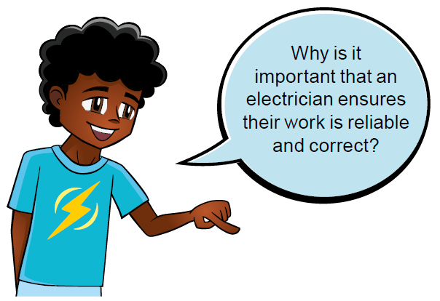
Career Connections
Electrician
Warehouse Worker
Role: An electrician ensures homes are wired correctly so that people can use electricity to power their electronics and lights.

Slide 13

Multimedia Resources
You may wish to embed a relevant, age-appropriate video for your students here. See the Notes for an example.
Notes:
Choose a relevant, age-appropriate video for your students.
Example:
I Can Be What?! | Electrician – https://www.youtube.com/watch?v=8Il1dBXkDQ4 – length 5:28
Day in the Life of an Electrician – https://www.youtube.com/watch?v=ZfskvPZHKnA – length 3:12

Slide 14

Clean Up

Slide 15


FIRST® and the FIRST® logo are registered trademarks of For Inspiration and Recognition of Science and Technology (FIRST). LEGO® and MINDSTORMS® are registered trademarks of the LEGO Group. FIRST® LEGO® League and SUPERPOWEREDSM are jointly held trademarks of FIRST and the LEGO Group. SPIKE™ Prime is a trademark of LEGO® Education. All other trademarks are the property of their respective owners. ©2022 FIRST and the LEGO Group. All rights reserved.

