Slide 1




SESSION 10
Let’s Celebrate

Slide 2
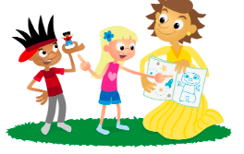
Get Ready
Today we will:
Use our ideas to build a team model.
Share our Engineering Notebooks.
Solve a special challenge.
Have fun!
Notes:
Preparing the Teams (10 minutes)
Welcome the children to the event and tell them what they will do during the session. They will use their ideas to build their team model together, share their Engineering Notebooks, and solve a special challenge. The children can complete the Session 10 Engineering Notebook page to provide direction on what to share with the reviewers.

Slide 3
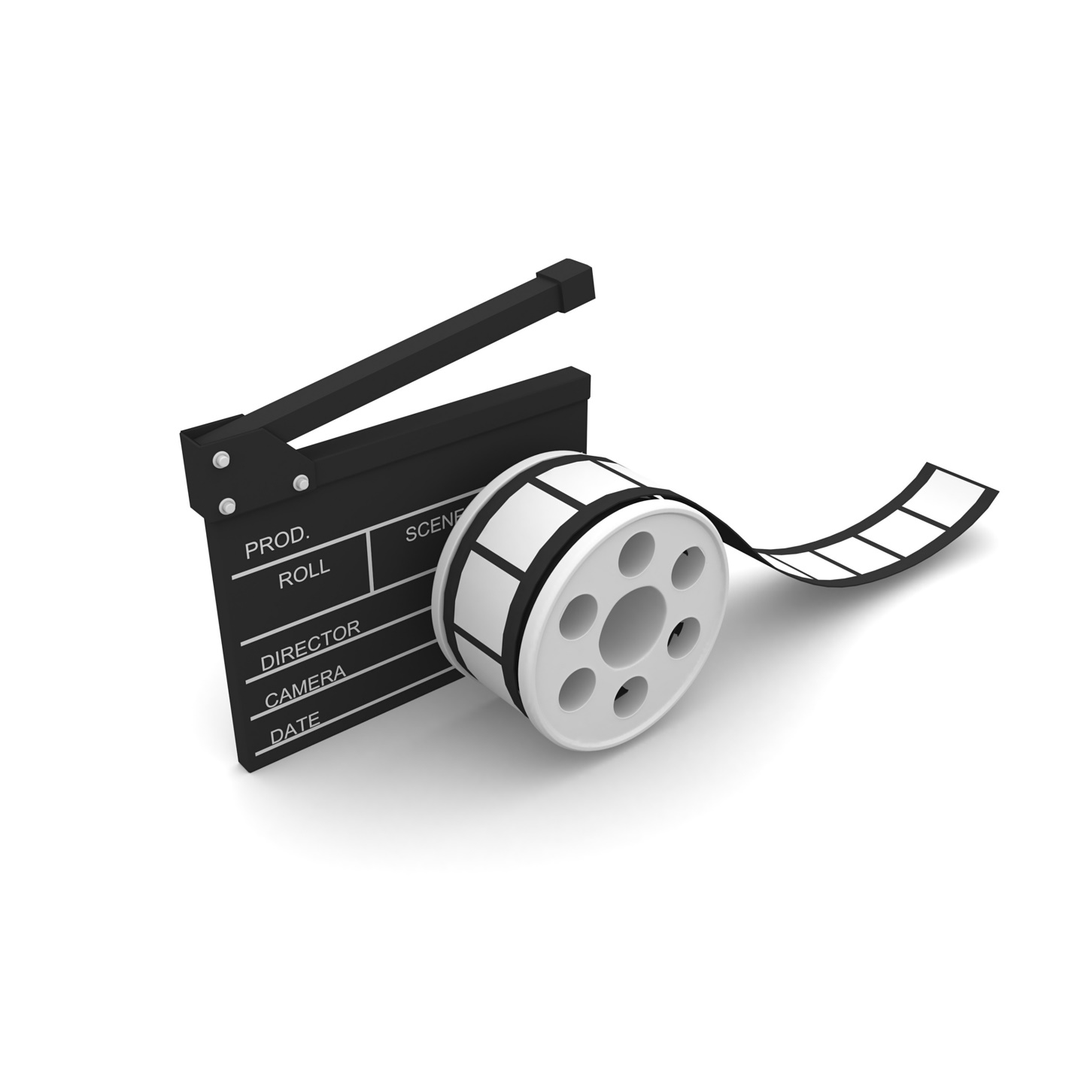
Optional Video
Visit the ​
FIRST® LEGO ® League ​
YouTube Channel ​
to watch the ​
SUPERPOWEREDSM
Season Launch Video

Slide 4
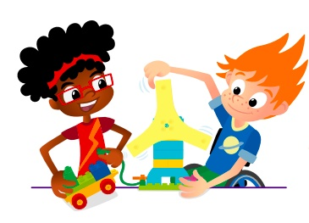
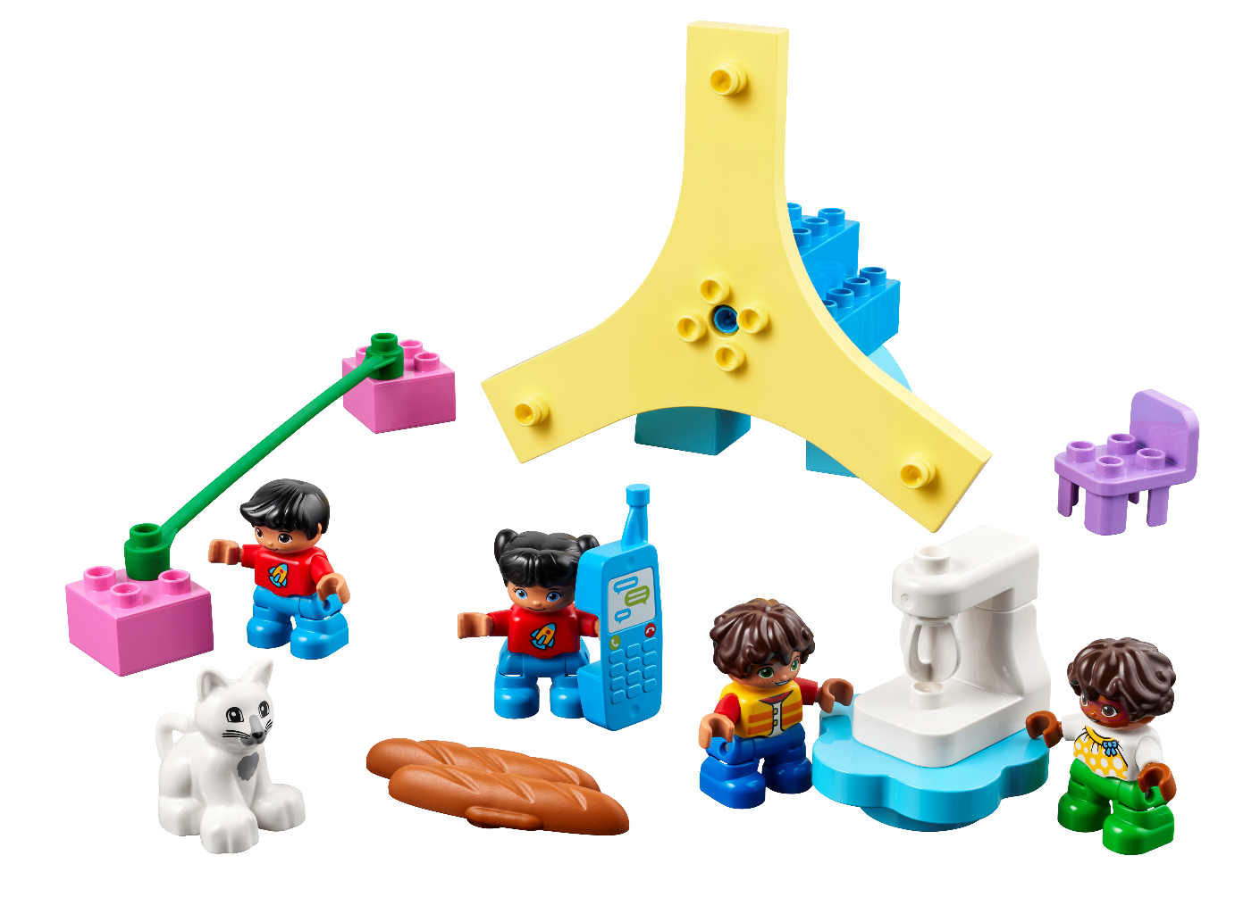
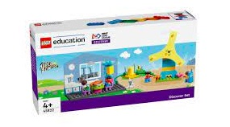
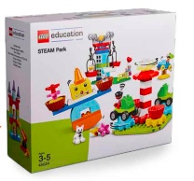
Final Challenge
Work as a team to build the whole energy story.
Include the kitchen, turbine and mat.
Use STEAM Park pieces to make something move.
You Need..
Notes:
Final Challenge (20 minutes) ​
At the event, have the teams:
• Build their team model of the entire energy story of their community and including all parts from the Discover set.
• Use STEAM Park pieces to make something move to represent energy being used.

Slide 5
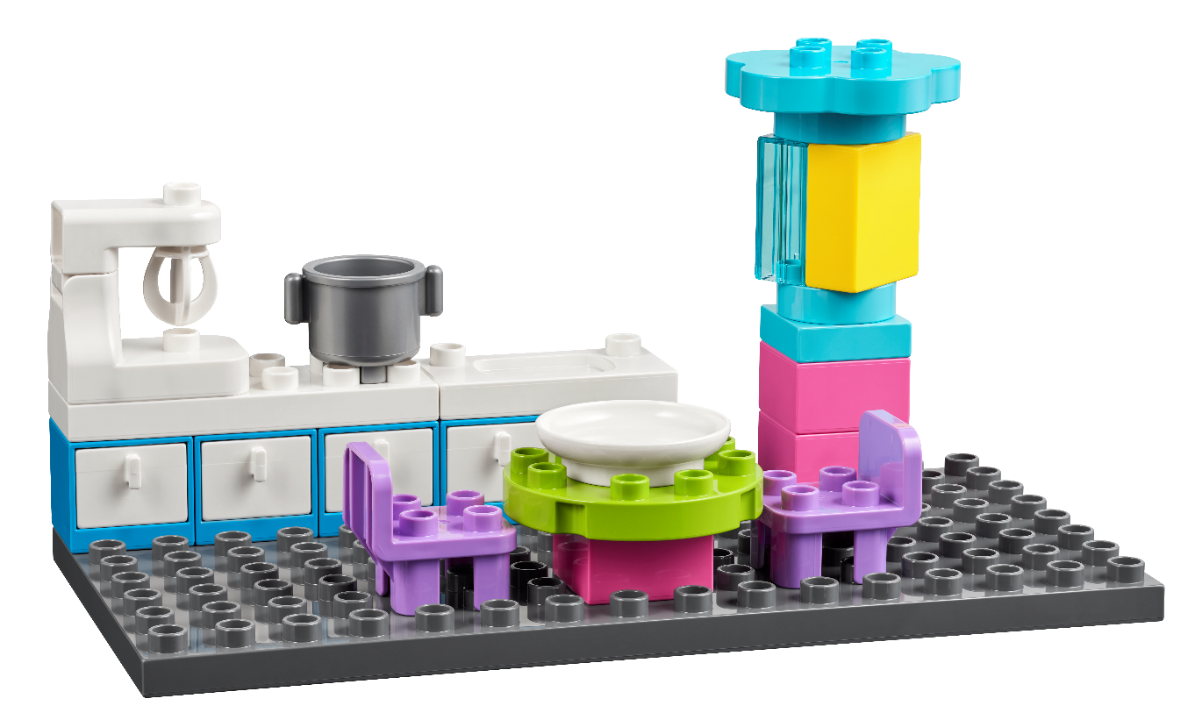
Special Challenge
Work with another team to:
  Distribute energy between your models.
  Create connections from different energy sources between your models.
You Need..
Notes:
Special Challenge (10 minutes)​
Match up two teams and have them solve the special challenge together:
You could ask the children to:
• Distribute energy between the two team models using functional pieces from STEAM Park.
• Connect the two team models to the same energy supply.
• Create connections from different energy sources between the two team models.

Slide 6

Celebrate
Notes:
Celebrate (10+ minutes)
While the building, problem-solving, and reviewing are the most important part of how the event works, you should allow plenty of time to celebrate each team’s achievements in front of everyone at the event. You could extend this time and allow time for the children to share and present what they learned.

Slide 7
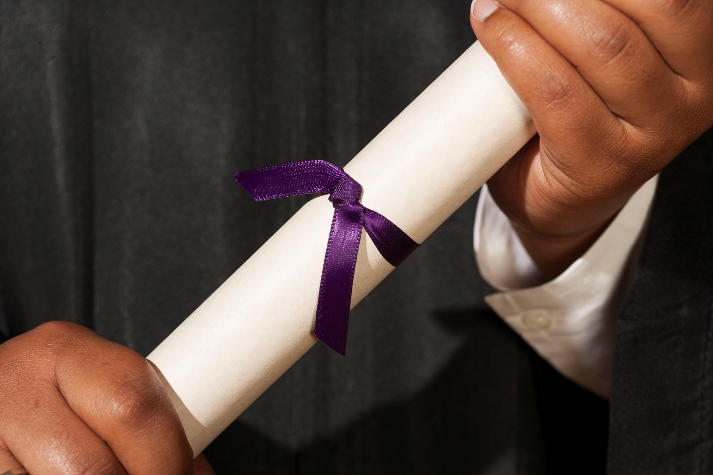
Celebrate
Visit the
FIRST® LEGO ® League
Season Resources Page
for the Discover certificate
Notes:
Celebrate (10+ minutes)
While the building, problem-solving, and reviewing are the most important part of how the event works, you should allow plenty of time to celebrate each team’s achievements in front of everyone at the event. You could extend this time and allow time for the children to share and present what they learned.
You may wish to insert an image of the certificate here.

Slide 8
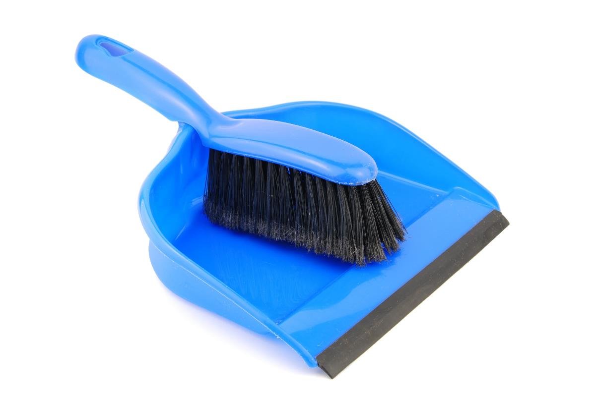
Clean Up
Notes:
You may wish to play a video or song during clean up time Link on GoNoodle: https://family.gonoodle.com/activities/clean-up. Link on YouTube Kids: https://www.youtubekids.com/watch?v=ZJFk87ZsHn0 . Link on Youtube: https://youtu.be/ZJFk87ZsHn0

Slide 9


LEGO, the LEGO logo, DUPLO and the DUPLO logo are trademarks of the/sont des marques de commerce du/ son marcas registradas de LEGO Group. ©2022 The LEGO Group. All rights reserved/ Tous droits réservés/ Todos los derechos reservados. FIRST®, the FIRST® logo, and FIRST ENERGIZESM are trademarks of For Inspiration and Recognition of Science and Technology (FIRST). LEGO® is a registered trademark of the LEGO Group. FIRST® LEGO® League and SUPERPOWEREDSM are jointly held trademarks of FIRST and the LEGO Group. ©2022 FIRST and the LEGO Group. All rights reserved.

