Slide 1


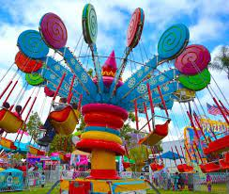

SESSION 5
Fun Fair

Slide 2
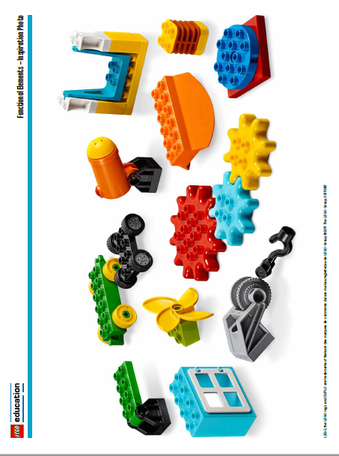
Big Question
How can we use a moving part in our fun fair design?
Outcomes
Teams will use
imagination and
creativity to create
innovative moving ride
designs.
Teams will apply
knowledge of functional
pieces to create a fun
fair ride with moving
parts.
Notes:
Each session has a Big Question that can be shared to frame the session.​
Blippi Visits A Theme Park! | Learn With Blippi For Kids! | Educational Videos For Toddlers
https://www.youtube.com/watch?v=dMV8hL_RH2k

Slide 3
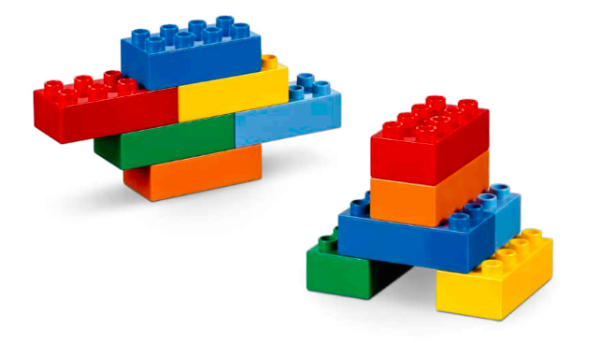
Six Bricks - Warm-Up
Notes:
Six Bricks Warm-Up (10 minutes)​
What can you build?
Base Activity​
1. In groups of 4, children mix their bricks together.
2. Have the children use their bricks build a model that represents an energy source (like a solar panel) or energy consumer (like a fun fair or amusement park ride).
3. Then have them describe how the ride uses energy to make it move.
4. Then have them create characters that are riding the ride.
This activity can also be linked to a theme, story, or book.
Guiding Questions:
• Does your ride have a name?
• What sound does it make?
• How does it move?
• How does energy get from the source to the ride?

Slide 4
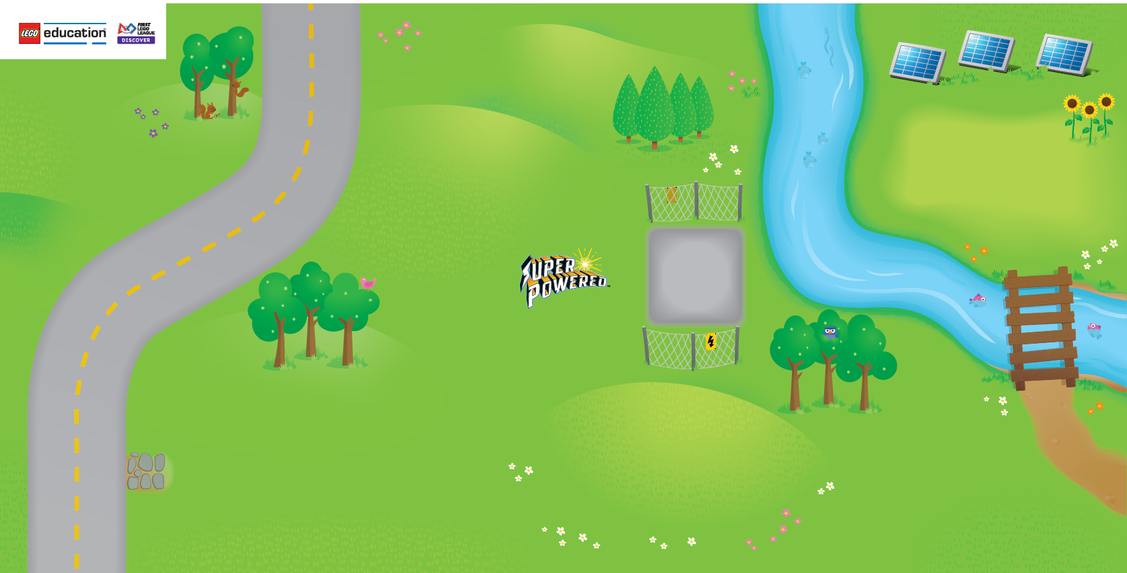
Task 1 - Explore
Notes:
Task 1 (10 minutes)​
Have each team unfold their Discover mat. Identify the different energy sources on the mat and how energy is transported to different areas.
You could ask the teams:
• What different types of moving rides have you seen or ridden at a fun fair, carnival, or amusement park?
• How could you create an innovative fun fair ride that uses energy to move?
• How can you connect your fun fair ride to the energy supply?

Slide 5

Optional Video
You may wish to embed a relevant, age-appropriate video for your students here. See the Notes for an example.
Notes:
Example Video:
Blippi Visits A Theme Park! | Learn With Blippi For Kids!
https://www.youtube.com/watch?v=dMV8hL_RH2k

Slide 6
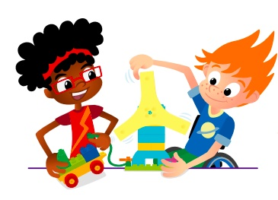
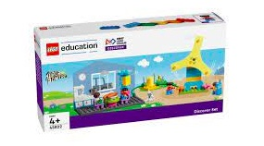
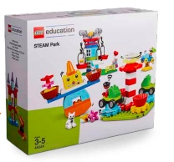
Task 2 - Create
Build fair rides with moving parts that use energy.
You Need..
Notes:
Task 2 (25 minutes)
Have each team pick out the functional pieces in STEAM Park and show how they move. There are some great pieces that are provided to make different fair rides.
They should use them to create a ride for the fun fair with moving parts.
This will represent how the ride uses energy to make it move.
The ride can be built on the mat on one of the open areas.

Slide 7

Task 3 - Share
Share what you built.
Show how the fair ride moves.
Explain how the fair ride uses energy.
Notes:
Task 3 (15 minutes)​
Have the teams describe the movement in their builds. The teams could share together to give them more confidence in talking in front of people.
They can demonstrate how their fun fair ride moves and explain how the ride uses energy.
Ask them to use the word innovative where possible.

Slide 8
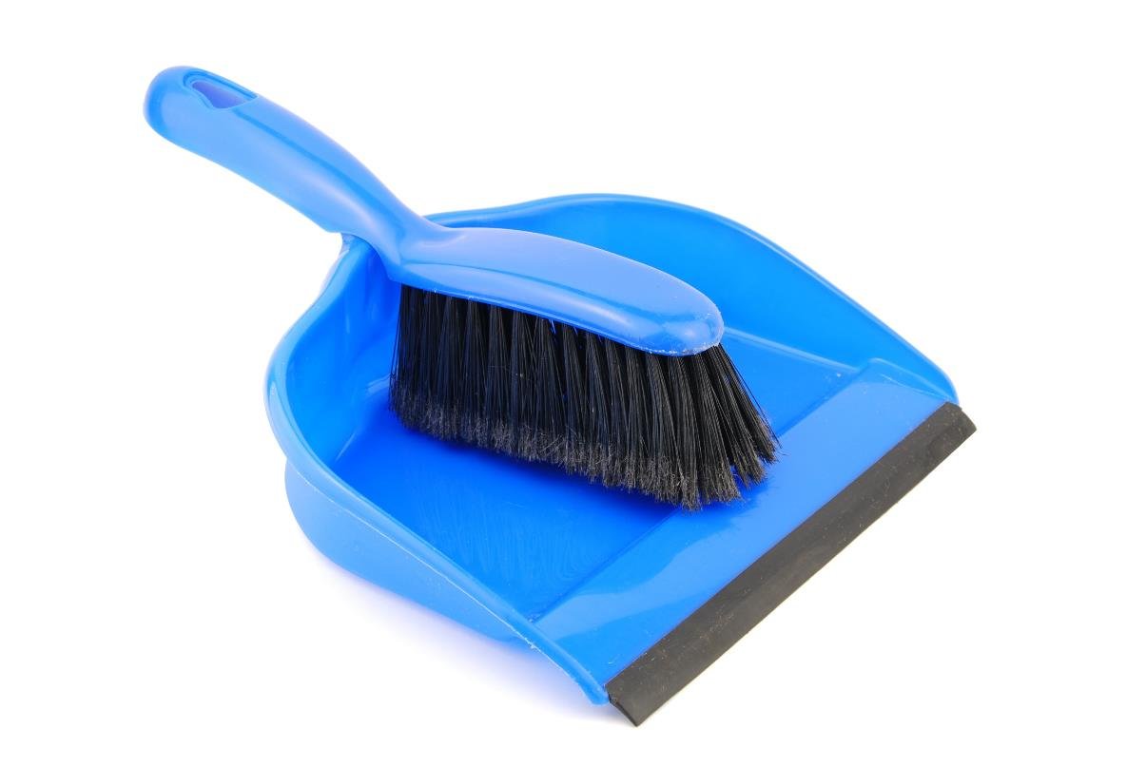
Clean Up
Notes:
You may wish to play a video or song during clean up time Link on GoNoodle: https://family.gonoodle.com/activities/clean-up. Link on YouTube Kids: https://www.youtubekids.com/watch?v=ZJFk87ZsHn0 . Link on Youtube: https://youtu.be/ZJFk87ZsHn0

Slide 9

LEGO, the LEGO logo, DUPLO and the DUPLO logo are trademarks of the/sont des marques de commerce du/ son marcas registradas de LEGO Group. ©2022 The LEGO Group. All rights reserved/ Tous droits réservés/ Todos los derechos reservados. FIRST®, the FIRST® logo, and FIRST ENERGIZESM are trademarks of For Inspiration and Recognition of Science and Technology (FIRST). LEGO® is a registered trademark of the LEGO Group. FIRST® LEGO® League and SUPERPOWEREDSM are jointly held trademarks of FIRST and the LEGO Group. ©2022 FIRST and the LEGO Group. All rights reserved.

