Slide 1


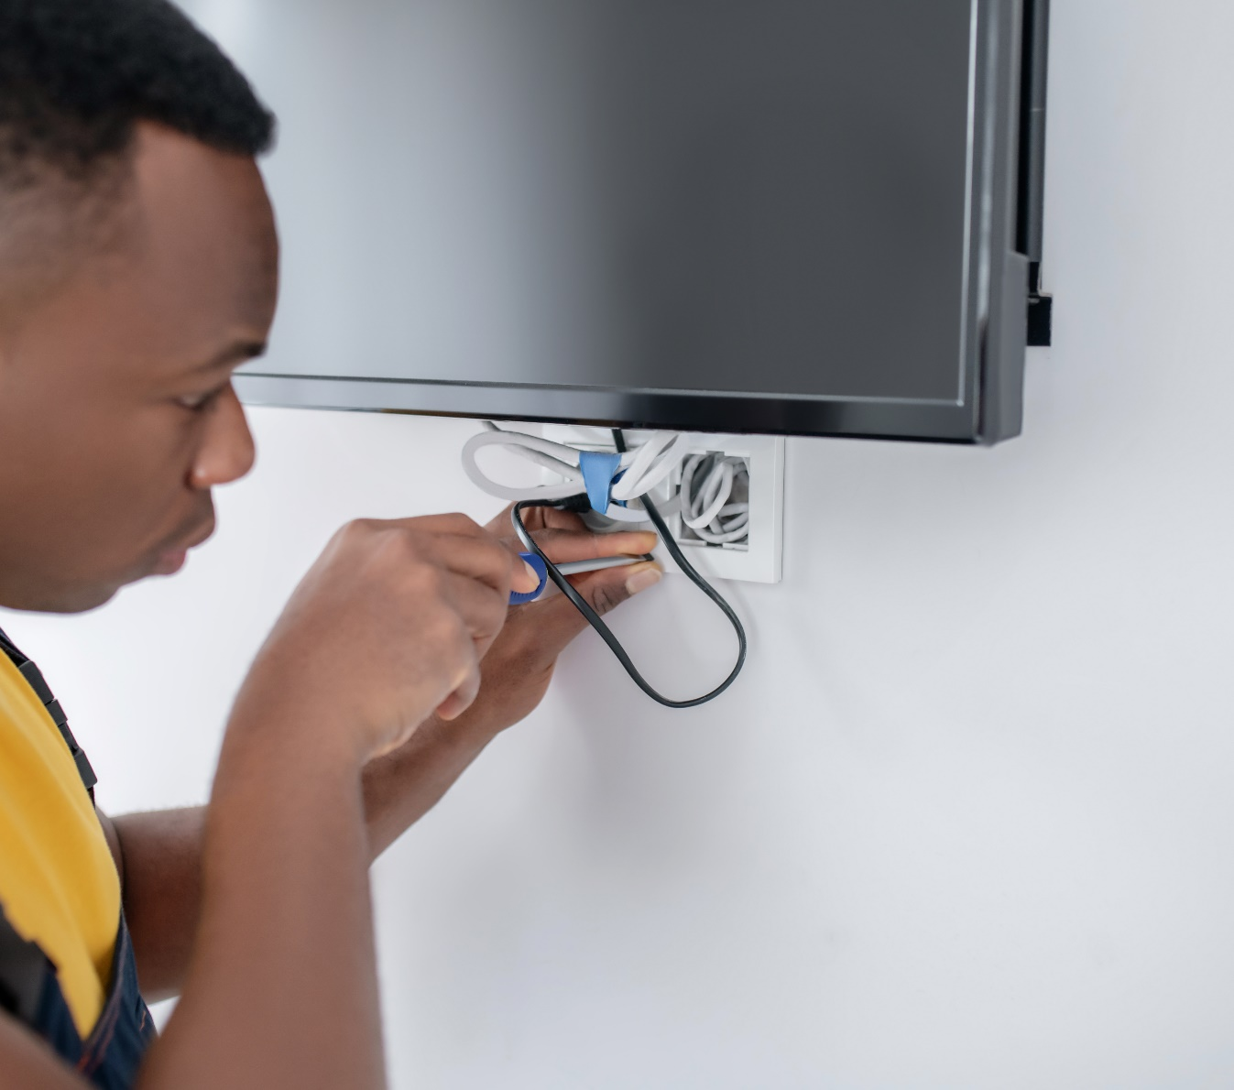

SESSION 6
Your Energy Story

Slide 2
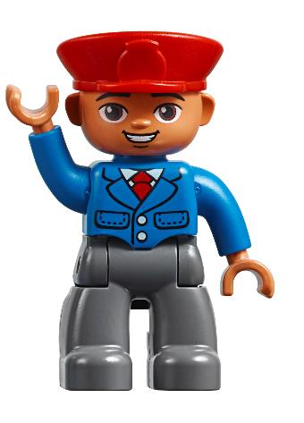
Big Question
What is the energy story in your community?
Outcomes
Teams will identify
different energy jobs.
Teams will create an
energy story of their
community.
Notes:
Each session has a Big Question that can be shared to frame the session.​

Slide 3
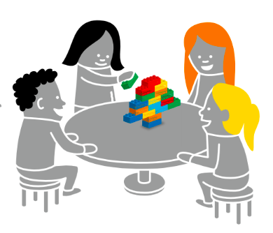
Six Bricks - Warm-Up
Notes:
Six Bricks Warm-Up (10 minutes)​
Build the Picture
Base Activity​
1. In groups of 4, children mix their bricks together and choose a leader.
2. The adult whispers a word related to energy (e.g., light, electricity, solar panel, wind turbine) to the leader.
3. Back with his or her group, the leader quickly builds that word for the others to guess.
4. The group may not ask questions but can call out words. The leader can say when they get it right.
Part 2
5. Choose a new leader and repeat the activity with a new word.
6. Continue until all children in the group have been a leader.
Guiding Questions:
• How did the first group figure out the word?
• What can you do to help the next leader of the group?

Slide 4
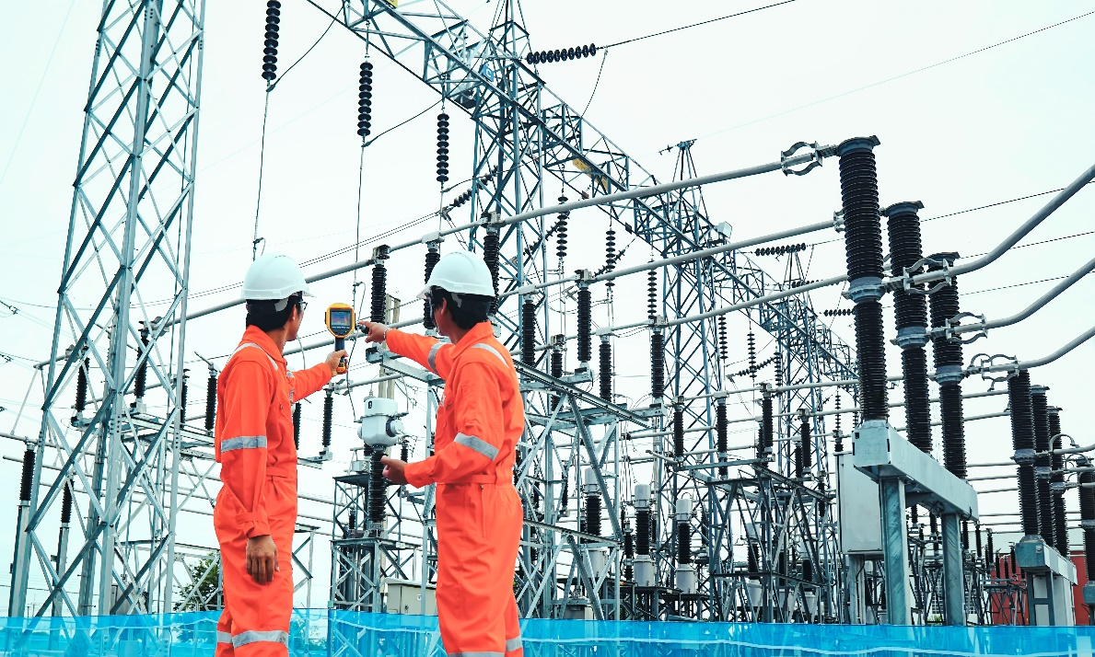
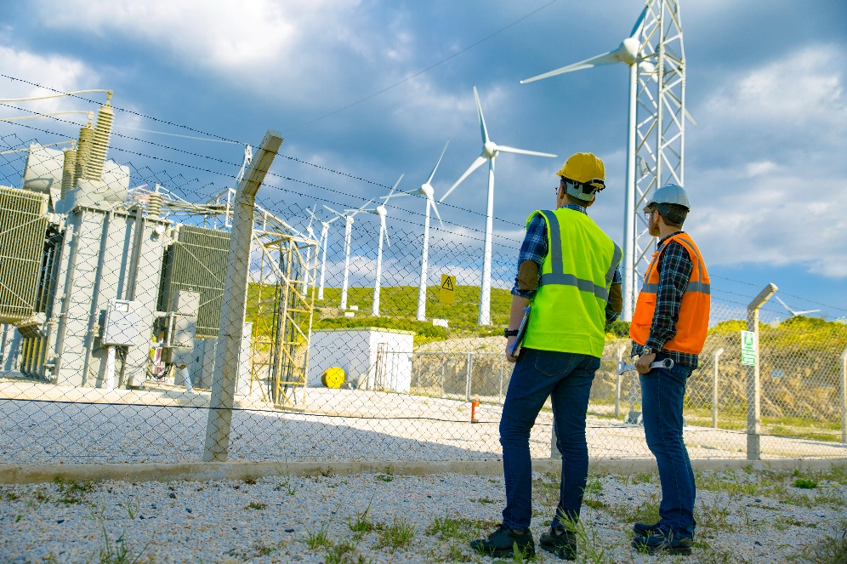
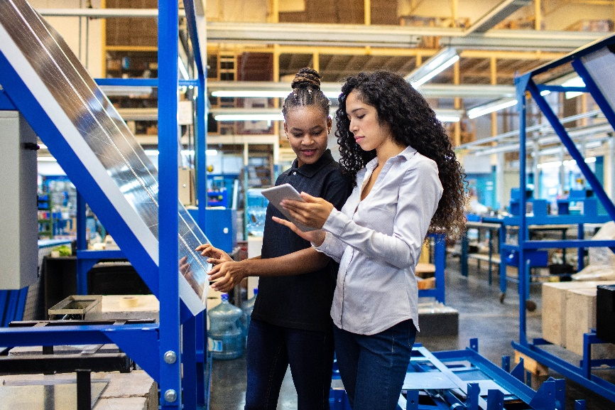
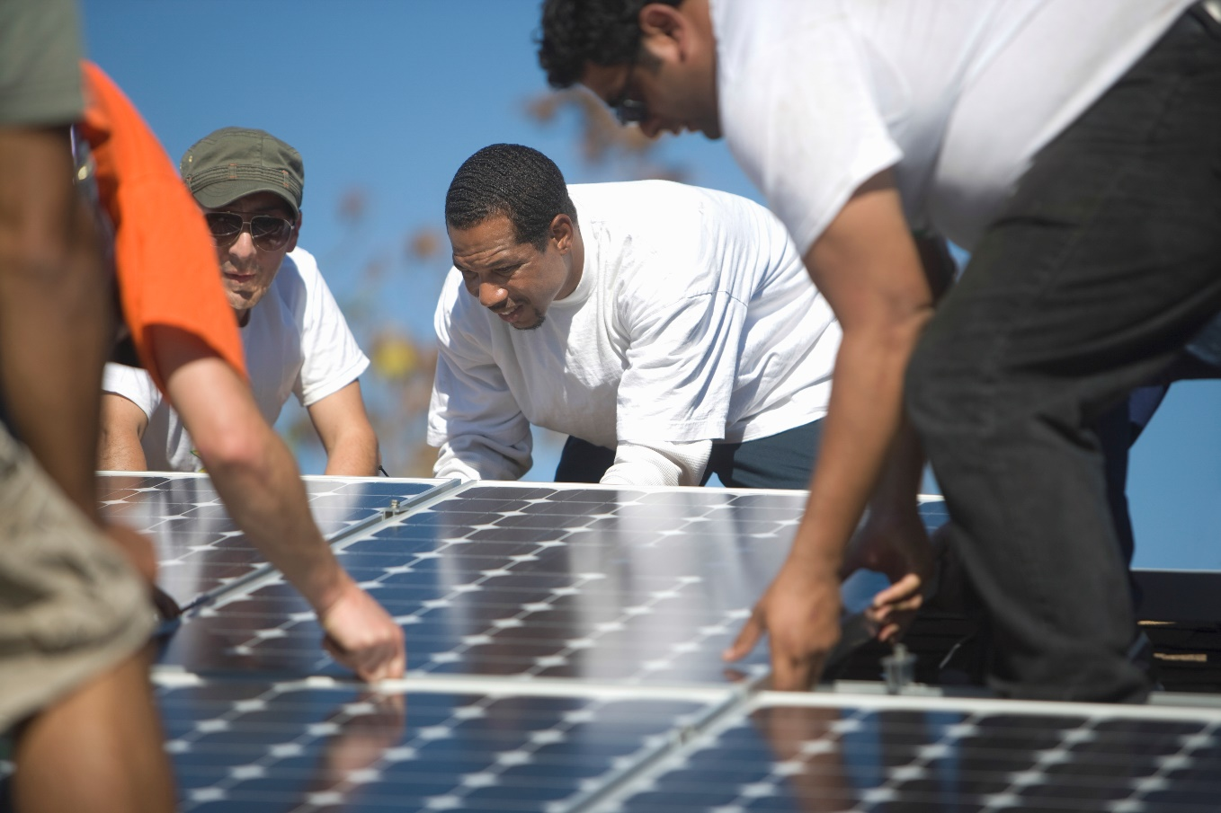
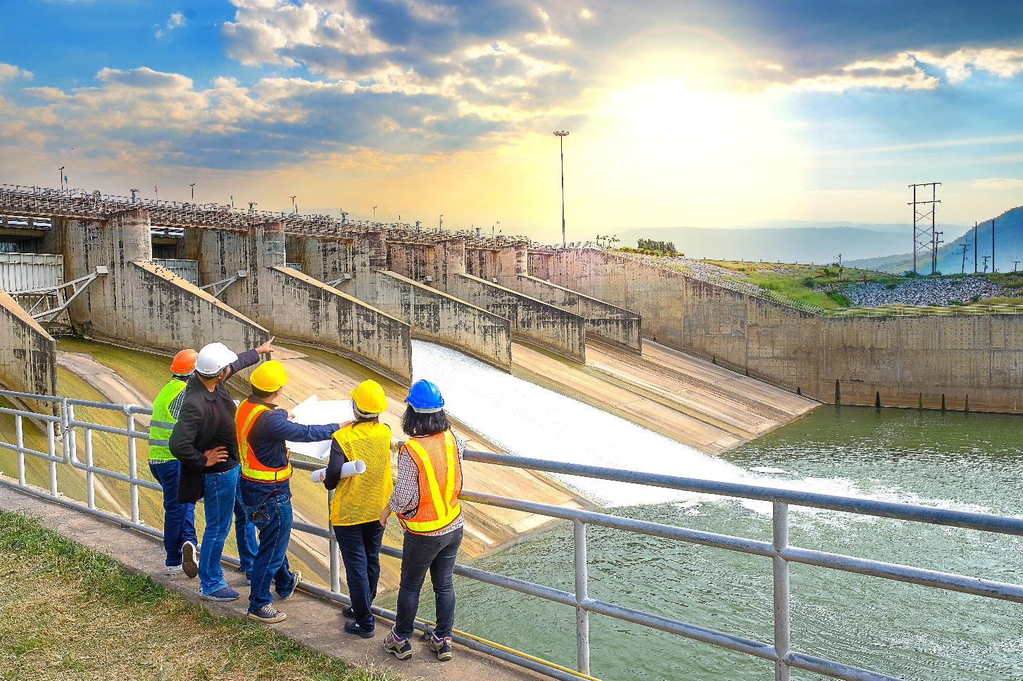
Task 1 - Explore
Notes:
Task 1 (10 minutes)
Have some children act out (mime) the different energy jobs and select others to guess what they are miming. Then repeat, swapping the children miming and guessing. 1
You could ask the children:
• What different jobs do people who work in energy have?
• Who works on power lines and energy stations in your community?
• What tools do these people use in their energy jobs?
• What types of unique vehicles do people use in energy?

Slide 5

Optional Video
You may wish to embed a relevant, age-appropriate video for your students here. See the Notes for an example.
Notes:
How does renewable energy work? Solar, Wind & Wave power Explained| LEGO learning
https://www.youtube.com/watch?v=8CwYGKV_3gw&t=24s

Slide 6
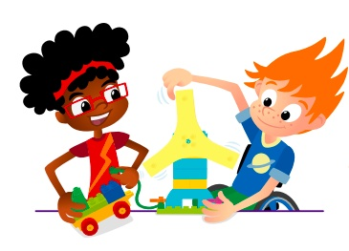
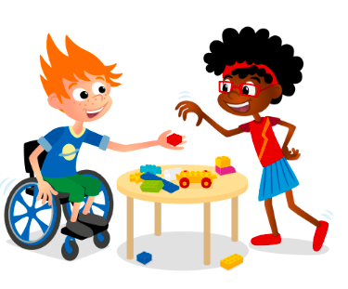
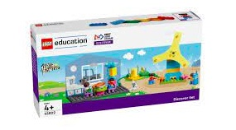
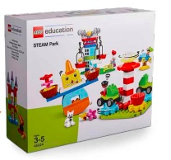
Task 2 - Create
Create the energy story for your community.
You Need..
Notes:
Task 2 (25 minutes)
Have each team create the energy story for their own community. Be sure they include where their energy comes from and how it is used in different ways.
They should include different energy connections including distribution and storage.
They should also include different people who work with energy.
The teams could use pieces from the Discover set and STEAM Park and the various LEGO® DUPLO® figures to represent different energy workers, their tools, and equipment.

Slide 7
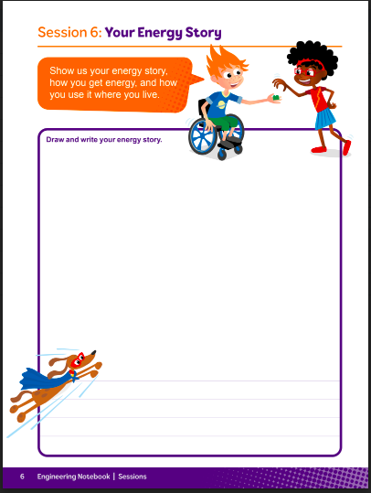
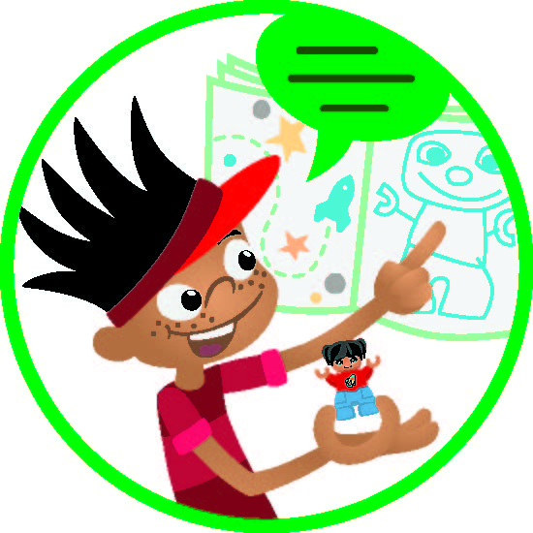
Task 3 - Share
Notes:
Task 3 (15 minutes)​
In their Engineering Notebooks, have the children write or draw a picture of a person in an energy job. They can also draw a picture of their energy story and label each part (source, distribution, storage, user).

Slide 8
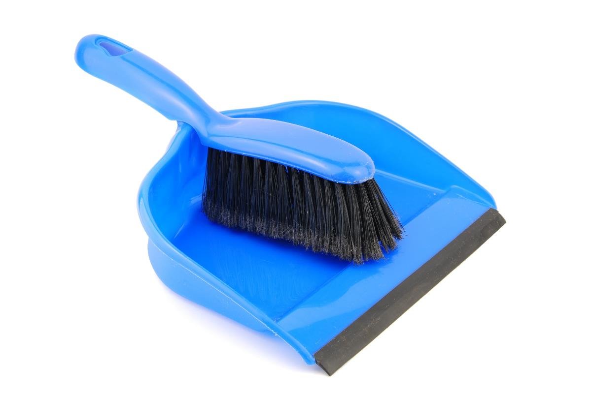
Clean Up
Notes:
You may wish to play a video or song during clean up time Link on GoNoodle: https://family.gonoodle.com/activities/clean-up. Link on YouTube Kids: https://www.youtubekids.com/watch?v=ZJFk87ZsHn0 . Link on Youtube: https://youtu.be/ZJFk87ZsHn0

Slide 9


LEGO, the LEGO logo, DUPLO and the DUPLO logo are trademarks of the/sont des marques de commerce du/ son marcas registradas de LEGO Group. ©2022 The LEGO Group. All rights reserved/ Tous droits réservés/ Todos los derechos reservados. FIRST®, the FIRST® logo, and FIRST ENERGIZESM are trademarks of For Inspiration and Recognition of Science and Technology (FIRST). LEGO® is a registered trademark of the LEGO Group. FIRST® LEGO® League and SUPERPOWEREDSM are jointly held trademarks of FIRST and the LEGO Group. ©2022 FIRST and the LEGO Group. All rights reserved.

