Slide 1


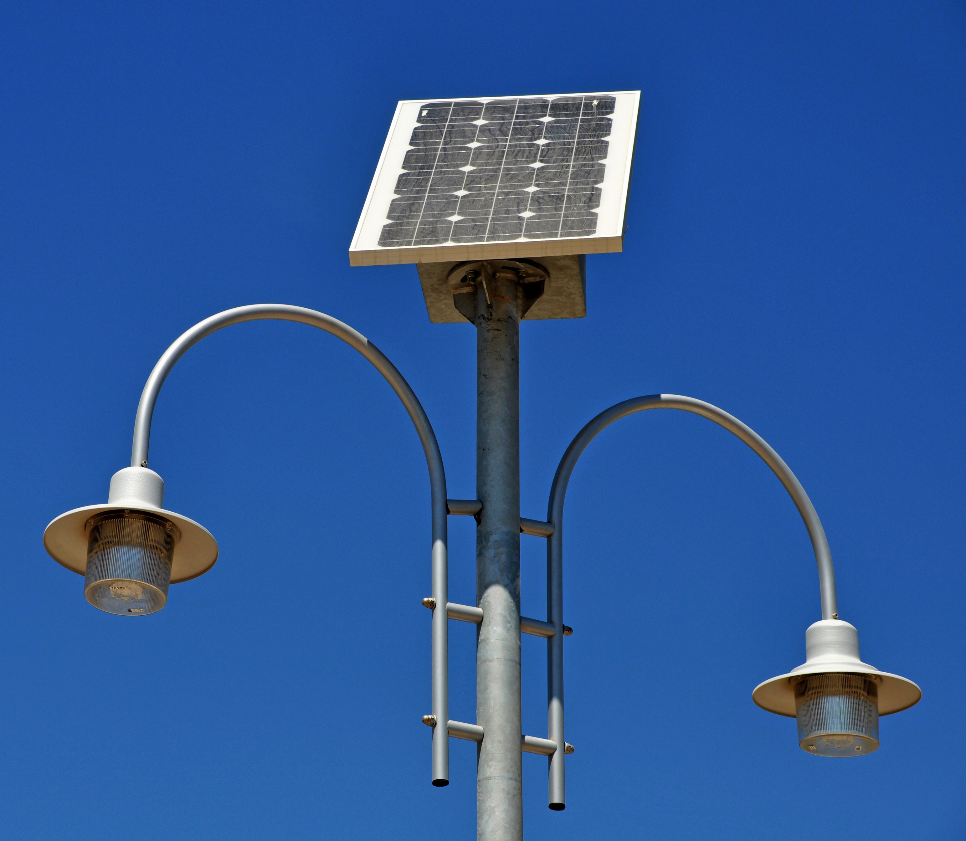

SESSION 8
Future Energy

Slide 2

Big Question
How can you create a better energy future by combining everyone’s ideas?
Outcomes
The teams will apply
knowledge and
experience from the
previous sessions to
solve a problem.
The teams will work
together to combine
ideas to create a
cohesive solution.
Notes:
Each session has a Big Question that can be shared to frame the session.​

Slide 3
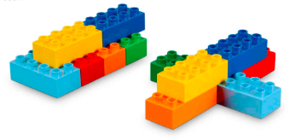
Six Bricks - Warm-Up
Notes:
Six Bricks Warm-Up (10 minutes)​
Future Car
Base Activity​
1. Children use their six bricks to build a vehicle of the future that uses energy in a better way.
2. Then they take turns describing how their vehicle. They can explain what kind of energy it uses and where you get energy.
3. Then have them explain why the energy they chose is better.
Guiding Questions:
• What type of energy does your vehicle use?
• How does your vehicle move?
• Where will energy come from in the future?
• Do you have any questions to ask your friends about their model?

Slide 4
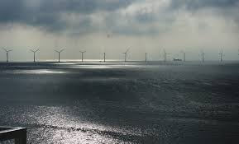
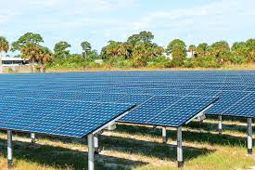
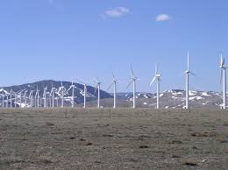
Task 1 - Explore
Notes:
Task 1 (10 minutes)
Have a discussion about these questions and the future of energy. The children could think about their community and what future energy needs they will have. Examples could include using more renewable energy or using energy more efficiently.
You could ask the children:
• How could you make future use of energy better?
• How have they worked together previously to combine ideas?
• What happens if we run out of fossil fuels in the future?

Slide 5

Optional Video
You may wish to embed a relevant, age-appropriate video for your students here. See the Notes for an example.
Notes:
Top 10 Energy Sources of the Future
https://www.youtube.com/watch?v=uStFvcz9Or4

Slide 6
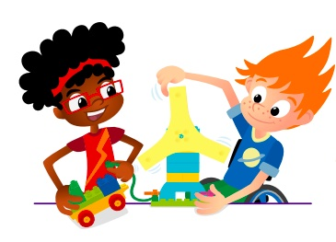
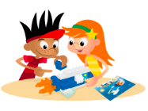
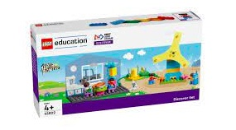
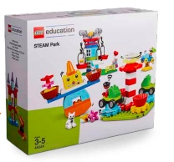
Task 2 - Create
Build your new and improved energy story including source, distribution, storage and consumer.
You Need..
Notes:
Before building, have teams decide who will build each part of their future community. They will then build the whole future energy story including source, distribution, storage, and consumer.
Once everyone has built their part, encourage teams to look at each part that has been built and what it does. They should find creative ways to connect each part together. They can iterate on their designs to combine each other’s builds.

Slide 7
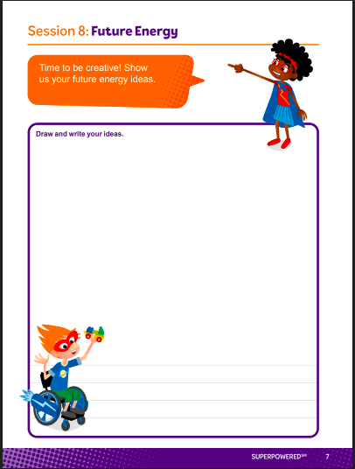
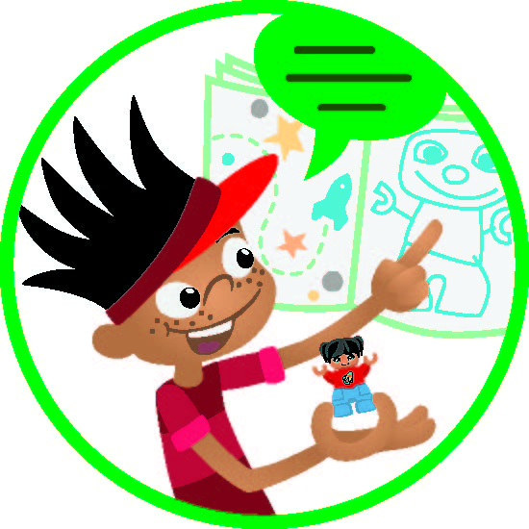
Task 3 - Share
Notes:
Task 3 (15 minutes)​
In their Engineering Notebooks, have the children write or draw their future community. Ask them to explain how they combined their ideas to create the ultimate solution.

Slide 8
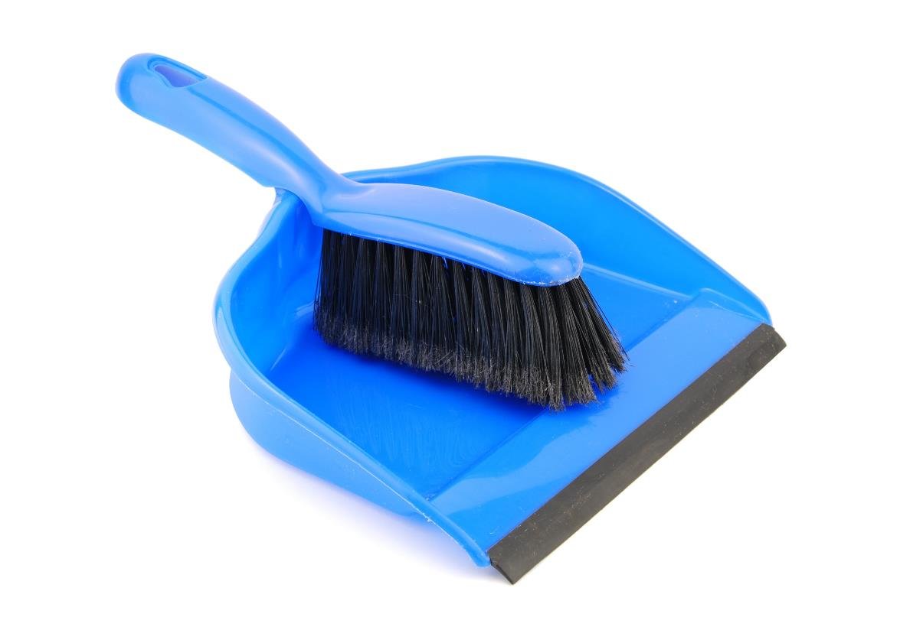
Clean Up
Notes:
You may wish to play a video or song during clean up time Link on GoNoodle: https://family.gonoodle.com/activities/clean-up. Link on YouTube Kids: https://www.youtubekids.com/watch?v=ZJFk87ZsHn0 . Link on Youtube: https://youtu.be/ZJFk87ZsHn0

Slide 9

LEGO, the LEGO logo, DUPLO and the DUPLO logo are trademarks of the/sont des marques de commerce du/ son marcas registradas de LEGO Group. ©2022 The LEGO Group. All rights reserved/ Tous droits réservés/ Todos los derechos reservados. FIRST®, the FIRST® logo, and FIRST ENERGIZESM are trademarks of For Inspiration and Recognition of Science and Technology (FIRST). LEGO® is a registered trademark of the LEGO Group. FIRST® LEGO® League and SUPERPOWEREDSM are jointly held trademarks of FIRST and the LEGO Group. ©2022 FIRST and the LEGO Group. All rights reserved.

