Slide 1


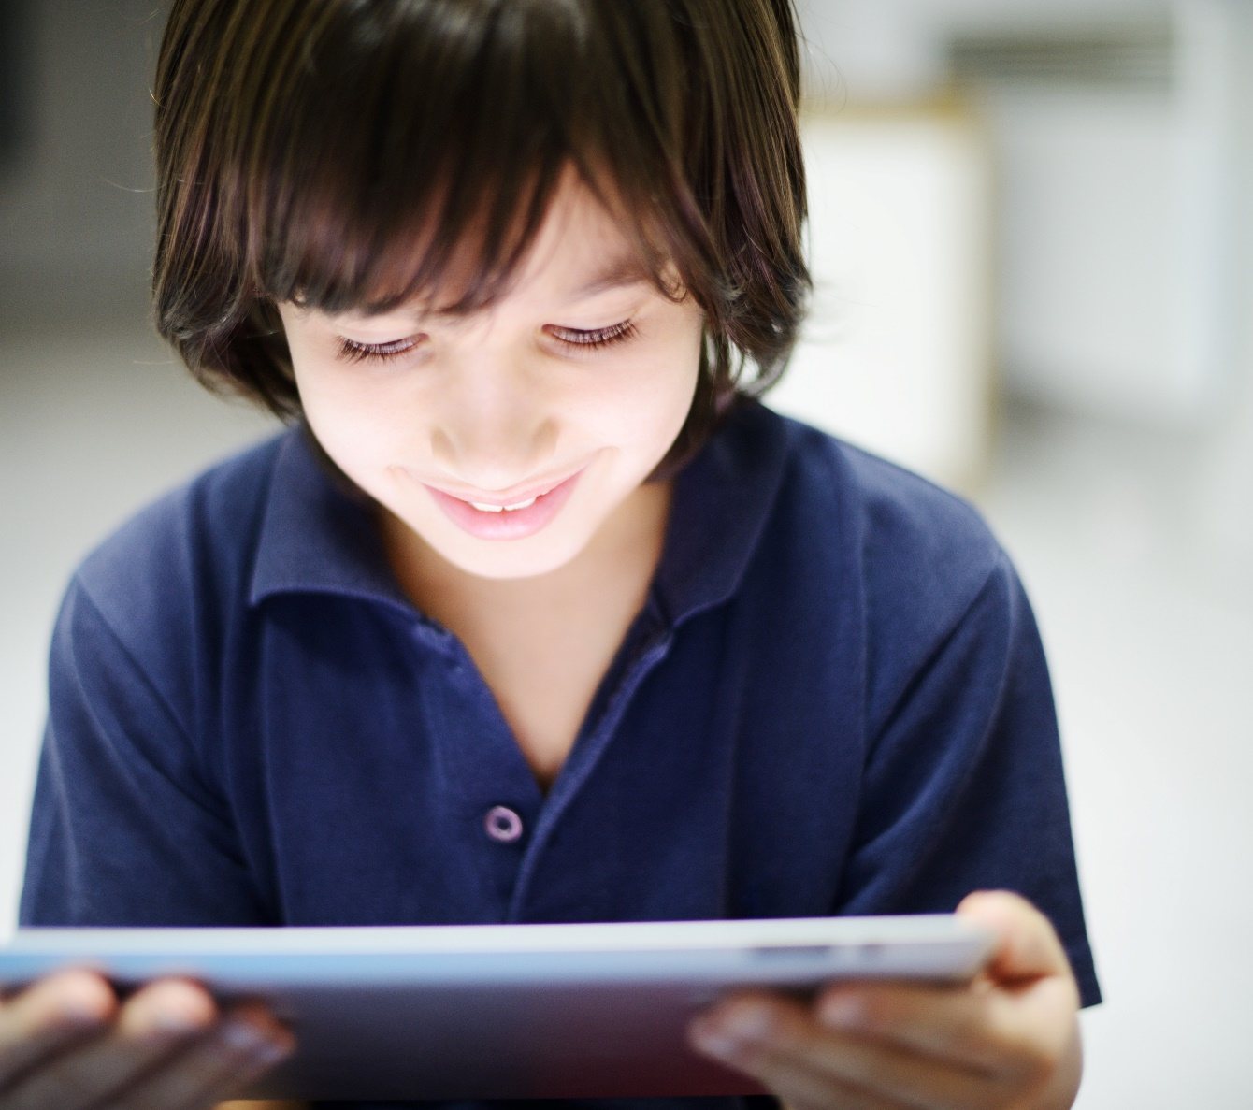

SESSION 9
Improve Energy Story

Slide 2
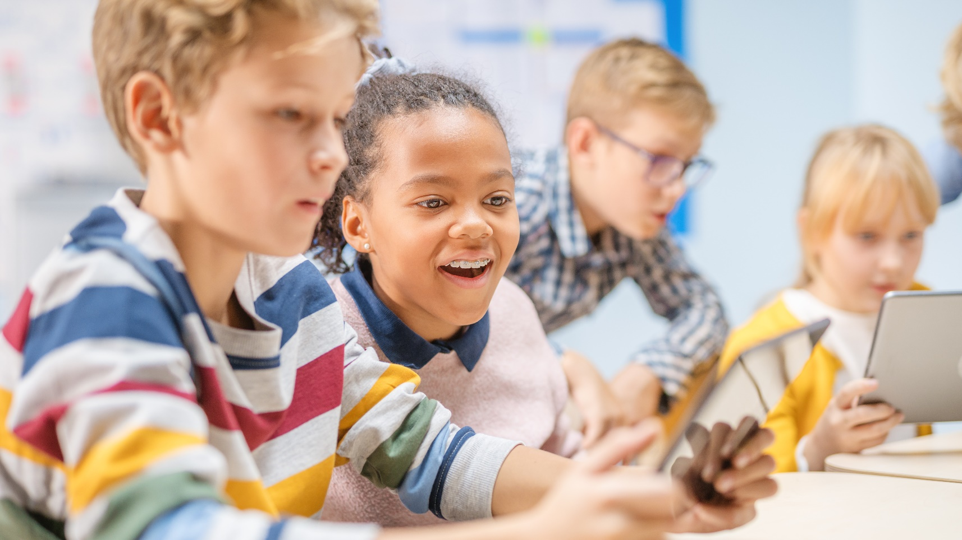
Big Question
How do we improve the energy story of our community?
Outcomes
Teams will reflect on
their experiences
throughout the
sessions.
Teams will build their
improved solution
to their community’s
energy story.
Notes:
Each session has a Big Question that can be shared to frame the session.​

Slide 3
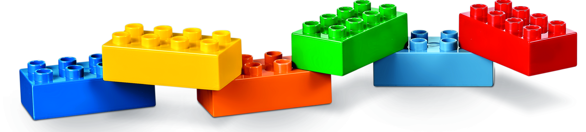
Six Bricks - Warm-Up
Notes:
Six Bricks Warm-Up (10 minutes)​
Along the Wire
Base Activity​
1. In groups of four, have the children mix their bricks together.
2. The children should work together to build a long line of connected blocks to represent a wire that transmits energy.
3. The children should think about where the energy starts and how it will travel to the end of the line.
4. Allow the group to think about how to explain their design and how energy travels along the wire.
Guiding Questions:
• How can you show movement of energy in your wire?
• How can you present how energy flows along the wire to others?
• What provides the energy at the start of your wire (source)?
• What will use the energy at the end of the wire (energy user)?
• What would happen if there was a break in the wire?

Slide 4
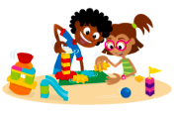
Task 1 - Explore
Notes:
Task 1 (10 minutes)​
Ask the children to reflect on their experiences throughout the sessions.
Leave time for them to tell their improved energy story and to make sure everyone says something.
You could ask the children to:
• How can they improve the energy story of their community?
• Reflect on their solutions from previous sessions. How could they iterate and improve on their previous ideas?
• How could they make better energy choices?

Slide 5

Optional Video
You may wish to embed a relevant, age-appropriate video for your students here. See the Notes for an example.
Notes:
Different Sources of Energy, Using Energy Responsibly, Educational Video for Kids
https://www.youtube.com/watch?v=wMOpMka6PJI

Slide 6
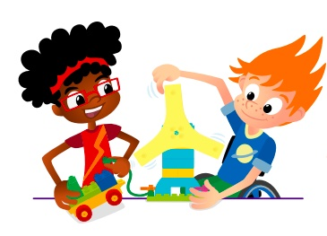
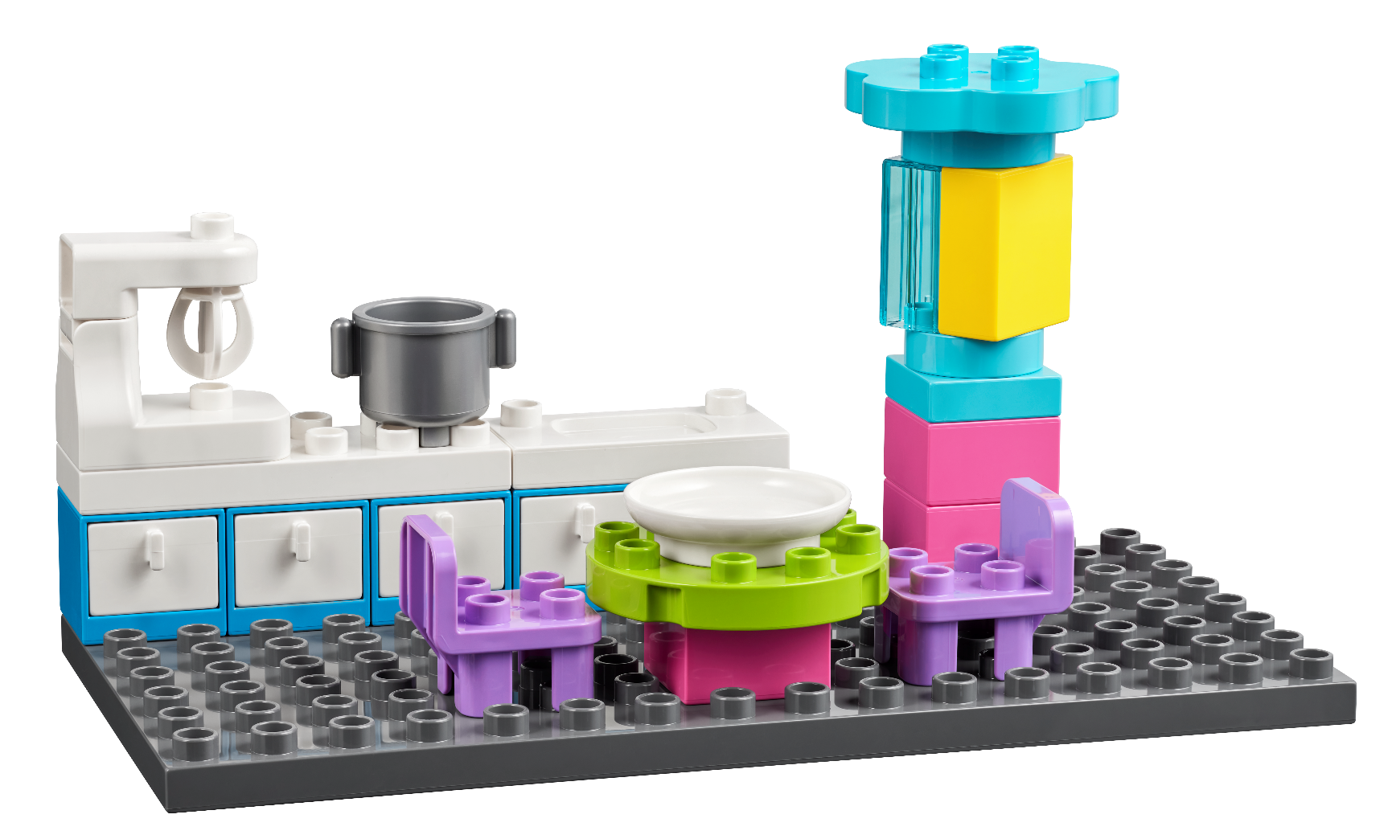
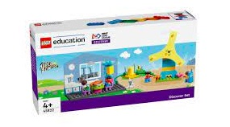
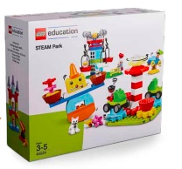
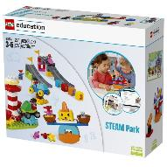
Task 2 - Create
Work as a team to build the new and improved energy story.
You Need..
Notes:
Task 2 (25 minutes)
Tell the teams they will build on and improve their ideas and solutions from previous sessions. The teams can use pieces from the Discover set and STEAM Park.
They could think about the different people in their town and what energy needs they have. Have them discuss who will say what about their solution in Task 3.

Slide 7
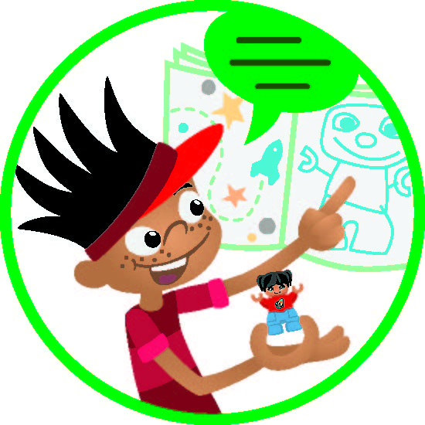
Task 3 - Share
Share what you built.
How did you combine your ideas to create your final solution?
How did you work together?
Notes:
Task 3 (15 minutes)​
Have the children share what they have built with the whole class.
Have them explain how they improved their community’s energy story. Have teams reflect on which ideas they chose, why, and how they worked together in this session.

Slide 8
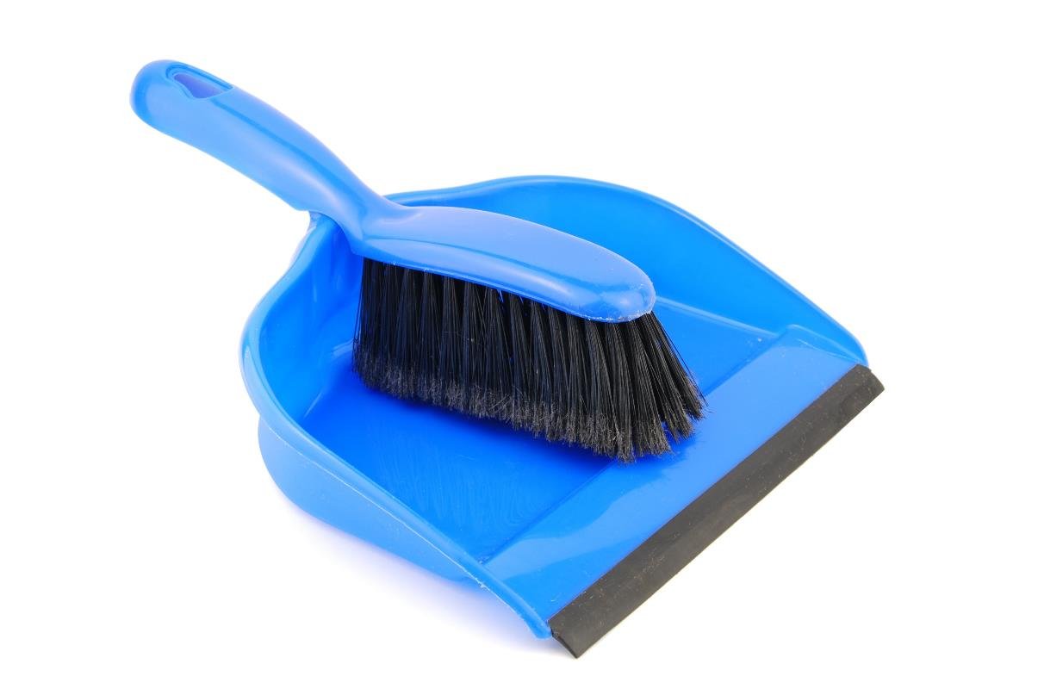
Clean Up
Notes:
You may wish to play a video or song during clean up time Link on GoNoodle: https://family.gonoodle.com/activities/clean-up. Link on YouTube Kids: https://www.youtubekids.com/watch?v=ZJFk87ZsHn0 . Link on Youtube: https://youtu.be/ZJFk87ZsHn0

Slide 9


LEGO, the LEGO logo, DUPLO and the DUPLO logo are trademarks of the/sont des marques de commerce du/ son marcas registradas de LEGO Group. ©2022 The LEGO Group. All rights reserved/ Tous droits réservés/ Todos los derechos reservados. FIRST®, the FIRST® logo, and FIRST ENERGIZESM are trademarks of For Inspiration and Recognition of Science and Technology (FIRST). LEGO® is a registered trademark of the LEGO Group. FIRST® LEGO® League and SUPERPOWEREDSM are jointly held trademarks of FIRST and the LEGO Group. ©2022 FIRST and the LEGO Group. All rights reserved.

