Slide 1
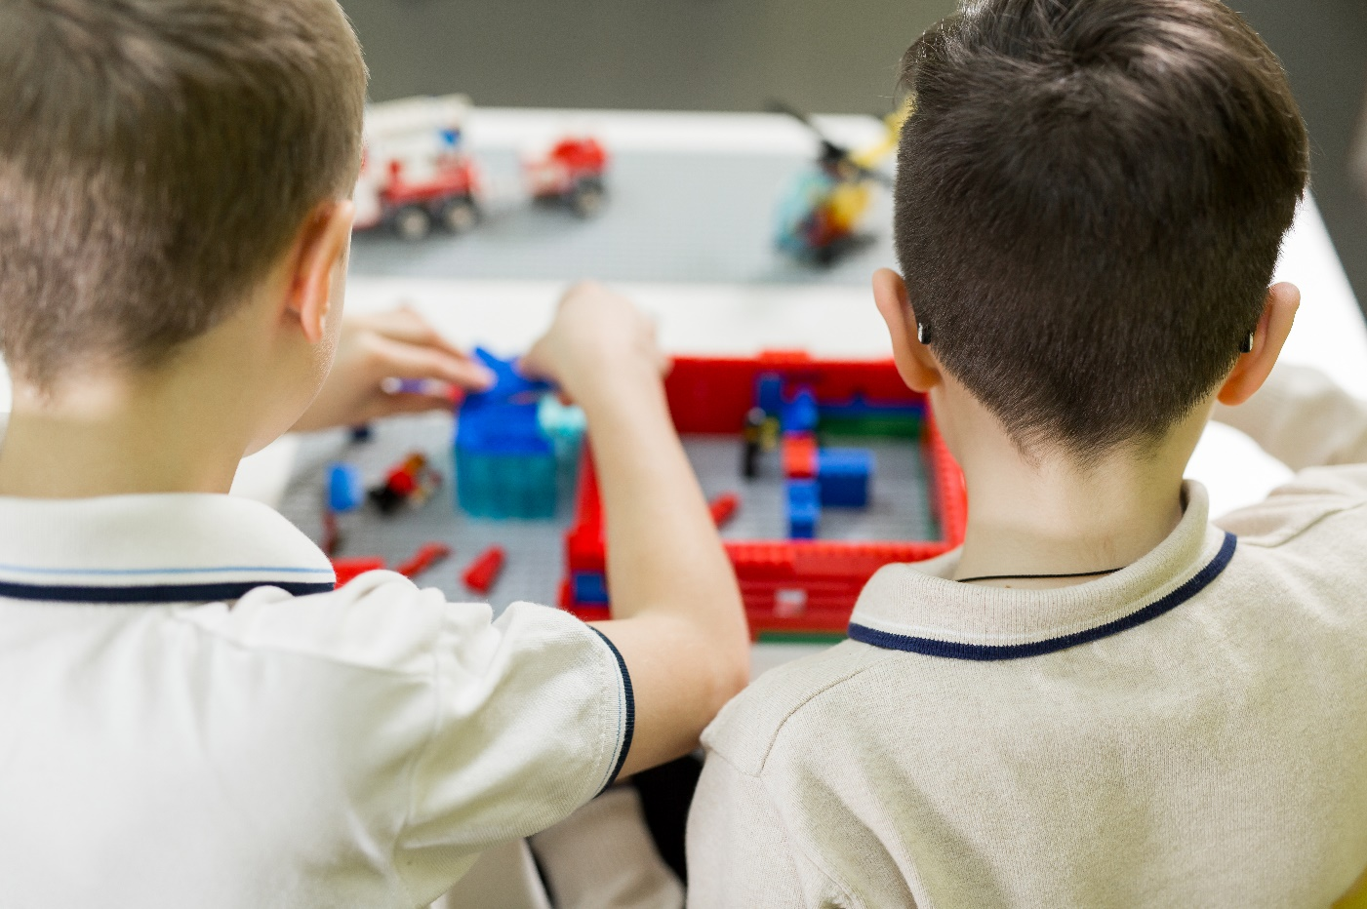



SESSIONS 8 & 9
Build a Team Model

Slide 2
Guiding Questions
How will you plan out your design for your team model?
What do you think is the most important part of your team model?
Outcomes
The team will draw their team model design and label its required parts.
The team will create a team model of a better energy journey for their community.
How will your team model show a better energy journey for your community?
What are the strengths and weaknesses of your design?
How can you motorize part of your team model?
How does your team model show you created a better energy journey?
Notes:
Each session has Guiding Questions that can be shared to frame the session.
Session Tips
The team will need all three parts of their Explore model and mat.
Each team member could build a part of the team model (source, storage, distribution, consumption) using a baseplate.
The team model can use extra LEGO® bricks, minifigures, base plates, and other LEGO elements. You may NOT use glue, paint, or art supplies.
The team model should be able to fit on a table and be easily transportable.
The team will apply coding concepts throughout the sessions to create their programs.
The team should incorporate all parts of the Explore model as well as the explore mat.
​

Slide 3

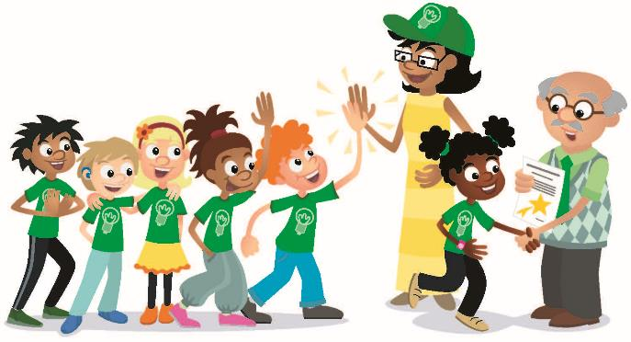
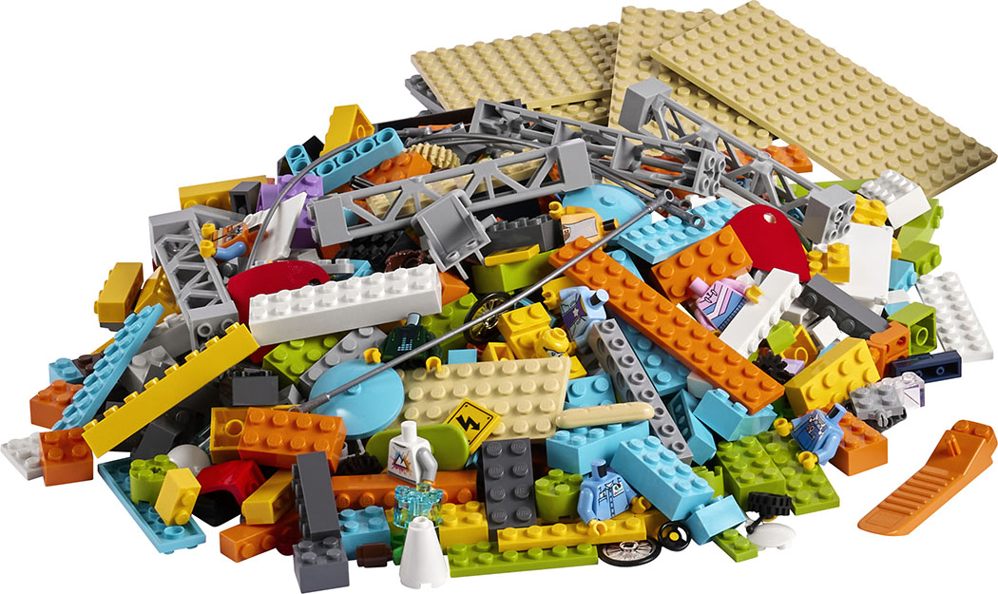
Introduction – Teamwork Build
Session 8
Examples of Teamwork
Ask the students to provide examples of Teamwork and record them here
Example of Teamwork
Example of Teamwork
We found we were stronger when we worked together.
Notes:
***Skip this slide during session 9***
Introduction
Teamwork and Fun Builds
(10 minutes)
Have the team provide examples of how they have used teamwork (Session 8) and fun (Session 9) throughout the sessions.
Have the team create a build from the prototyping pieces representing this Core Value or examples of the team using teamwork and fun.

Slide 4

Introduction – Fun Build
Session 9
Examples of Fun
Ask the students to provide examples of Fun and record them here
Example of Fun
Example of Fun
We enjoyed and celebrated what we did!
Notes:
***Skip this slide during session 8***
Introduction
Teamwork and Fun Builds
(10 minutes)
Have the team provide examples of how they have used teamwork (Session 8) and fun (Session 9) throughout the sessions.
Have the team create a build from the prototyping pieces representing this Core Value or examples of the team using teamwork and fun.

Slide 5


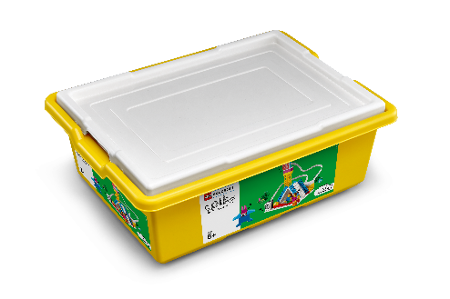

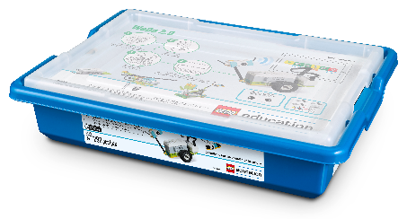
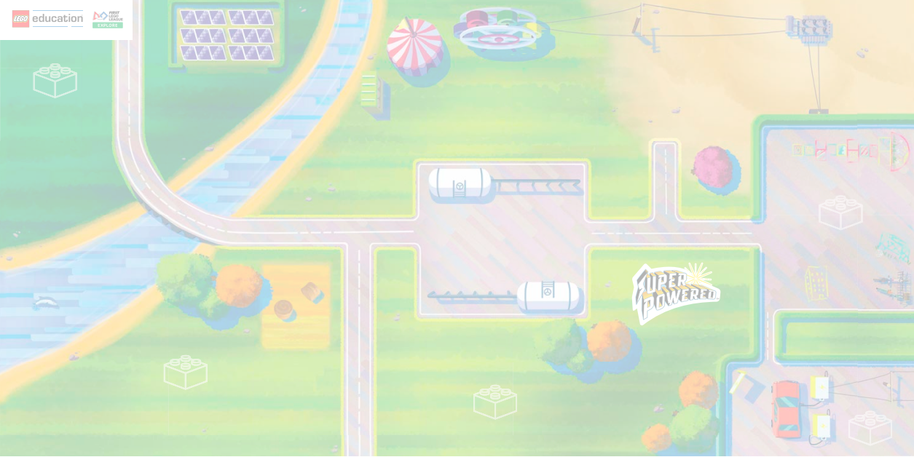
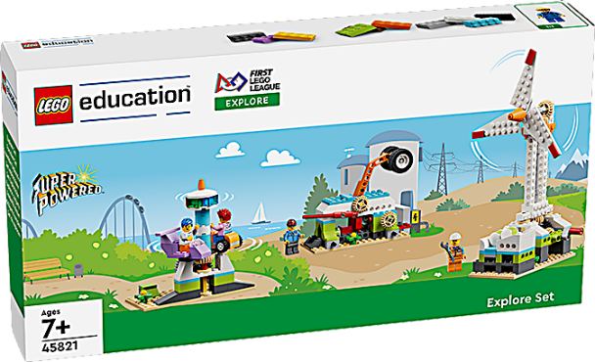
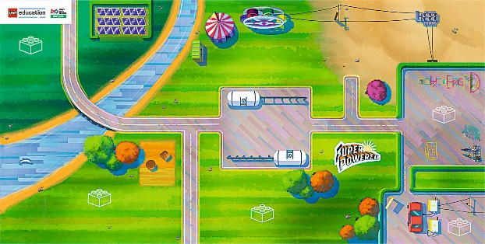
Tasks
Your energy choices can make a difference!
You need…
Build a team model to show a better energy journey for your community.
Notes:
Tasks (100 minutes)
Think about how you can make a better energy journey for your community.
Brainstorm your solutions.
Explore the list of required parts on the next page.
Draw your team model design and label the required parts.
Create your team model together. Use the mat and build the different parts of your energy journey.

Slide 6
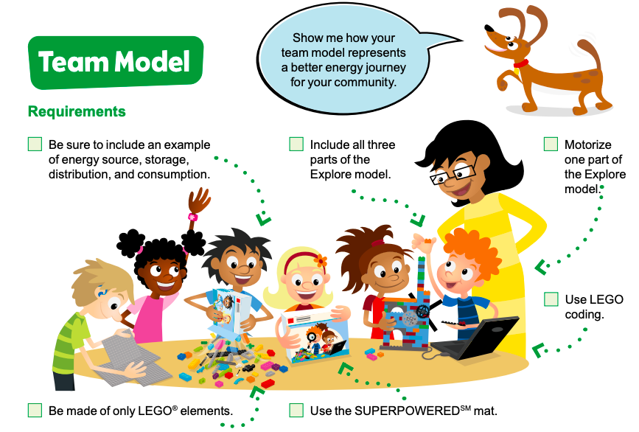
Tasks
Notes:
Tasks (100 minutes)
Think about how you can make a better energy journey for your community.
Brainstorm your solutions.
Explore the list of required parts on the next page.
Draw your team model design and label the required parts.
Create your team model together. Use the mat and build the different parts of your energy journey.

Slide 7
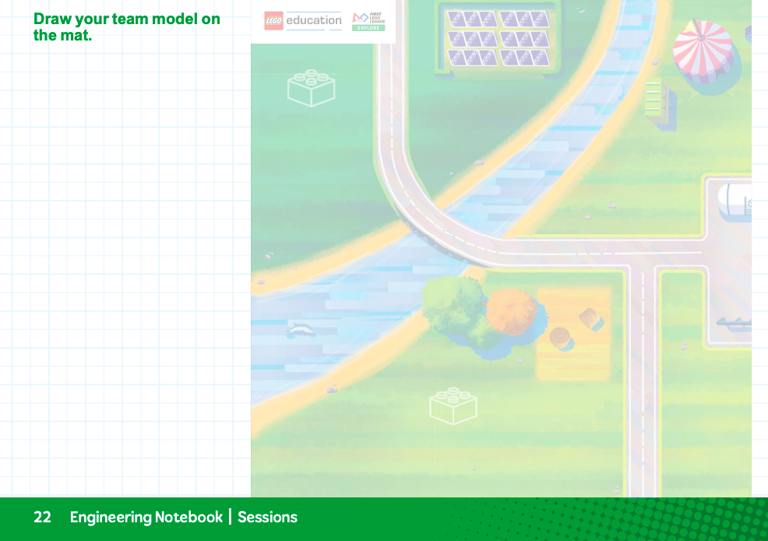
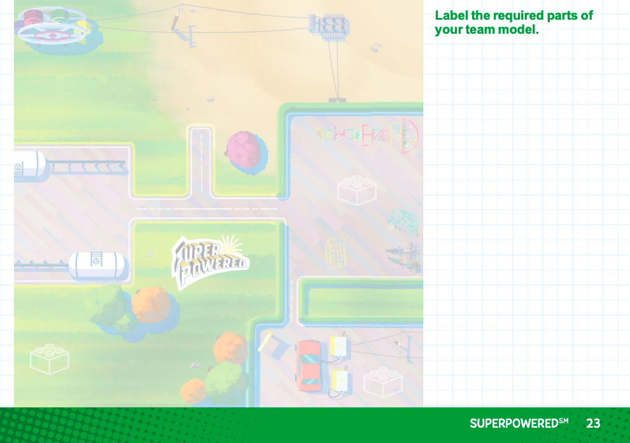
Tasks
Use these two pages to draw your team model design:
Label the required parts of your team model.
Notes:
Tasks (100 minutes)
Think about how you can make a better energy journey for your community.
Brainstorm your solutions.
Explore the list of required parts on the next page.
Draw your team model design and label the required parts.
Create your team model together. Use the mat and build the different parts of your energy journey.

Slide 8
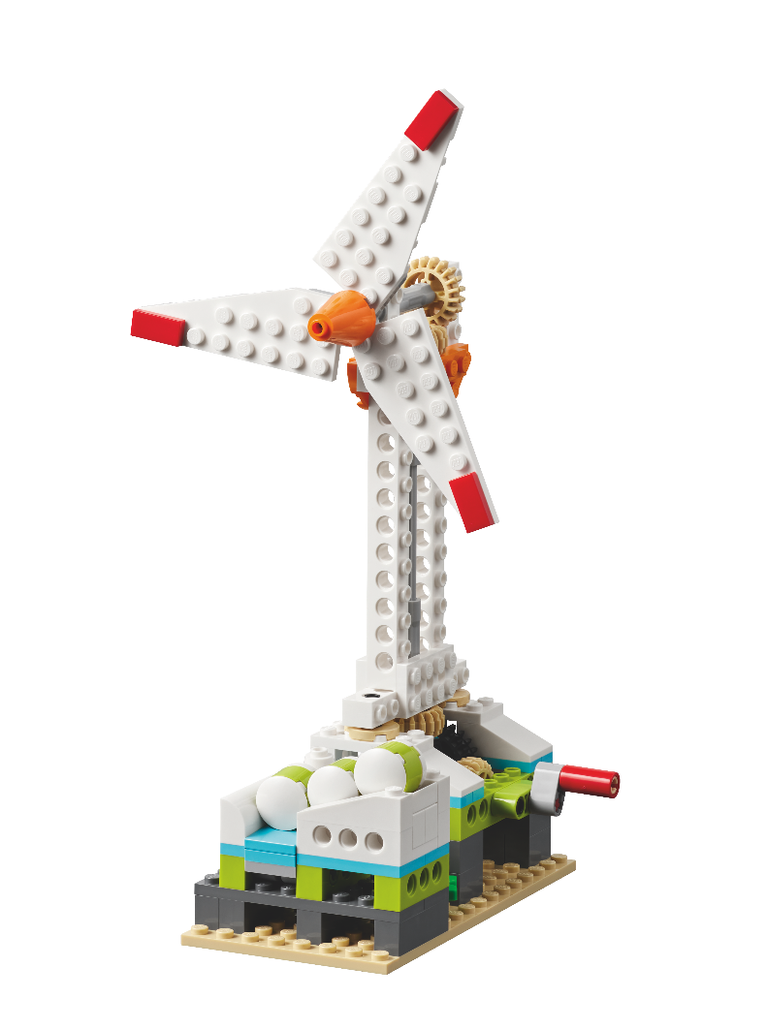
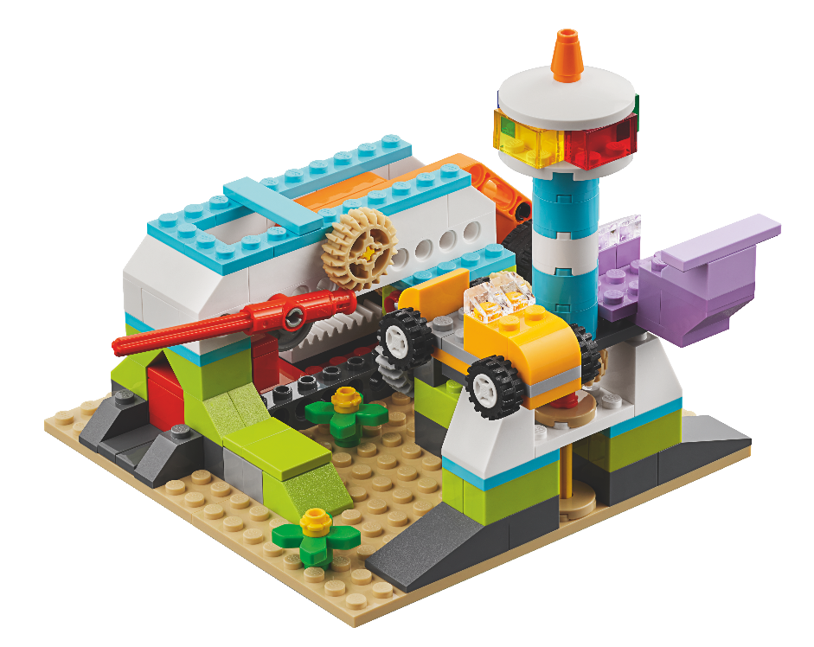
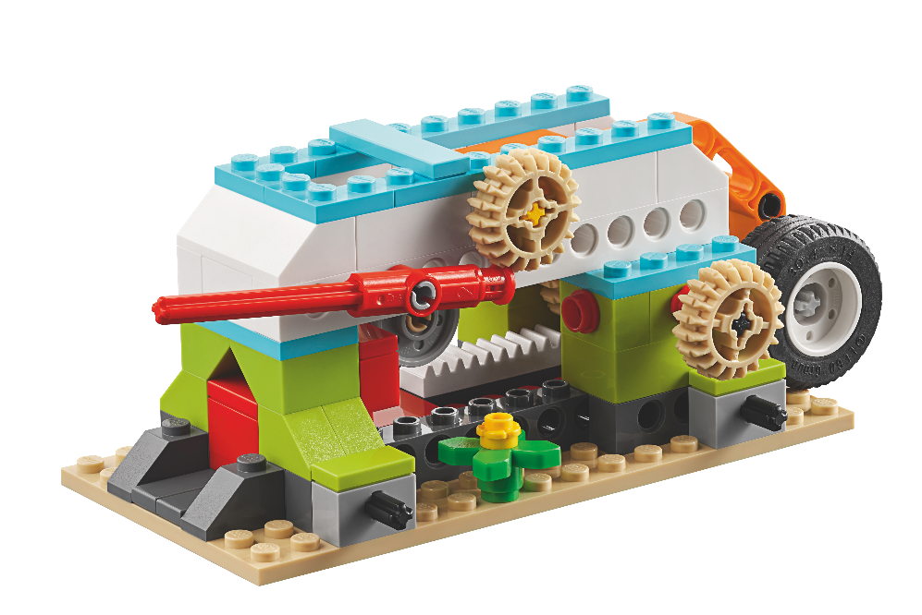

Tasks
Make a plan! Create your team model together.
Notes:
Tasks (100 minutes)
Think about how you can make a better energy journey for your community.
Brainstorm your solutions.
Explore the list of required parts on the next page.
Draw your team model design and label the required parts.
Create your team model together. Use the mat and build the different parts of your energy journey.

Slide 9
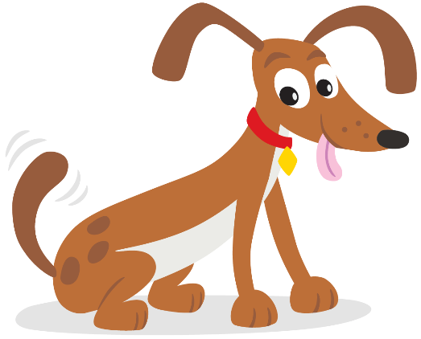
Share
Share what you did in the session.
Explain the program and how it motorizes either the wind turbine or the carousel.
Review the list of required parts and identify them on the team model.
Demonstrate how the team model works.
What have you discovered? Share with your team!
Notes:
Share (10 minutes)
Have the team:
• Share what they did in the session.
• Explain the program and how it motorizes either the wind turbine or the carousel.
• Review the list of required parts and identify them on the team model.
• Demonstrate how the team model works.

Slide 10

Optional Video:
You may wish to embed a relevant, age-appropriate video for your students here. See the Notes for an example.
Notes:
Choose a relevant, age-appropriate video for your students.
Here is one example from NBC News Learn on what is innovation: https://www.youtube.com/watch?v=EYU5VrO5wn4&feature=youtu.be

Slide 11
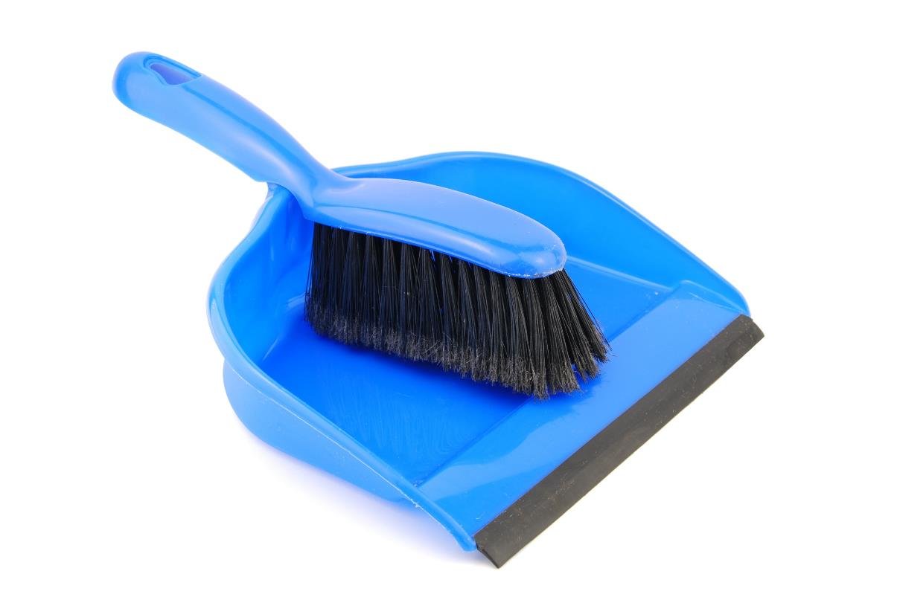
Clean Up
Notes:
You may wish to play a video or song during clean up time Link on GoNoodle: https://family.gonoodle.com/activities/clean-up. Link on YouTube Kids: https://www.youtubekids.com/watch?v=ZJFk87ZsHn0 . Link on Youtube: https://youtu.be/ZJFk87ZsHn0
Cleanup Pointers
• The team model will remain assembled from this point forward until the event.
• Check that any unused pieces from the LEGO coding set are returned to it.

Slide 12

LEGO, the LEGO logo and the SPIKE logo are trademarks of the/sont des marques de commerce du/son marcas registradas de LEGO Group. ©2022 The LEGO Group. All rights reserved/Tous droits réservés/Todos los derechos reservados. FIRST®, the FIRST® logo, and FIRST® ENERGIZESM are registered trademarks of For Inspiration and Recognition of Science and Technology (FIRST). LEGO® is a registered trademark of the LEGO Group. FIRST® LEGO® League and SUPERPOWEREDSM are jointly held trademarks of FIRST and the LEGO Group. ©2022 FIRST and the LEGO Group. All rights reserved.

