Slide 1
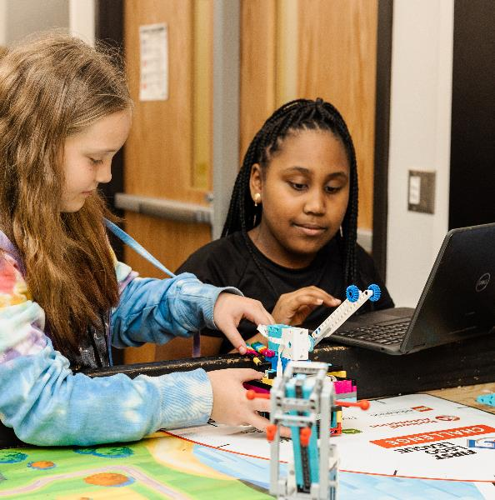
Session 5
Investigate Ideas
Notes:
Facilitator Tips - Team-building activities are great for teams to develop, use their Core Values, and learn how to work together.
Session 5 Tips =
The team should be able to describe what everyone’s strong points are and why they like working with them.
If the team is sharing one robot, they can code on individual devices and then take turns running their programs on the robot.
The provided program for the guided mission will not only solve the Theater Scene Change mission but will also be helpful to use on other missions.
Remind the team to test program changes in small steps instead of changing the entire program at once.
If an attachment is needed for a mission, keep it in a plastic bag labeled with the mission number.

Slide 2

Session Overview
Outcomes
The team will apply coding principles to the guided mission.
The team will research solutions and identify their innovation project problem to solve. (Revisit page 6 of the Engineering Notebook.)
Notes:
Facilitator Tips - Team-building activities are great for teams to develop, use their Core Values, and learn how to work together.
Session 5 Tips =
The team should be able to describe what everyone’s strong points are and why they like working with them.
If the team is sharing one robot, they can code on individual devices and then take turns running their programs on the robot.
The provided program for the guided mission will not only solve the Theater Scene Change mission but will also be helpful to use on other missions.
Remind the team to test program changes in small steps instead of changing the entire program at once.
If an attachment is needed for a mission, keep it in a plastic bag labeled with the mission number.

Slide 3
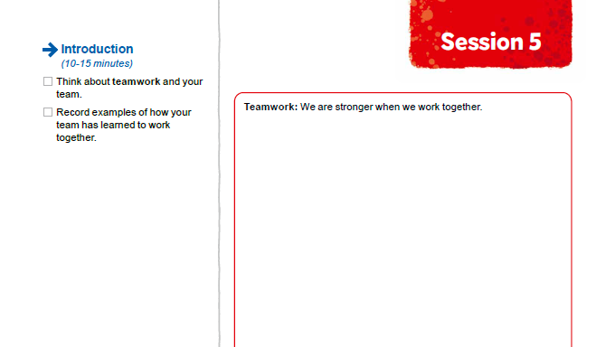


Introduction
Think about teamwork and your team.
Record examples of how your team has learned to work together.
Notes:
Introduction (10-15 minutes)
Facilitator Tips -
The team should be able to describe what everyone’s strong points are and why they like working with them.
If the team is sharing one robot, they can code on individual devices and then take turns running their programs on the robot.
The provided program for the guided mission will not only solve the Theater Scene Change mission but will also be helpful to use on other missions.
Remind the team to test program changes in small steps instead of changing the entire program at once.
If an attachment is needed for a mission, keep it in a plastic bag labeled with the mission number.

Slide 4
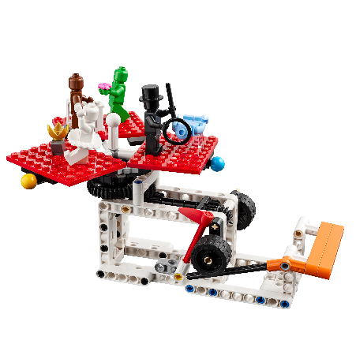

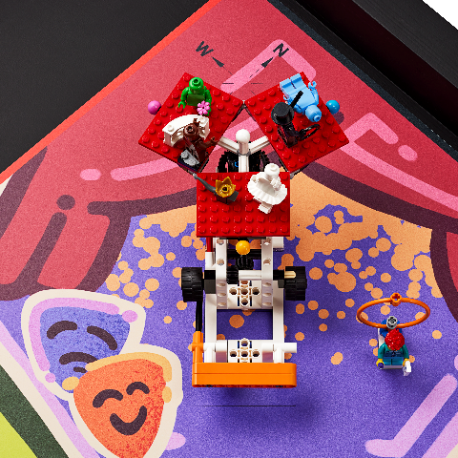
Guided Mission
Open the SPIKE™ Prime app. Find your lesson.
Read over the guided mission.
Have fun practicing this guided mission until it works perfectly!
Notes:
Team Tasks (100-120 minutes) – The Guided Mission 2023-24 – https://education.lego.com/en-us/lessons/prime-competition-ready
URL for SPIKE on-line: https://spike.legoeducation.com (remember to use a Chrome browser)
Facilitator Tips -
The team should be able to describe what everyone’s strong points are and why they like working with them.
If the team is sharing one robot, they can code on individual devices and then take turns running their programs on the robot.
The provided program for the guided mission will not only solve the Theater Scene Change mission but will also be helpful to use on other missions.
Remind the team to test program changes in small steps instead of changing the entire program at once.
If an attachment is needed for a mission, keep it in a plastic bag labeled with the mission number.

Slide 5
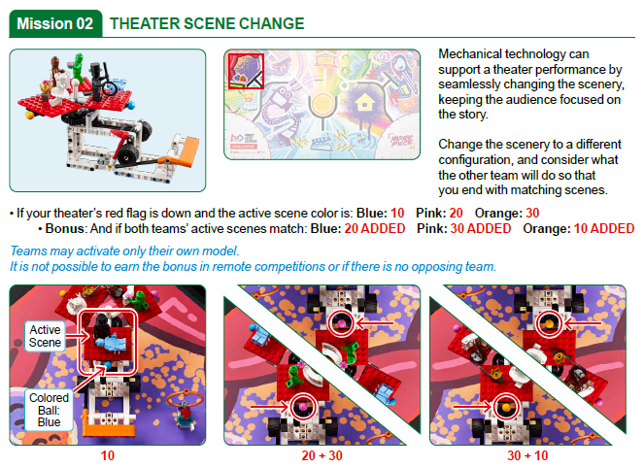
Notes:
Team Tasks (100-120 minutes) – The Guided Mission 2023-24 – https://education.lego.com/en-us/lessons/prime-competition-ready
URL for SPIKE on-line: https://spike.legoeducation.com (remember to use a Chrome browser)
Facilitator Tips -
The team should be able to describe what everyone’s strong points are and why they like working with them.
If the team is sharing one robot, they can code on individual devices and then take turns running their programs on the robot.
The provided program for the guided mission will not only solve the Theater Scene Change mission but will also be helpful to use on other missions.
Remind the team to test program changes in small steps instead of changing the entire program at once.
If an attachment is needed for a mission, keep it in a plastic bag labeled with the mission number.

Slide 6
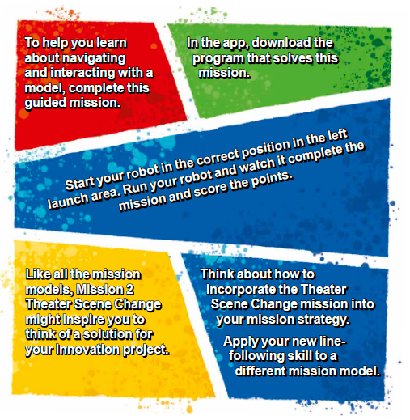
Guided Mission:
Mission 2 Theater Scene Change
Notes:
- To help you learn about navigating and interacting with a model, complete this guided mission.
- In the app, download the program that solves this mission.
- Start your robot in the correct position in the left launch area. Run your robot and watch it complete the mission and score the points.
- Like all the mission models, Mission 2 Theater Scene Change might inspire you to think of a solution for your innovation project.
- Think about how to incorporate the Theater Scene Change mission into your mission strategy. Apply your new line-following skill to a different mission model.

Slide 7

Guided Mission:
Mission 2 Theater Scene Change
Notes:
To help you learn about navigating and interacting with a model, complete this guided mission.

Slide 8

Guided Mission:
Mission 2 Theater Scene Change
Notes:
In the app, download the program that solves this mission.

Slide 9
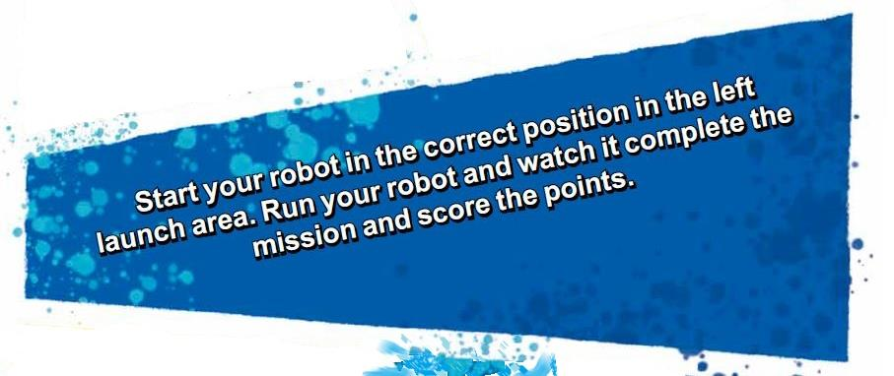
Guided Mission:
Mission 2 Theater Scene Change
Notes:
Start your robot in the correct position in the left launch area. Run your robot and watch it complete the mission and score the points.

Slide 10
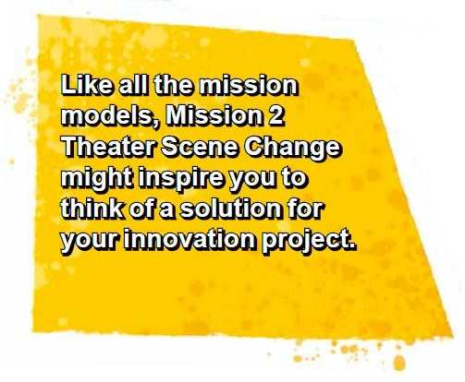

Guided Mission:
Mission 2 Theater Scene Change
Notes:
Like all the mission models, Mission 2 Theater Scene Change might inspire you to think of a solution for your innovation project.

Slide 11
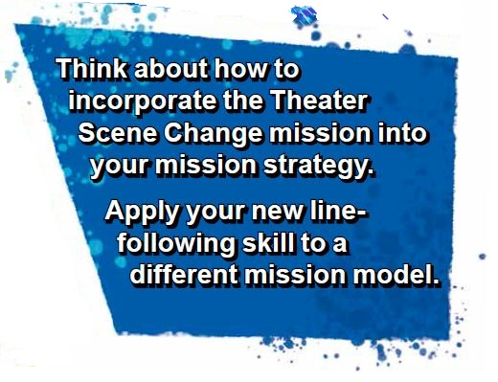
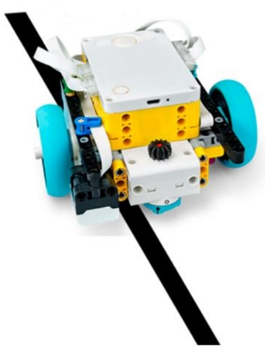
Guided Mission:
Mission 2 Theater Scene Change
Notes:
Think about how to incorporate the Theater Scene Change mission into your mission strategy.
Apply your new line-following skill to a different mission model.

Slide 12

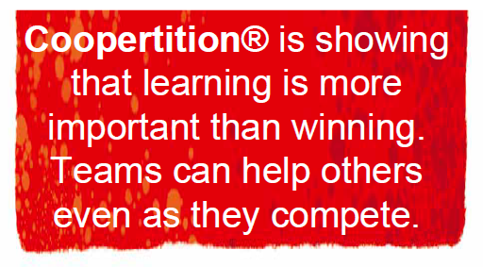
Reflection Questions
What does the guided mission show you about Coopertition®?
Can you change the program so that the mission works when you start the robot from the opposite launch area?
Notes:
Team Tasks (100-120 minutes)
Facilitator Tips -
The team should be able to describe what everyone’s strong points are and why they like working with them.
If the team is sharing one robot, they can code on individual devices and then take turns running their programs on the robot.
The provided program for the guided mission will not only solve the Theater Scene Change mission but will also be helpful to use on other missions.
Remind the team to test program changes in small steps instead of changing the entire program at once.
If an attachment is needed for a mission, keep it in a plastic bag labeled with the mission number.

Slide 13
Investigations
Revisit Sessions 1-4 to review the Project Sparks.
Think about the great solutions you have come up with in the previous sessions.
Notes:
Team Tasks (100-120 minutes)
Facilitator Tips
Encourage the team to record all problem ideas they have identified for the innovation project.
Project resource examples include the Internet, books, magazines, personal stories, user experiences, and experts (in person or virtual).
Each team member might not get their favorite problem chosen, but the team should choose something everyone supports.
The team can use a problem identified within one of the Project Sparks to develop their solution.
The team will write their final problem statement here. If they have multiple ideas, they could use a voting process to narrow it down to one.

Slide 14

Investigations
Research the Innovation Project and different problems you have identified.
Use this page to capture your research.
Notes:
Team Tasks (100-120 minutes)
Facilitator Tips
Encourage the team to record all problem ideas they have identified for the innovation project.
Project resource examples include the Internet, books, magazines, personal stories, user experiences, and experts (in person or virtual).
Each team member might not get their favorite problem chosen, but the team should choose something everyone supports.
The team can use a problem identified within one of the Project Sparks to develop their solution.
The team will write their final problem statement here. If they have multiple ideas, they could use a voting process to narrow it down to one.

Slide 15

Investigations
Identify the problem your team will solve and record your problem statement.
Notes:
Team Tasks (100-120 minutes)
Facilitator Tips
Encourage the team to record all problem ideas they have identified for the innovation project.
Project resource examples include the Internet, books, magazines, personal stories, user experiences, and experts (in person or virtual).
Each team member might not get their favorite problem chosen, but the team should choose something everyone supports.
The team can use a problem identified within one of the Project Sparks to develop their solution.
The team will write their final problem statement here. If they have multiple ideas, they could use a voting process to narrow it down to one.

Slide 16
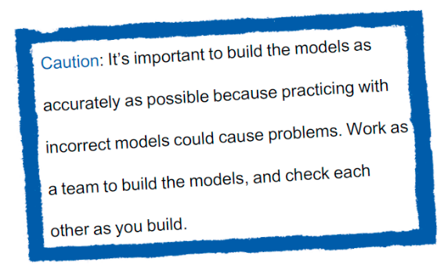

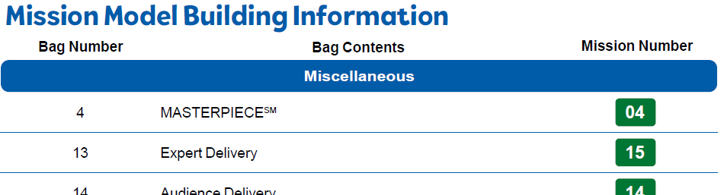
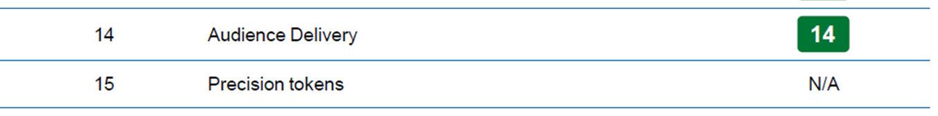
Miscellaneous Models
Build miscellaneous models in Bags 4,14, and 15.
Notes:
Team Tasks (100-120 minutes)
Have team members build miscellaneous models.

Slide 17

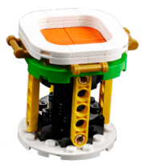
Miscellaneous Models
Identify the missions that relate to the models you built.
Notes:
Team Tasks (100-120 minutes)
Have team members build miscellaneous models.

Slide 18
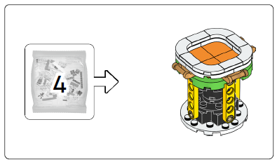
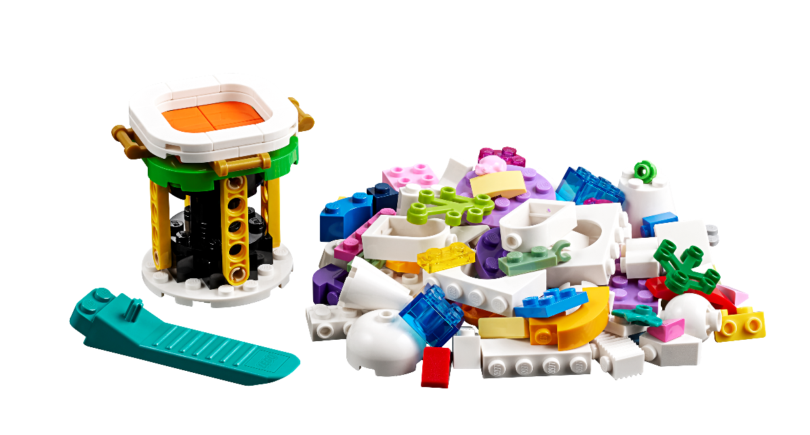
MASTERPIECE
? bags
Notes:
Team Tasks (100-120 minutes)
Have team members build miscellaneous models.

Slide 19
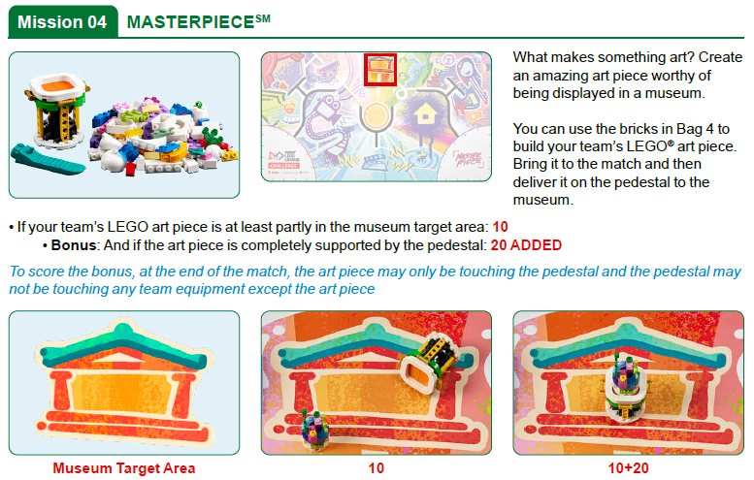
Notes:
Team Tasks (100-120 minutes)
Have team members build miscellaneous models.

Slide 20
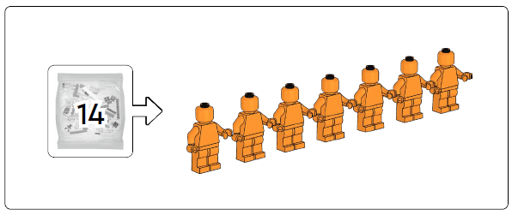

Audience Delivery
Notes:
Team Tasks (100-120 minutes)
Have team members build miscellaneous models.

Slide 21
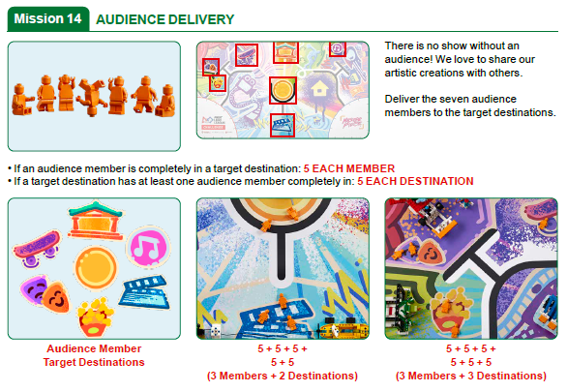
Notes:
Team Tasks (100-120 minutes)
Have team members build miscellaneous models.

Slide 22

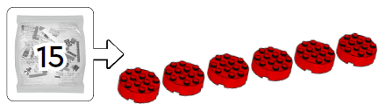

Precision Tokens
Notes:
Team Tasks (100-120 minutes)
Have team members build miscellaneous models.

Slide 23

Share
Get together at the mat.
Put each miscellaneous model where it belongs.
Show how your robot scores points on the guided mission.
Discuss the problem your team has identified and think about next steps.
Discuss the reflection questions.
Clean up your space.
Notes:
Share (10-15 minutes)
Note: Have team members put each miscellaneous model where it belongs.
Facilitator Tips
Encourage the team to record all problem ideas they have identified for the innovation project.
Project resource examples include the Internet, books, magazines, personal stories, user experiences, and experts (in person or virtual).
Each team member might not get their favorite problem chosen, but the team should choose something everyone supports.
The team can use a problem identified within one of the Project Sparks to develop their solution.
The team will write their final problem statement here. If they have multiple ideas, they could use a voting process to narrow it down to one.

Slide 24
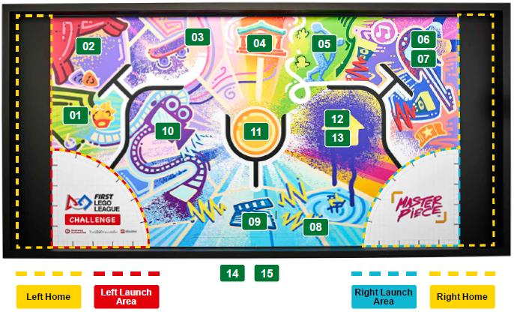
Models built this session are for the circled missions.
Notes:
Note: Have team members put each miscellaneous model where it belongs.
Facilitator Tips
Encourage the team to record all problem ideas they have identified for the innovation project.
Project resource examples include the Internet, books, magazines, personal stories, user experiences, and experts (in person or virtual).
Each team member might not get their favorite problem chosen, but the team should choose something everyone supports.
The team can use a problem identified within one of the Project Sparks to develop their solution.
The team will write their final problem statement here. If they have multiple ideas, they could use a voting process to narrow it down to one.

Slide 25
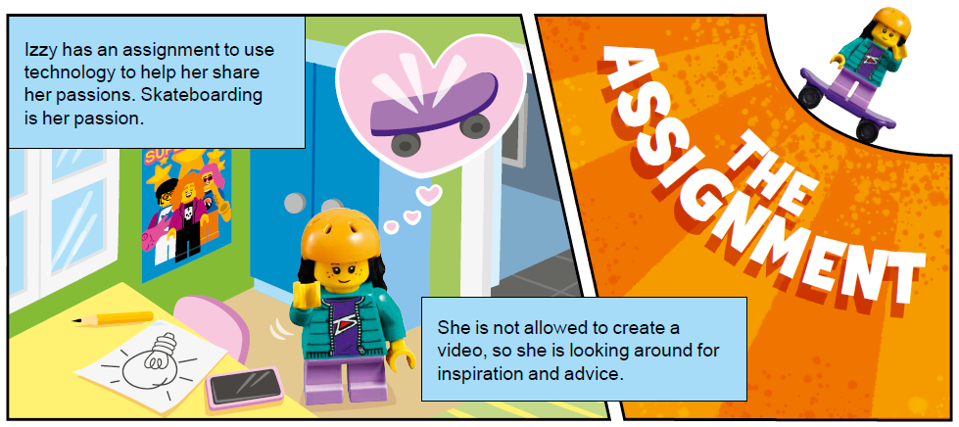
Reflection Questions
What problem did you decide to solve?
Is there an expert you can talk to about the problem?
Notes:
Facilitator Tips
Encourage the team to record all problem ideas they have identified for the innovation project.
Project resource examples include the Internet, books, magazines, personal stories, user experiences, and experts (in person or virtual).
Each team member might not get their favorite problem chosen, but the team should choose something everyone supports.
The team can use a problem identified within one of the Project Sparks to develop their solution.
The team will write their final problem statement here. If they have multiple ideas, they could use a voting process to narrow it down to one.

Slide 26

Multimedia Resources
You may wish to embed a relevant, age-appropriate video for your students here. See the Notes for an example.
Notes:
Choose a relevant, age-appropriate video for your students.
Example: How to Pick a Project Topic and Conduct Research (40:10)

Slide 27

Clean Up
Notes:
Allow time for cleanup and place any unfinished models and their pieces in a sealed plastic bag.
Clean Up Pointers
You may wish to play a video or song during clean up time Link on
GoNoodle: https://family.gonoodle.com/activities/clean-up
Link on YouTube Kids: https://www.youtubekids.com/watch?v=ZJFk87ZsHn0
Link on Youtube: https://youtu.be/ZJFk87ZsHn0

Slide 28


LEGO, the LEGO logo, the SPIKE logo, MINDSTORMS and the MINDSTORMS logo are trademarks of the LEGO Group. ©2023 The LEGO Group. All rights reserved. FIRST®, the FIRST® logo, Coopertition®, Gracious Professionalism®, and FIRST IN SHOWSM, are trademarks of For Inspiration and Recognition of Science and Technology (FIRST). LEGO® is a registered trademark of the LEGO Group. FIRST® LEGO® League and MASTERPIECESM are jointly held trademarks of FIRST and the LEGO Group. All other trademarks are the property of their respective owners. ©2023 FIRST and the LEGO Group. All rights reserved.

