Slide 1
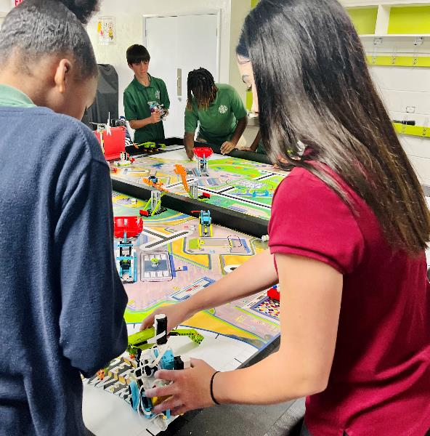
Session 7
Create Solutions
Notes:
Facilitator Tips - By embracing the Core Values, the team learns that friendly competition and mutual gain are not separate goals and that helping one another is the foundation of teamwork.
Session 7 Tips =
Check the team knows the Core Values and understands what Gracious Professionalism® is.
Different members of the team can be responsible for specific missions and develop and own the robot run for those missions.
When the team has a base robot, do a straight drive test. If it doesn’t go straight, look at the robot’s center of gravity and balance.
Have the team determine which launch area will be the starting position and make sure there is enough room for the whole robot to fit inside the launch area.
Encourage the students to explain the program as the robot moves.

Slide 2

Session Overview
Outcomes
The team will create their innovation project solution and complete the Innovation Project Planning page.
The team will design and iterate on their robot to complete additional robot game missions.
Notes:
Facilitator Tips - By embracing the Core Values, the team learns that friendly competition and mutual gain are not separate goals and that helping one another is the foundation of teamwork.
Session 7 Tips =
Check the team knows the Core Values and understands what Gracious Professionalism® is.
Different members of the team can be responsible for specific missions and develop and own the robot run for those missions.
When the team has a base robot, do a straight drive test. If it doesn’t go straight, look at the robot’s center of gravity and balance.
Have the team determine which launch area will be the starting position and make sure there is enough room for the whole robot to fit inside the launch area.
Encourage the students to explain the program as the robot moves.

Slide 3
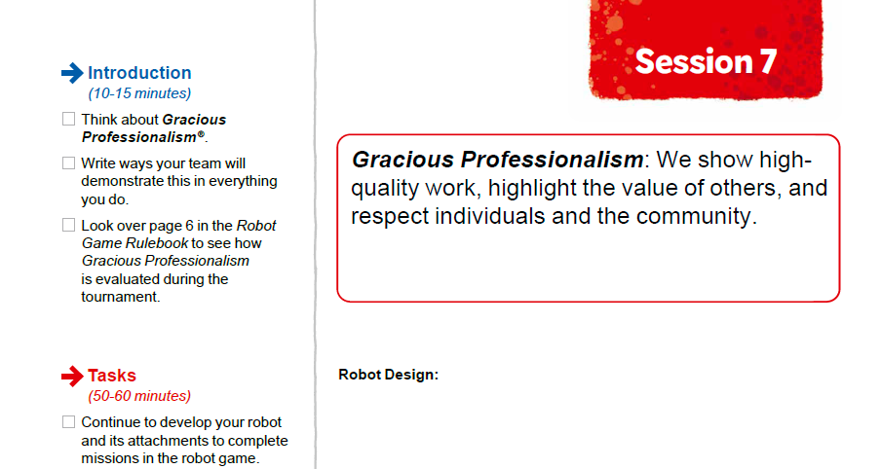

Introduction
Think about Gracious Professionalism®.
Write ways your team will demonstrate this in everything you do.
Notes:
Facilitator Tips -
Check the team knows the Core Values and understands what Gracious Professionalism® is.
Different members of the team can be responsible for specific missions and develop and own the robot run for those missions.
When the team has a base robot, do a straight drive test. If it doesn’t go straight, look at the robot’s center of gravity and balance.
Have the team determine which launch area will be the starting position and make sure there is enough room for the whole robot to fit inside the launch area.
Encourage the students to explain the program as the robot moves.

Slide 4
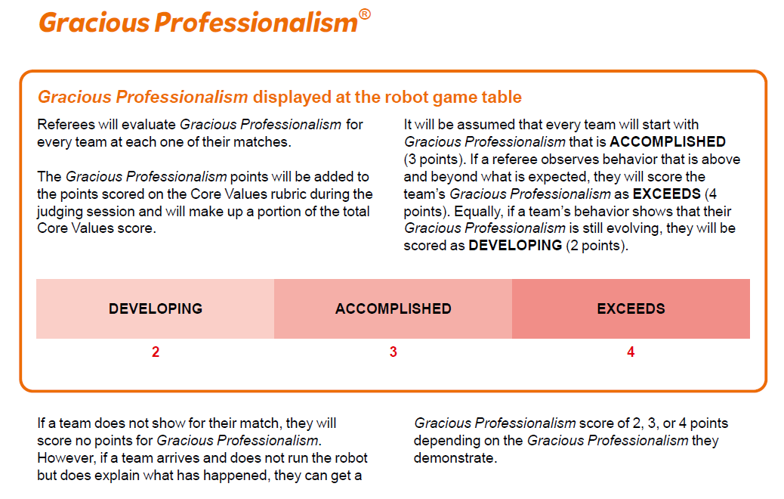
Introduction
Look over page 6 in the Robot Game Rulebook to see how Gracious Professionalism® is evaluated during the tournament.
Notes:
Facilitator Tips -
Check the team knows the Core Values and understands what Gracious Professionalism® is.
Different members of the team can be responsible for specific missions and develop and own the robot run for those missions.
When the team has a base robot, do a straight drive test. If it doesn’t go straight, look at the robot’s center of gravity and balance.
Have the team determine which launch area will be the starting position and make sure there is enough room for the whole robot to fit inside the launch area.
Encourage the students to explain the program as the robot moves.

Slide 5

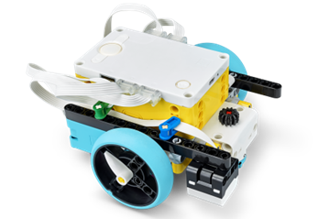
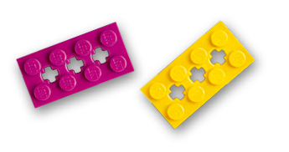
Solve Missions
Continue to develop your robot and its attachments to complete missions in the Robot Game.
You can improve the existing robot used in the previous sessions or create a new design.
Notes:
Team Tasks (100-120 minutes)
URL for SPIKE on-line: https://spike.legoeducation.com (remember to use a Chrome browser)
Facilitator Tips -
Check the team knows the Core Values and understands what Gracious Professionalism® is.
Different members of the team can be responsible for specific missions and develop and own the robot run for those missions.
When the team has a base robot, do a straight drive test. If it doesn’t go straight, look at the robot’s center of gravity and balance.
Have the team determine which launch area will be the starting position and make sure there is enough room for the whole robot to fit inside the launch area.
Encourage the students to explain the program as the robot moves.

Slide 6
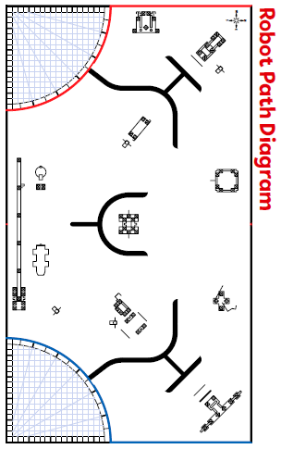
Solve Missions
Create a program for each new mission you attempt. You could combine mission solutions into one program.
Test and improve your robot and its programs.
Revisit previous lessons to develop your coding skills or work on solving the missions.
Notes:
Team Tasks (100-120 minutes)
Facilitator Tips -
Check the team knows the Core Values and understands what Gracious Professionalism® is.
Different members of the team can be responsible for specific missions and develop and own the robot run for those missions.
When the team has a base robot, do a straight drive test. If it doesn’t go straight, look at the robot’s center of gravity and balance.
Have the team determine which launch area will be the starting position and make sure there is enough room for the whole robot to fit inside the launch area.
Encourage the students to explain the program as the robot moves.

Slide 7


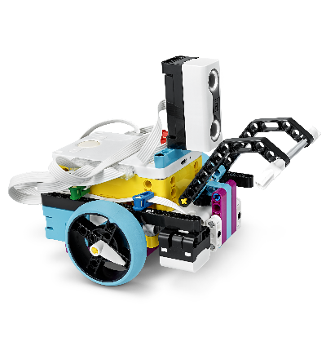
Reflection Questions
Can you follow how the program on your device is making your robot move?
How can you iterate and improve on the existing robot design used in previous sessions?
Notes:
Team Tasks (100-120 minutes)
Facilitator Tips -
Check the team knows the Core Values and understands what Gracious Professionalism® is.
Different members of the team can be responsible for specific missions and develop and own the robot run for those missions.
When the team has a base robot, do a straight drive test. If it doesn’t go straight, look at the robot’s center of gravity and balance.
Have the team determine which launch area will be the starting position and make sure there is enough room for the whole robot to fit inside the launch area.
Encourage the students to explain the program as the robot moves.

Slide 8
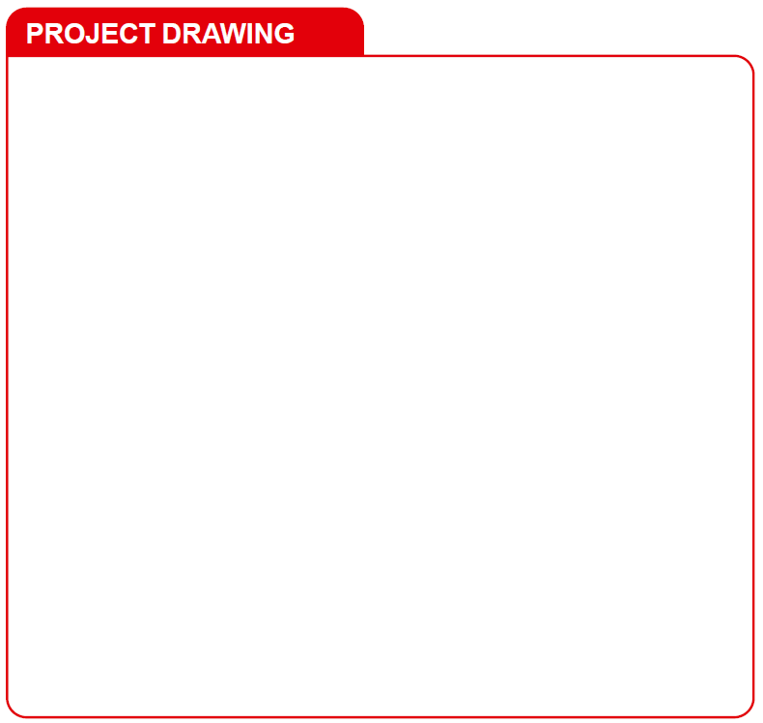
Develop Project Solution
Develop and create your Innovation Project solution.
Sketch your solution. Label the parts and how it will work.
Notes:
Team Tasks (100-120 minutes)
Facilitator Tips
Provide a variety of materials for the team to use to make a prototype of their project solution.
A drawing can include a detailed annotated sketch or a computer-aided design (CAD) drawing.
Have the team think of people (audience or experts) they would like to get feedback from on their solution.
Arrange a visit to look at examples in your community that can be a focus of the project.
Consider inviting an expert or user to this session to share content about their identified problem.

Slide 9

Develop Project Solution
Describe your solution and explain how it solves the problem.
Create a prototype, model, or drawing of your solution.
Document the process you use to develop your solution on page 23, Innovation Project Planning.
Notes:
Team Tasks (100-120 minutes)
Facilitator Tips
Provide a variety of materials for the team to use to make a prototype of their project solution.
A drawing can include a detailed annotated sketch or a computer-aided design (CAD) drawing.
Have the team think of people (audience or experts) they would like to get feedback from on their solution.
Arrange a visit to look at examples in your community that can be a focus of the project.
Consider inviting an expert or user to this session to share content about their identified problem.

Slide 10

Share
Get together at the mat.
Show any missions you are working on or have completed.
Discuss your research and your Innovation Project solution.
Discuss the reflection questions.
Clean up your space.
Notes:
Share (10-15 minutes)
Facilitator Tips
Provide a variety of materials for the team to use to make a prototype of their project solution.
A drawing can include a detailed annotated sketch or a computer-aided design (CAD) drawing.
Have the team think of people (audience or experts) they would like to get feedback from on their solution.
Arrange a visit to look at examples in your community that can be a focus of the project.
Consider inviting an expert or user to this session to share content about their identified problem.

Slide 11


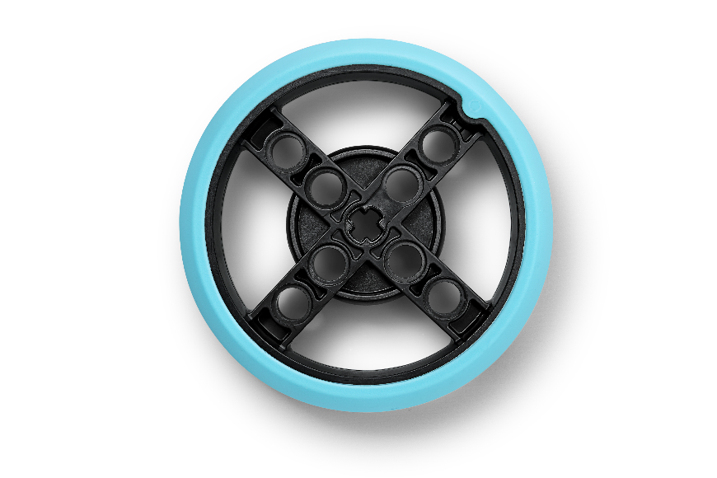
Reflection Questions
Can you describe your innovative solution in under five minutes?
How does your solution address your identified problem?
Notes:
Facilitator Tips
Provide a variety of materials for the team to use to make a prototype of their project solution.
A drawing can include a detailed annotated sketch or a computer-aided design (CAD) drawing.
Have the team think of people (audience or experts) they would like to get feedback from on their solution.
Arrange a visit to look at examples in your community that can be a focus of the project.
Consider inviting an expert or user to this session to share content about their identified problem

Slide 12

Multimedia Resources
You may wish to embed a relevant, age-appropriate video for your students here. See the Notes for an example.
Notes:
Choose a relevant, age-appropriate video for your students.
Example: Innovation Project for FIRST LEGO League: Create and Iterate your Prototype (13:46)

Slide 13

Clean Up
Notes:
Allow time for cleanup and place any unfinished models and their pieces in a sealed plastic bag.
Clean Up Pointers
You may wish to play a video or song during clean up time Link on
GoNoodle: https://family.gonoodle.com/activities/clean-up
Link on YouTube Kids: https://www.youtubekids.com/watch?v=ZJFk87ZsHn0
Link on Youtube: https://youtu.be/ZJFk87ZsHn0

Slide 14


LEGO, the LEGO logo, the SPIKE logo, MINDSTORMS and the MINDSTORMS logo are trademarks of the LEGO Group. ©2023 The LEGO Group. All rights reserved. FIRST®, the FIRST® logo, Coopertition®, Gracious Professionalism®, and FIRST IN SHOWSM, are trademarks of For Inspiration and Recognition of Science and Technology (FIRST). LEGO® is a registered trademark of the LEGO Group. FIRST® LEGO® League and MASTERPIECESM are jointly held trademarks of FIRST and the LEGO Group. All other trademarks are the property of their respective owners. ©2023 FIRST and the LEGO Group. All rights reserved.

