Slide 1
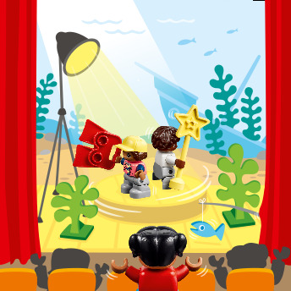
Session 4
Theater Show
Notes:
Session 4: Theater Show
Provide real-world examples, including photos and videos, when introducing the tasks. Set expectations for use of voice when sharing ideas. Expect productive talk, movement, and interactions between children. Circulate and redirect children to the task as needed.

Slide 2
Big Question
Can you create a play that tells an interesting story?​
Outcomes
Teams will identify items needed to put on a play.
The children will document their uses of technology or moving pieces in their Engineering Notebooks.
Notes:
Outcomes
Teams will identify items needed to put on a play.
The children will document their uses of technology or moving pieces in their Engineering Notebooks.
Facilitator Tip
Allow the children to be creative and use any elements that will help share an interesting story.
Each team can perform their story and talk about what they added to their stage.

Slide 3
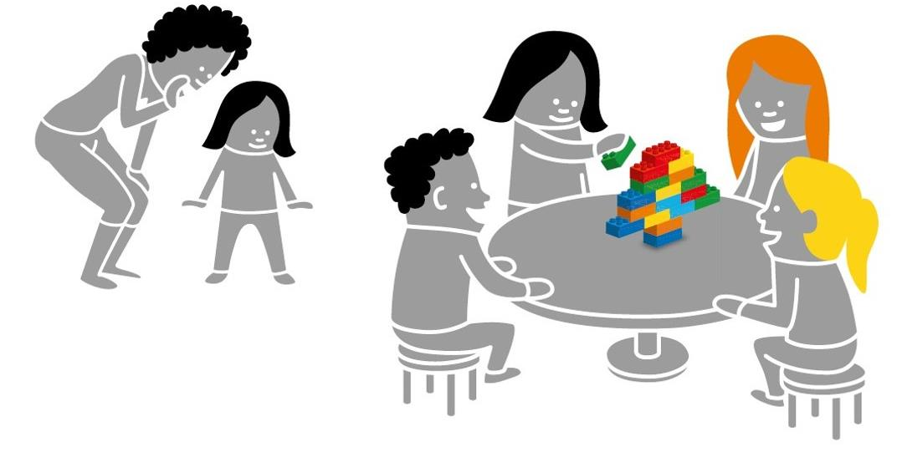
Warm-Up – Six Bricks
Notes:
Warm-Up: (10 minutes) Build The Picture
Base Activity
1. In groups of 4, children mix their bricks together and choose a leader.
2. The adult whispers a word related to a theater (e.g., stage, actor, light, speakers) to the leader.
3. Back with their group, the leader quickly builds a representation of that word for the others to guess.
4. The group may not ask questions but can call out words. The leader can say when they get it right.
Part 2
5. Choose a new leader and repeat the activity with a new word.
6. Continue until all children in the group have been a leader.
Guiding Questions:
• How did the first group figure out the word?
• What can you do to help the next leader of the group?

Slide 4
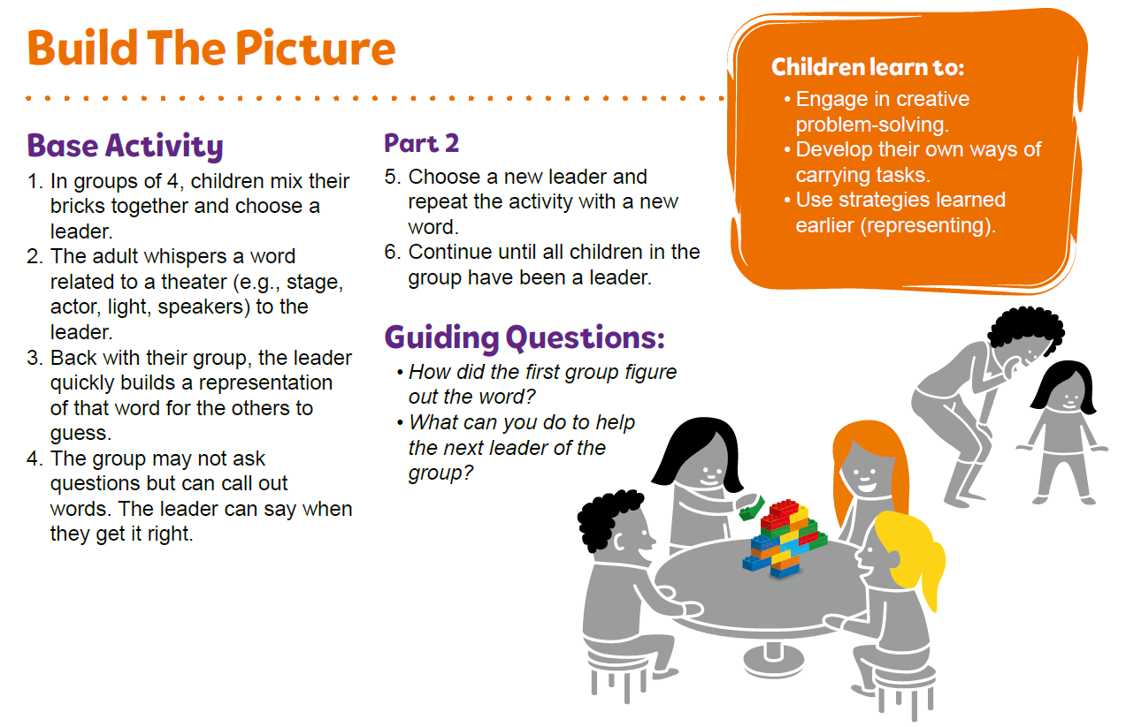
Warm-Up – Six Bricks
Notes:
Facilitator Tip – TMG Appendix (see page 26)

Slide 5
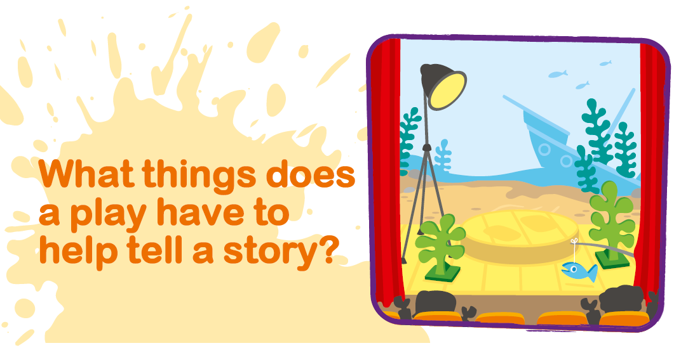
Explore Task
Notes:
Explore Task (1O minutes)
Have the children think about a time they have seen or have participated in a play in a theater. What things does a play have to help tell a story?
Locate the theater elements on the mat (i.e., masks, lights, speakers).
You could ask the teams to discuss some of the things below:
• The roles of actors and director
• The scenes and set pieces
• Effects (lighting, sound, special effects)
• Props (objects used by the actor in the story)

Slide 6
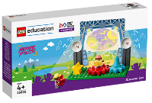
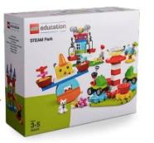
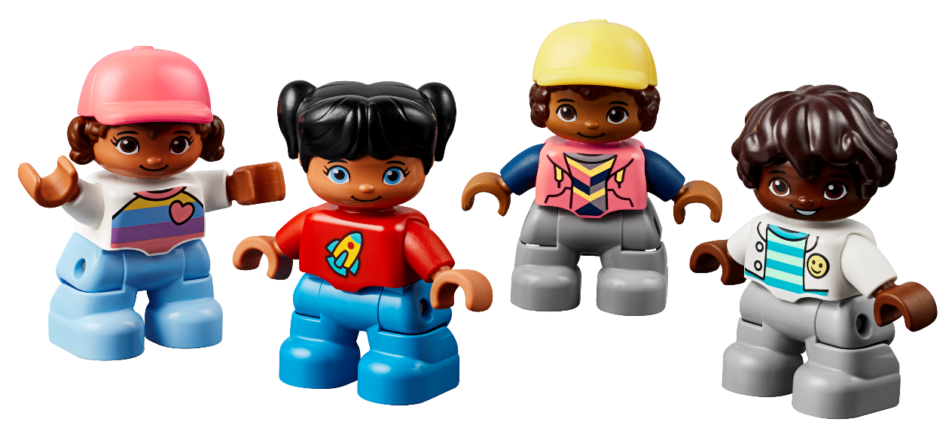
Create Task
You Need..
Build a stage and create a play.
Notes:
Create Task (25 minutes)
Have each team build a stage using the Discover set. Have them create their own play. They can use the building cards and STEAM Park pieces to help get started.
The children should work together to tell a short story using their stage and extra STEAM Park pieces. Ask the children to think about the kinds of technology that might be needed to help make something special happen on stage. They can change the background or props to create a new scene.
Playful Learning in Action – The children will listen and begin to empathize about each other’s ideas. The team will listen to everyone’s ideas, demonstrating inclusion.
Key Vocabulary – theater, special effects, props
Facilitator Tip
Allow the children to be creative and use any elements that will help share an interesting story.
Each team can perform their story and talk about what they added to their stage.

Slide 7

Playful Learning in Action
The children will listen and begin to empathize about each other’s ideas. The team will listen to everyone’s ideas, demonstrating inclusion.
Key Vocabulary
theater, special effects, props
Notes:
Create Task (25 minutes)
Have each team build a stage using the Discover set. Have them create their own play. They can use the building cards and STEAM Park pieces to help get started.
The children should work together to tell a short story using their stage and extra STEAM Park pieces. Ask the children to think about the kinds of technology that might be needed to help make something special happen on stage. They can change the background or props to create a new scene.
Playful Learning in Action – The children will listen and begin to empathize about each other’s ideas. The team will listen to everyone’s ideas, demonstrating inclusion.
Key Vocabulary – theater, special effects, props
Facilitator Tip
Allow the children to be creative and use any elements that will help share an interesting story.
Each team can perform their story and talk about what they added to their stage.

Slide 8

Share Task
Notes:
Share Task – (15 minutes)
In their Engineering Notebooks, have the children write or draw a picture of different technology or moving pieces that their stage uses.

Slide 9
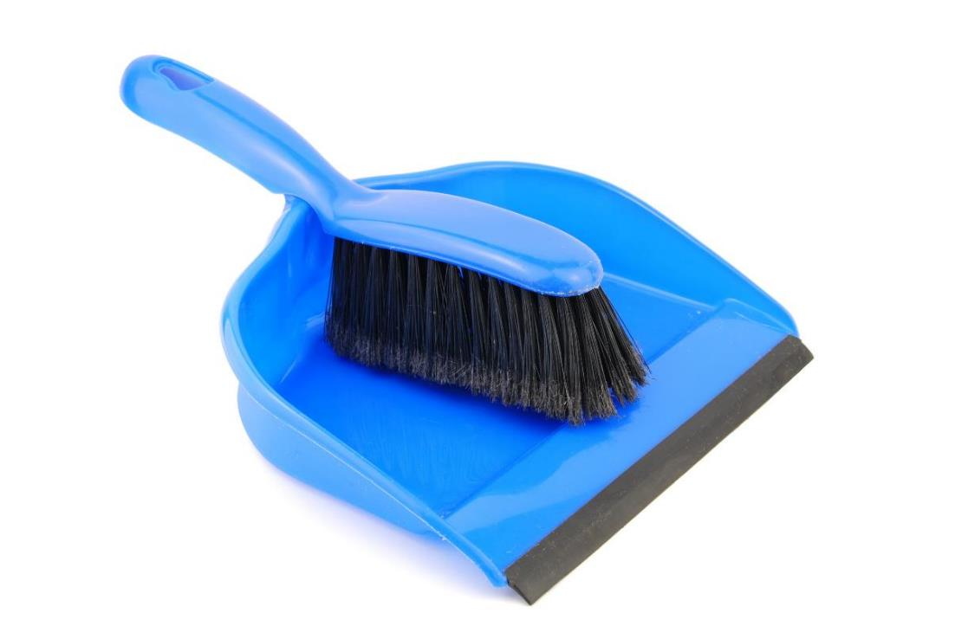
Clean Up
Notes:
You may wish to play a video or song during clean up time.
Link on GoNoodle: https://family.gonoodle.com/activities/clean-up
Link on YouTube Kids: https://www.youtubekids.com/watch?v=ZJFk87ZsHn0
Link on YouTube: https://youtu.be/ZJFk87ZsHn0

Slide 10


LEGO, the LEGO logo, DUPLO and the DUPLO logo are trademarks of the LEGO Group. ©2023 The LEGO Group. All rights reserved. FIRST®, the FIRST ® logo, and FIRST® in SHOWSM are trademarks of For Inspiration and Recognition of Science and Technology (FIRST). LEGO® is a registered trademark of the LEGO Group. FIRST ® LEGO® League and MASTERPIECESM are jointly held trademarks of FIRST and the LEGO Group. ©2023 FIRST and the LEGO Group. All rights reserved.

