Slide 1
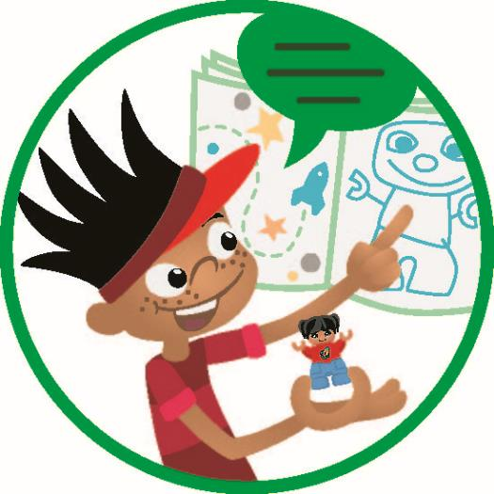
Session 9
Dress Rehearsal
Notes:
Session 9: Dress Rehearsal
It is time to reinforce the use of teamwork skills such as sharing, discussing, and compromising. Observe how the teams talk to each other and evaluate how this has changed over the course of the program.

Slide 2
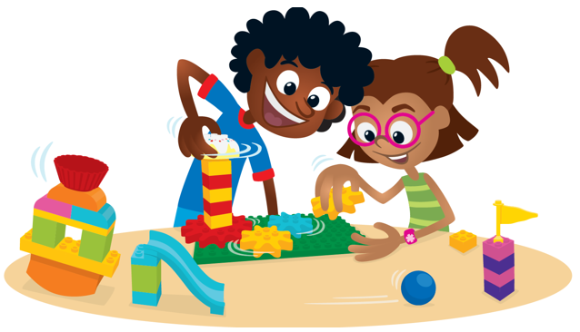
Big Question
How do we create a space to share our interests in our community?
Outcomes
Teams will reflect on their experiences throughout the sessions.
Teams will build their improved solution to their space where hobbies or interests are shared.
Notes:
Outcomes
Teams will reflect on their experiences throughout the sessions.
Teams will build their improved solution to their space where hobbies or interests are shared.
Facilitator Tip
Encourage children to think about and choose the best idea they had in the previous sessions.
It is important for teams to work together to combine their ideas into a cohesive solution.

Slide 3
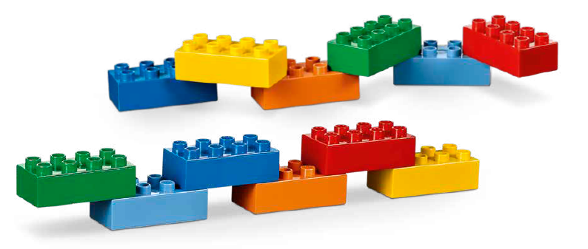
Warm-Up – Six Bricks
Notes:
Warm-Up: (10 minutes) It Takes a Team
Base Activity
1. In groups of 4, have the children mix their bricks together.
2. The children should work together to build a long line of connected blocks to represent a person that is part of a team and how they support each other to achieve success.
3. The children should think about what happens if a brick is missing from the line.
Guiding Questions:
• What job does each brick represent?
• How do the different jobs work together?
• What would happen if there was a break in the line?

Slide 4
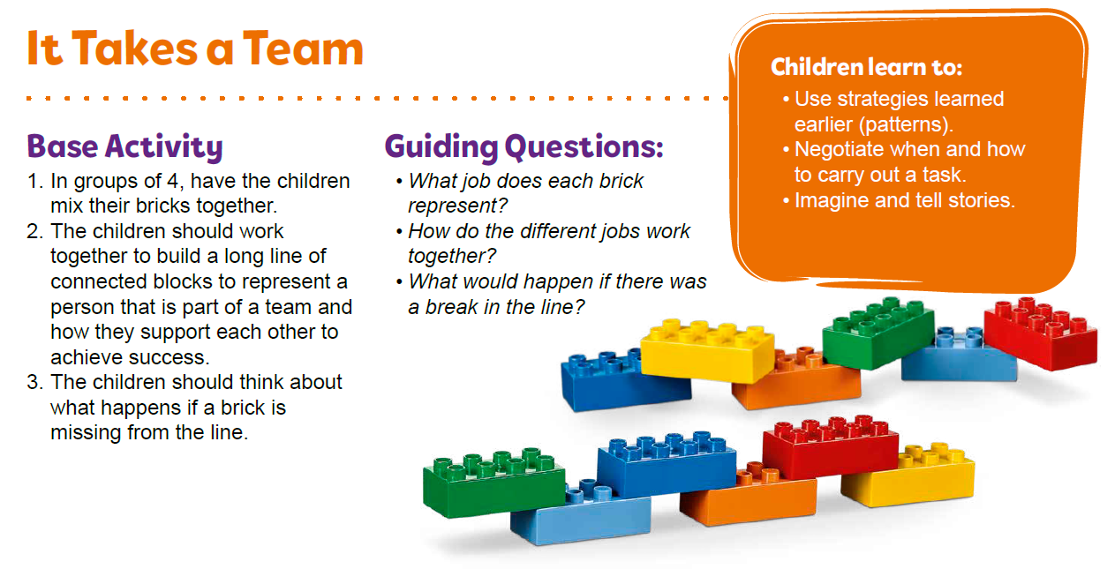
Warm-Up – Six Bricks
Notes:
Facilitator Tip – TMG Appendix (see page 29)

Slide 5
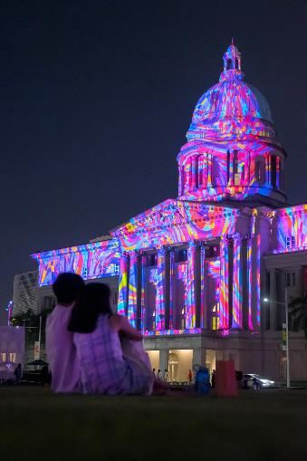
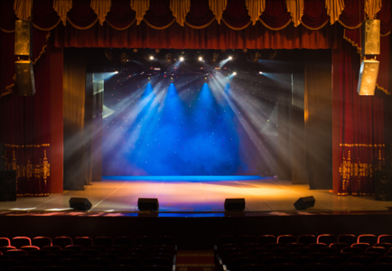
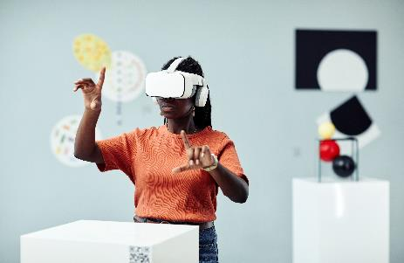
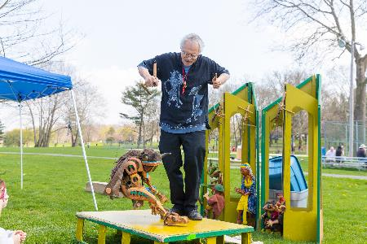
Explore Task
What things would people in the community like to share?
Notes:
Explore Task (1O minutes)
Ask the children to reflect on their experiences throughout the sessions.
Discuss the different needs of your community. What things would people in the community like to share?
Remind the children of the different people in their community they have been building for.
You could ask the children to:
• Think about different kinds of music styles and dances.
• How can they improve a theater in their community?
• Reflect on their solutions from previous sessions.
• How could they iterate and improve on their previous ideas?
Facilitator Tip
Encourage children to think about and choose the best idea they had in the previous sessions.

Slide 6
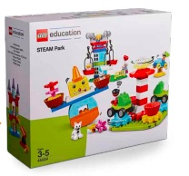
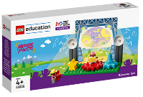
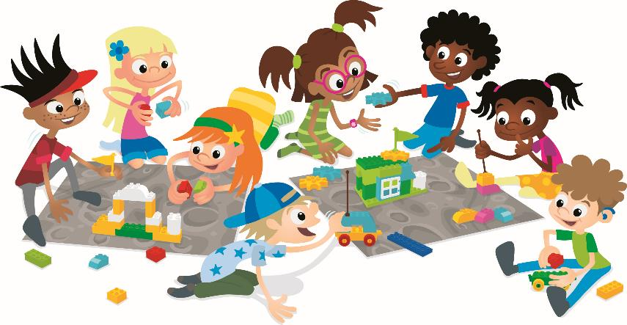
Create Task
You Need..
Build a place as a team where everyone can share
what they love doing with an audience.
Notes:
Create Task (25 minutes)
Tell the teams to put everything they have learned about together and build a place as a team where everyone can share what they love doing with an audience. They should think about the audience that will be in the place, the people that work there, and what creative ways they will use to entertain everyone.
The teams can use pieces from the Discover set and STEAM Park. Have them decide where their model should go on the mat. They should discuss who will say what about their solution in the Explore Task.
Playful Learning in Action – The teams will persist to create a team build and use teamwork to join their builds together.
Key Vocabulary – improve, reflect, iterate
Facilitator Tip
It is important for teams to work together to combine their ideas into a cohesive solution.

Slide 7
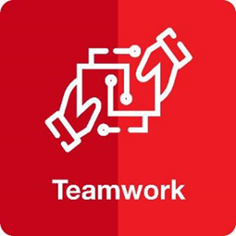
Playful Learning in Action
The teams will persist to create a team build and use teamwork to join their builds together.
Key Vocabulary
improve, reflect, iterate
Notes:
Create Task (25 minutes)
Tell the teams to put everything they have learned about together and build a place as a team where everyone can share what they love doing with an audience. They should think about the audience that will be in the place, the people that work there, and what creative ways they will use to entertain everyone.
The teams can use pieces from the Discover set and STEAM Park. Have them decide where their model should go on the mat. They should discuss who will say what about their solution in the Explore Task.
Playful Learning in Action – The teams will persist to create a team build and use teamwork to join their builds together.
Key Vocabulary – improve, reflect, iterate
Facilitator Tip
It is important for teams to work together to combine their ideas into a cohesive solution.

Slide 8
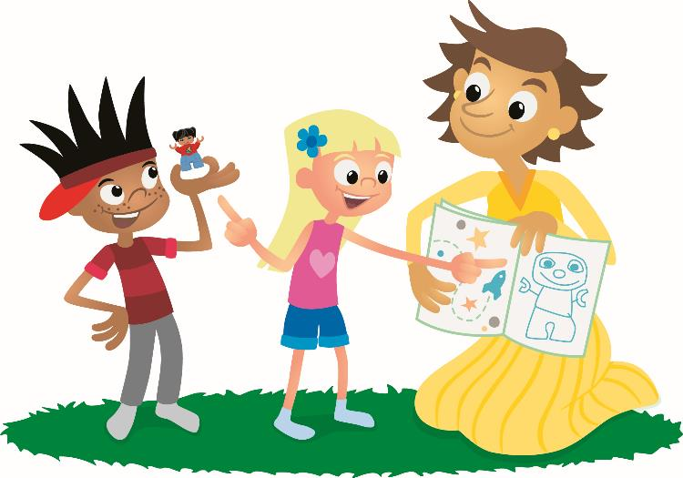
Share Task
What will the audience experience in your model?
Notes:
Share Task – (15 minutes)
Have the children share what they have built with the whole class. Have them explain their place and what the audience will experience. Have teams reflect on which ideas they chose, why, and how they worked together in this session.

Slide 9
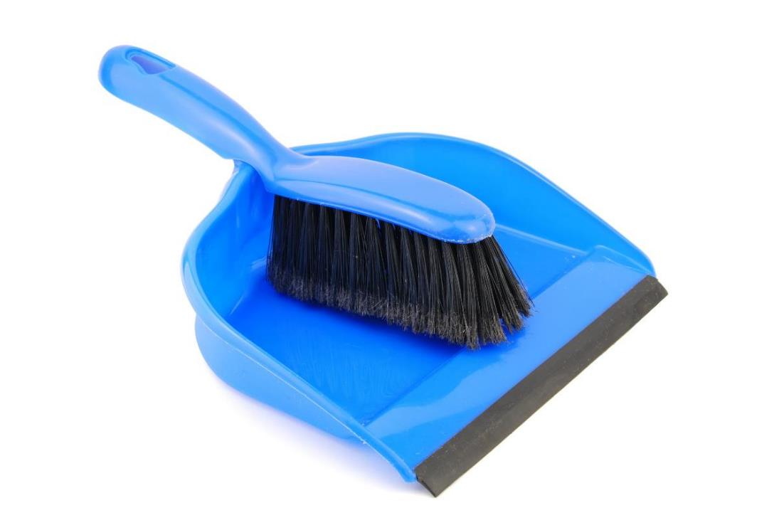
Clean Up
Notes:
You may wish to play a video or song during clean up time.
Link on GoNoodle: https://family.gonoodle.com/activities/clean-up
Link on YouTube Kids: https://www.youtubekids.com/watch?v=ZJFk87ZsHn0
Link on YouTube: https://youtu.be/ZJFk87ZsHn0

Slide 10


LEGO, the LEGO logo, DUPLO and the DUPLO logo are trademarks of the LEGO Group. ©2023 The LEGO Group. All rights reserved. FIRST®, the FIRST ® logo, and FIRST® in SHOWSM are trademarks of For Inspiration and Recognition of Science and Technology (FIRST). LEGO® is a registered trademark of the LEGO Group. FIRST ® LEGO® League and MASTERPIECESM are jointly held trademarks of FIRST and the LEGO Group. ©2023 FIRST and the LEGO Group. All rights reserved.

