Slide 1
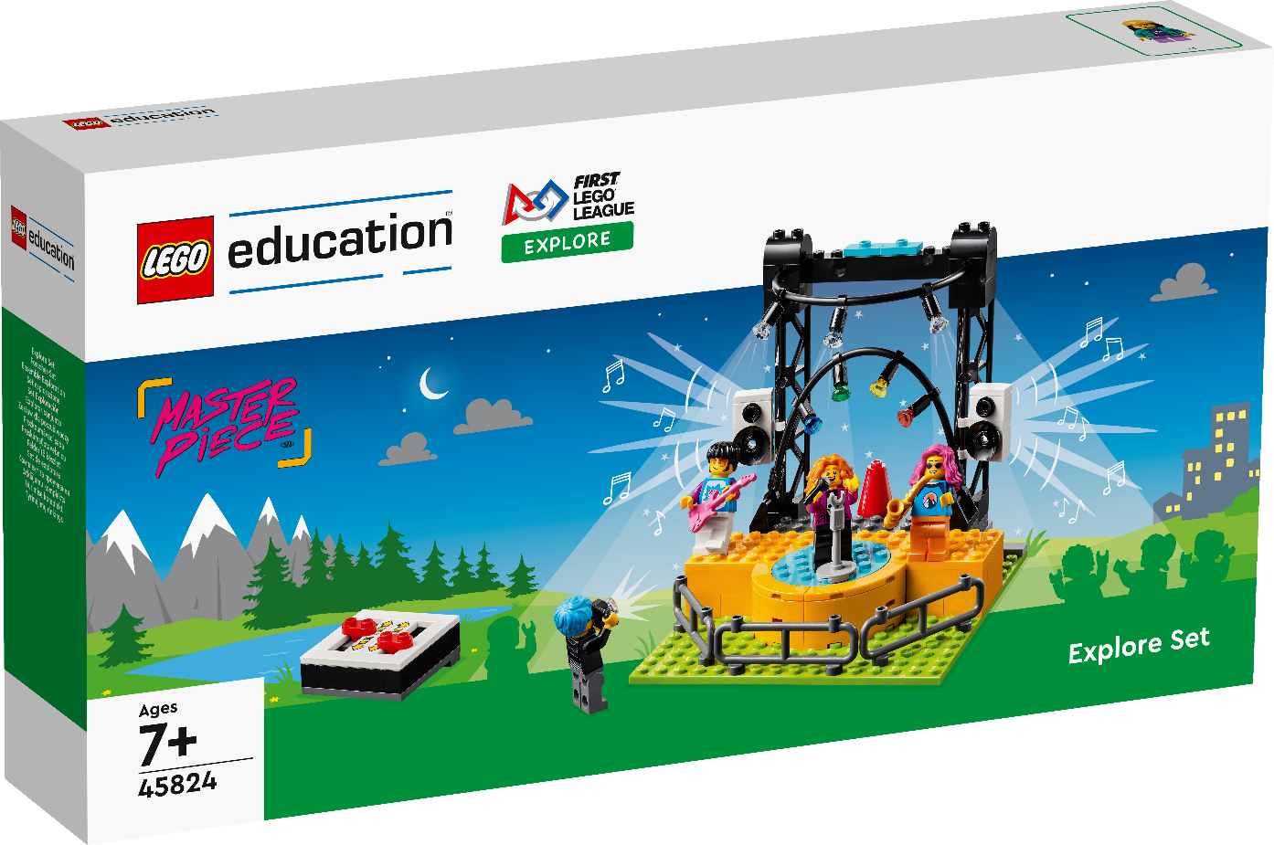

INTRODUCTION
Let’s Get Started

Slide 2

What is FIRST® LEGO League Explore?
Notes:
What is Explore video
YouTube link: https://youtu.be/afYrsiQ48wA

Slide 3
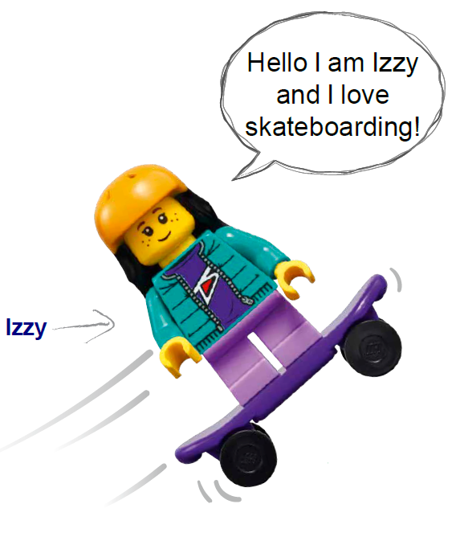
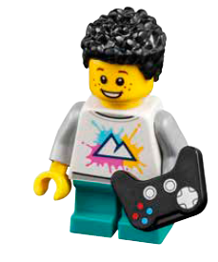
Welcome to MASTERPIECESM!
We will learn about how people’s passion for the arts are shared through STEM.
Notes:
Welcome to MASTERPIECESM
Welcome to the FIRST® IN SHOWSM season presented by Qualcomm. This year’s FIRST LEGO League challenge is called MASTERPIECESM. Children will learn about how people’s passion for the arts are shared through STEM (Science, Technology, Engineering, and Math). During each session, they will experience the engineering design process. There is no set order for this process, and they may go through each part several times in a single session. This means that during a session, children will be exploring the theme and ideas, creating solutions, testing them, iterating and changing them, and then sharing what they’ve learned with others.

Slide 4
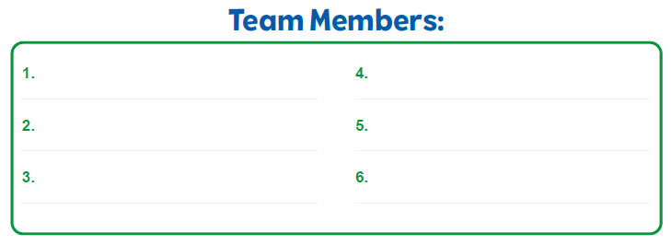
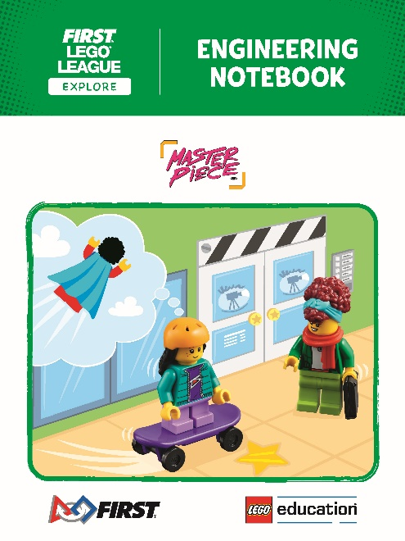
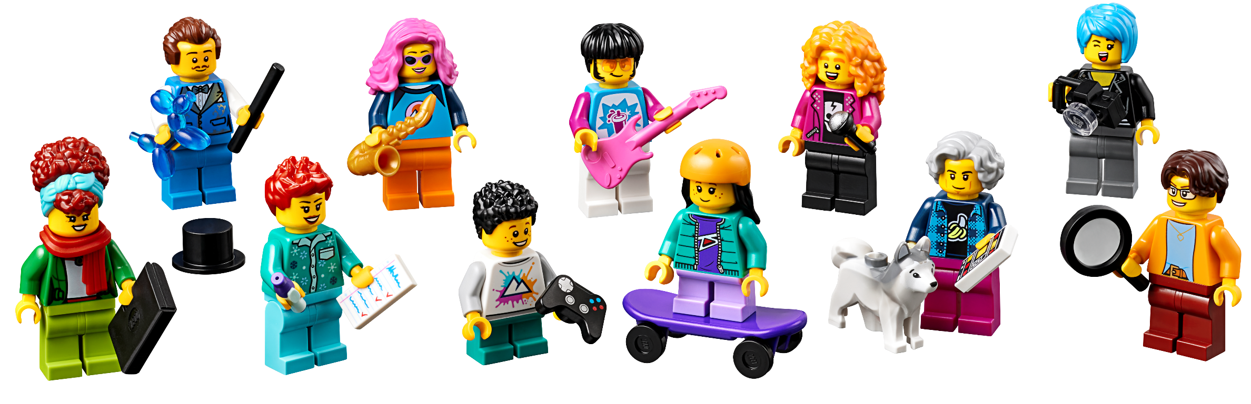
Form Your Team
Write your Team Members’ Names in your Engineering Notebook.
Notes:
Working in Teams
Together with your teammates, you will:
Discover real-world challenges and opportunities in this season’s theme.
Create a team model and program it to make part of it move.
Test and improve your code and build changes.
Track your work in the Engineering Notebook.
Make a team poster that reflects your team’s journey.
Share your model and poster with reviewers at an Explore festival.
Celebrate your accomplishments with family and other teams at the festival.

Slide 5
Together with your teammates, you will:
Discover real-world challenges and opportunities in this season’s theme.
Create a team model and program it to make part of it move.
Test and improve your code and build changes.
Track your work in the Engineering Notebook.
Make a team poster that reflects your team’s journey.
Share your model and poster with reviewers at an Explore festival.
Celebrate your accomplishments with family and other teams at the festival.
Notes:
Working in Teams
Together with your teammates, you will:
Discover real-world challenges and opportunities in this season’s theme.
Create a team model and program it to make part of it move.
Test and improve your code and build changes.
Track your work in the Engineering Notebook.
Make a team poster that reflects your team’s journey.
Share your model and poster with reviewers at an Explore festival.
Celebrate your accomplishments with family and other teams at the festival.

Slide 6




Slide 7
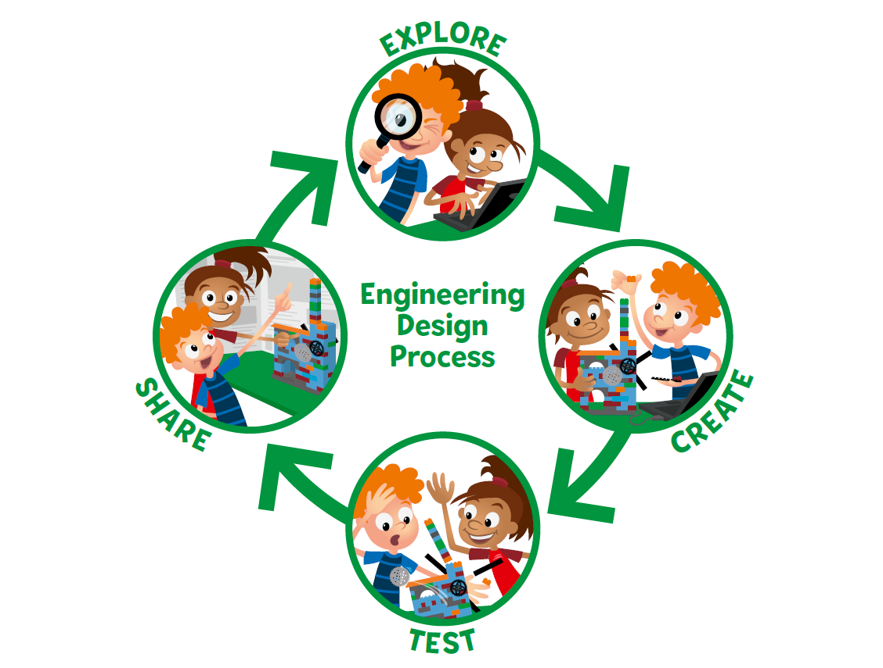

Notes:
During each session, they will experience the engineering design process. There is no set order for this process, and they may go through each part several times in a single session. This means that during a session, children will be exploring the theme and ideas, creating solutions, testing them, iterating and changing them, and then sharing what they’ve learned with others.

Slide 8
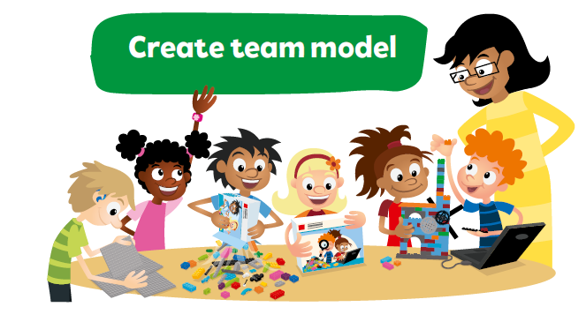

Slide 9

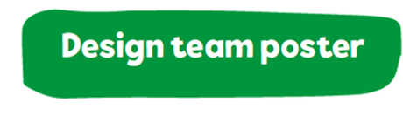



Slide 10
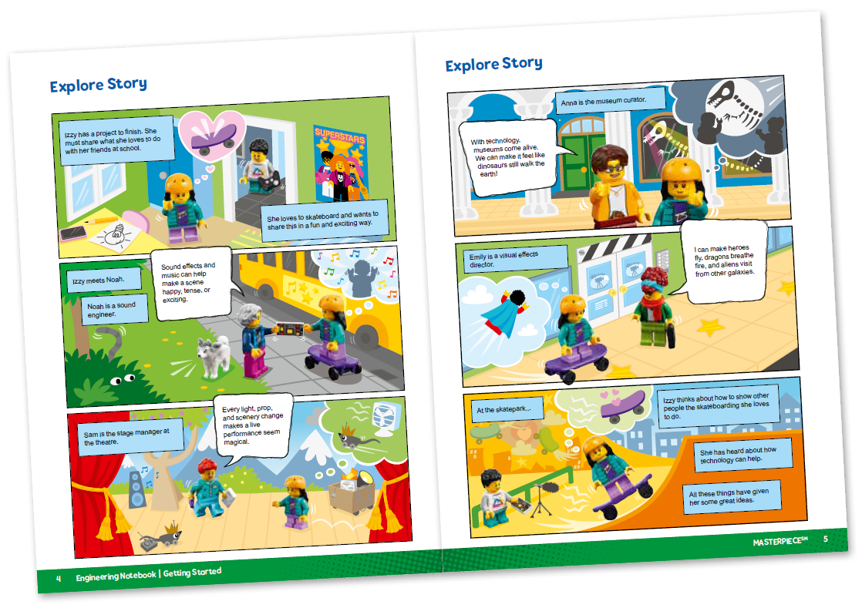
Explore Story

Slide 11

MASTERPIECESM
Visit the
FIRST® LEGO ® League
YouTube Channel
to watch the
MASTERPIECESM Season Launch Video

Slide 12

Core Values
Notes:
Draw or write an example of your team demonstrating each Core Value when directed in the sessions!
Use the Core Values to guide your team through your journey.
Have lots of FUN as you develop new skills and work together.

Slide 13
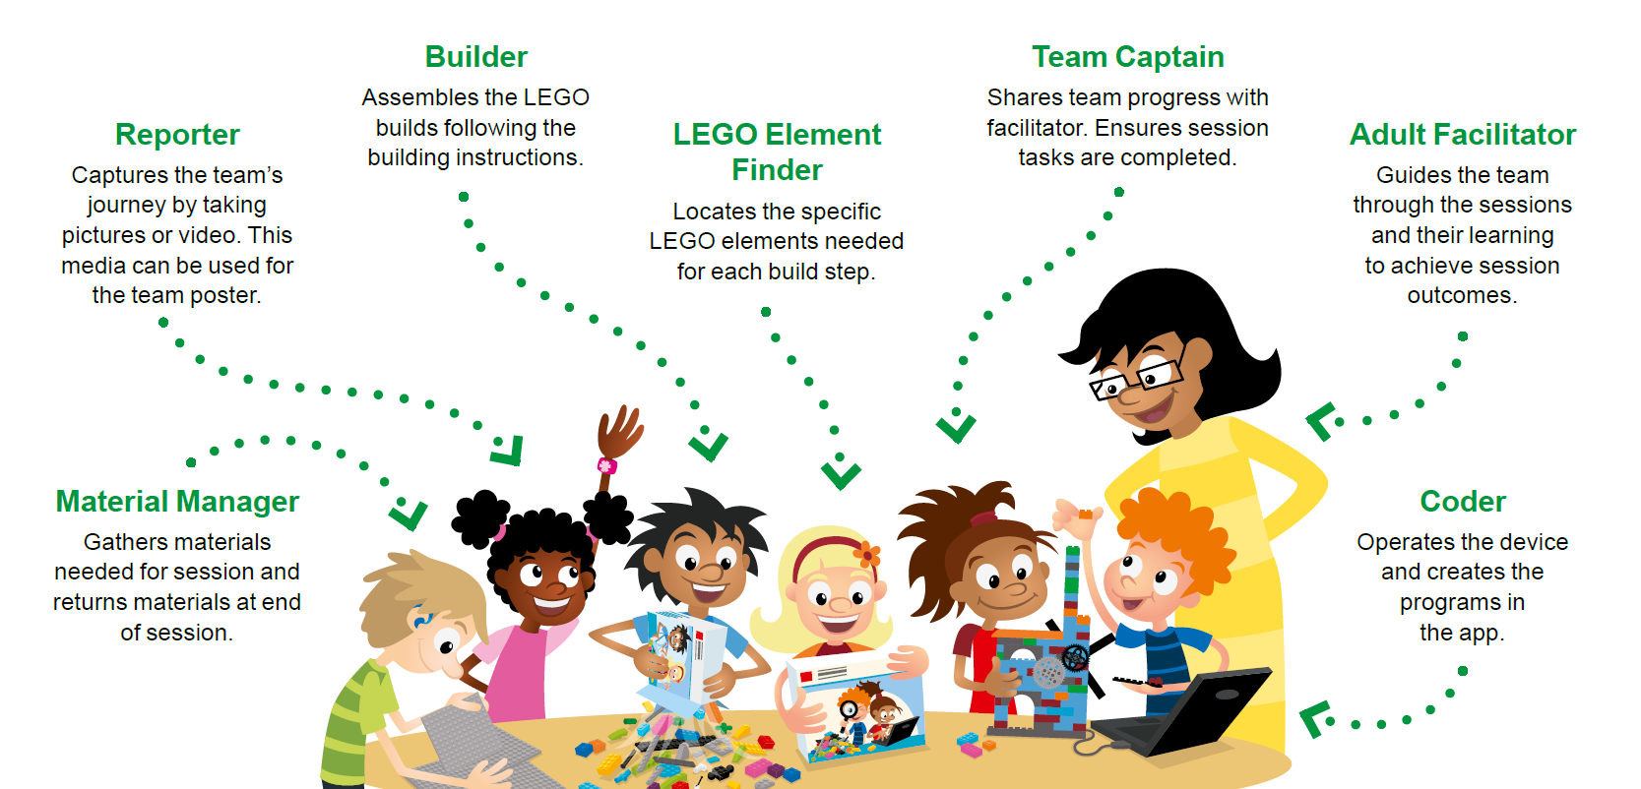
Team Roles
Notes:
Here are sample team roles to use during the sessions. Everyone on the team could experience each role multiple times throughout their FIRST® LEGO® League Explore experience. Using roles helps the team function more efficiently and ensures that everyone on the team is engaged. Some roles will be filled by multiple children during a session. For example, the builder and coder roles can be duplicated where the experience is designed for a pair of children.

Slide 14
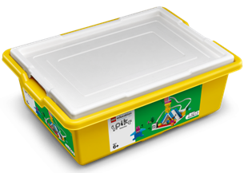

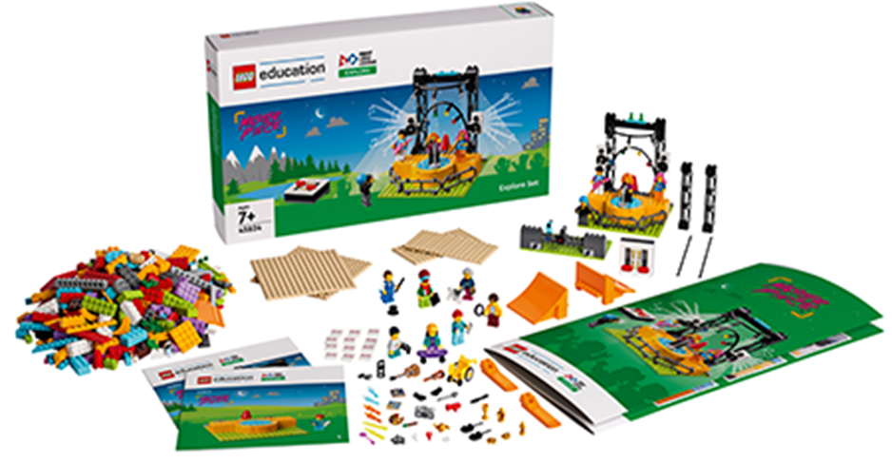
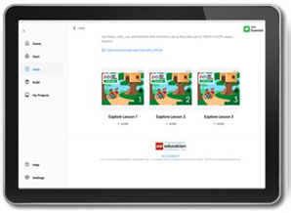

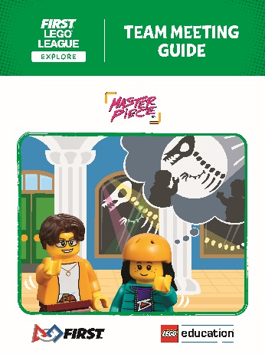



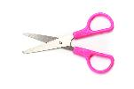
You Need
Each session lists the materials needed.
MASTERPIECESM Explore Set
Notes:
You might provide any instructions your students need about managing materials during the Explore sessions.
Material Management
Place any extra or found LEGO® pieces in a cup.
Have the children who are missing pieces come to the cup to look for them.
Wait to dismiss your team until you look over their LEGO® set.
The lid of the LEGO® set can be used as a tray to keep pieces from rolling away.
Use plastic bags or containers to store any unfinished builds and their associated pieces or assembled models.
Designate a storage space for the built models, Explore set, and LEGO® container.
The role of the Material Manager is to help in the process of clearing away and storing materials.

Slide 15

Clean Up
Notes:
Clean Up Pointers
You may wish to play a video or song during clean up time Link on
GoNoodle: https://family.gonoodle.com/activities/clean-up
Link on YouTube Kids: https://www.youtubekids.com/watch?v=ZJFk87ZsHn0
Link on Youtube: https://youtu.be/ZJFk87ZsHn0

Slide 16

LEGO, the LEGO logo and the SPIKE logo are trademarks of the/sont des marques de commerce du/son marcas registradas de LEGO Group. ©2023 The LEGO Group. All rights reserved/Tous droits réservés/Todos los derechos reservados. FIRST®, the FIRST® logo, and FIRST® in SHOWSM are registered trademarks of For Inspiration and Recognition of Science and Technology (FIRST). LEGO® is a registered trademark of the LEGO Group. FIRST® LEGO® League and MASTERPIECESM are jointly held trademarks of FIRST and the LEGO Group. ©2023 FIRST and the LEGO Group. All rights reserved.

